Slide 1
IRIS Enhanced MeliCERTes Ecosystem (EME) for secure and trusted online communication, collaboration and information sharing
Dr. Sofia Tsekeridou
Research and Innovation Development Dept.
Netcompany – Intrasoft
E-mail: sofia.tsekeridou@netcompany-intrasoft.com
IRIS Launch Event, Online, 05/07/2022

Slide 2
Vision and Objectives (1/2)
To extend the MeliCERTes II open source platform to enable:
Secure and efficient security / CTI information representation in standardized formats by capitalizing and extending ontologies such as STIX 2.1 (and mapping to MISP standards)
Secure disclosable AI and IoT relevant CTI information sharing
Promote wider awareness, better preparation, detection and response capabilities across all involved stakeholders
Define sharing policies and communities of trust, customizable data and information sharing governance models
Online communities' interaction in a trusted & Secure manner
Capitalizing on an extended base of stakeholders: not only CERT/CSIRT authorities across Europe but also Security Operators of Critical Infrastructures / Operators of Essential Services, even ISACs
Securely communicate and collaborate with CERT/CSIRT authorities and CI operators / Security operators

Slide 3
Vision and Objectives (2/2)
Secure storage and augmentation of the AI and IoT focused cybersecurity knowledge base at a European level
Provision of advanced and unified dashboard for incident reporting, situational awareness, information sharing, online communities support
Customized views and incident reporting/online communities’ capabilities per type of user/role
Access control and access rights to shared data based on
the type of user/operator
the type of service/infrastructure they provide
Advanced and fused interactive information visualization for better situational awareness and decision support
Distributed architecture – ecosystem
Instances deployed at stakeholders’ premises
Offering PKI, OAUTH and SAML AAA services integrated within the DPA module.

Slide 4
Conceptual Architecture – single instance
IRIS Enhanced MeliCERTes
Collaborative Threat Intelligence (CTI)
Data Protection and Accountability (DPA)
CTI Data
Threats, Events, Attacks, Vulnerabilities, Mitigation actions…
Standardized CTI representation
Disclosable AI data
Pan-European AI/IoT CTI and Stakeholders Knowledge base
Role-based Access Control
Unified EME Dashboard
Query
Data protection logs
$$⋯$$
$$⋯$$
Access control & rights services (AAA, OAUTH)
AI services & infrastructure
Operators
CERT / CSIRT
Sharing Policies
AI services & infrastructure
Operators
CERT / CSIRT
Communities of Trust via TC
AI services & IoT infrastructure
Operator
CERT / CSIRT
Customized information provisioning
Secure & Trusted communications

Slide 5
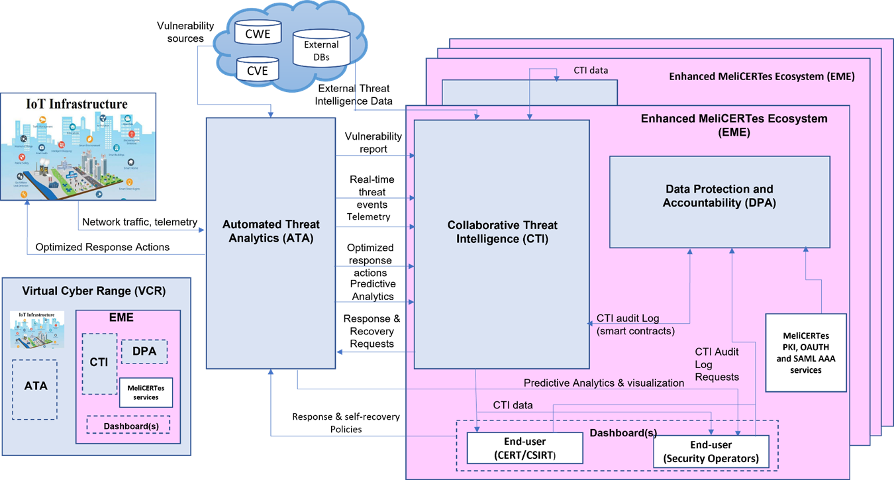
Conceptual Architecture – multiple instances - ecosystem

Slide 6
We are not re-inventing the wheel...
MeliCERTes CSP I & II – EU ISACS
MeliCERTes CSP I tender project - SMART 2015/1089:
Tender coordinated by Capgemini and other sub-contractors, including INTRASOFT
Enabling trusted online communication, collaboration and information sharing among CERTs and CSIRTs
https://github.com/melicertes/csp → Open source, license applies, primarily CERTs/CSIRTs certified to use/install
MeliCERTes facilitated building of a network for establishing confidence and trust among national CSIRTs and for promoting swift and effective operational cooperation.
CSIRTs participate in MeliCERTes within verified Trust Circles for sharing and collaborating on computer security incidents.
MeliCERTes CSP is an open source modular platform, supervised by ENISA, offering a complete security incident management solution.

Slide 7
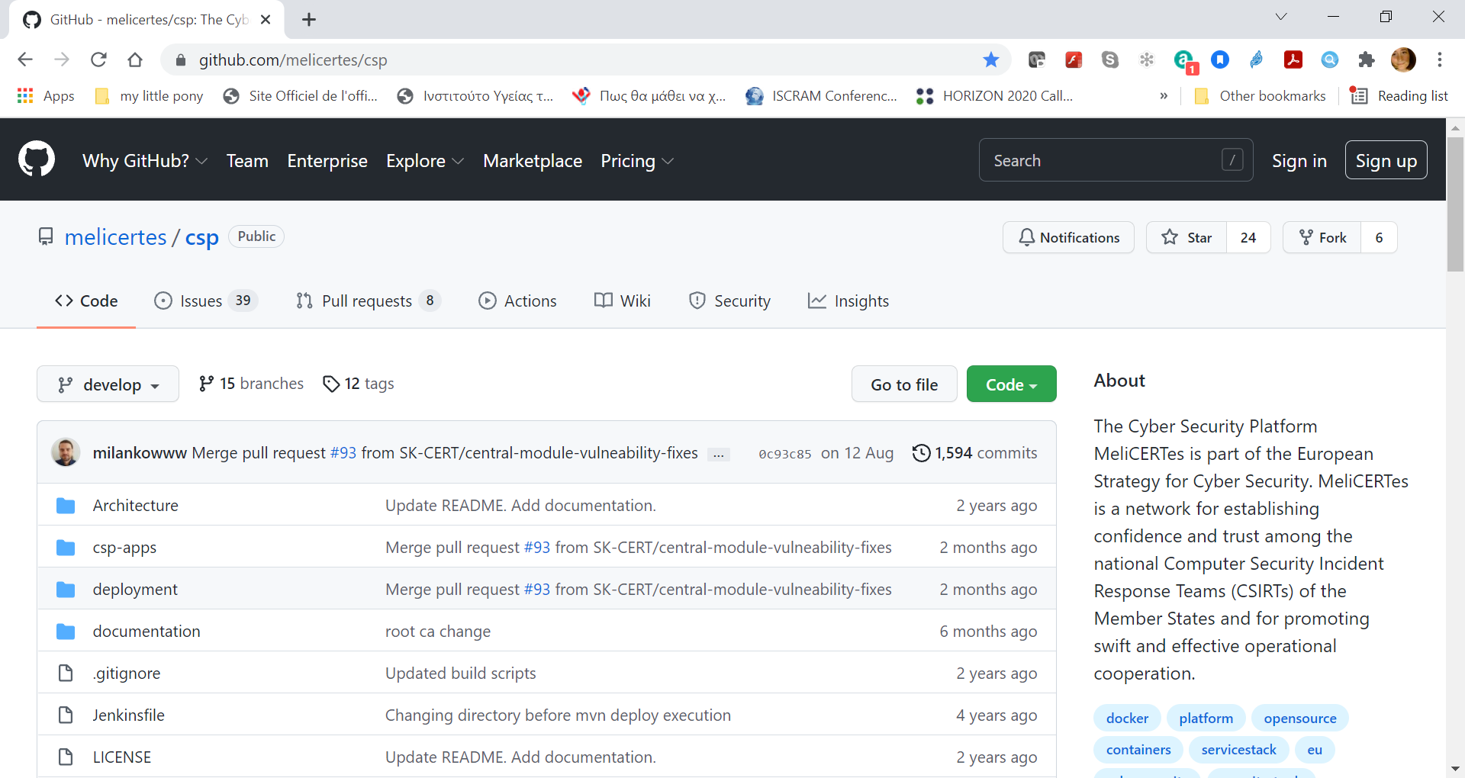
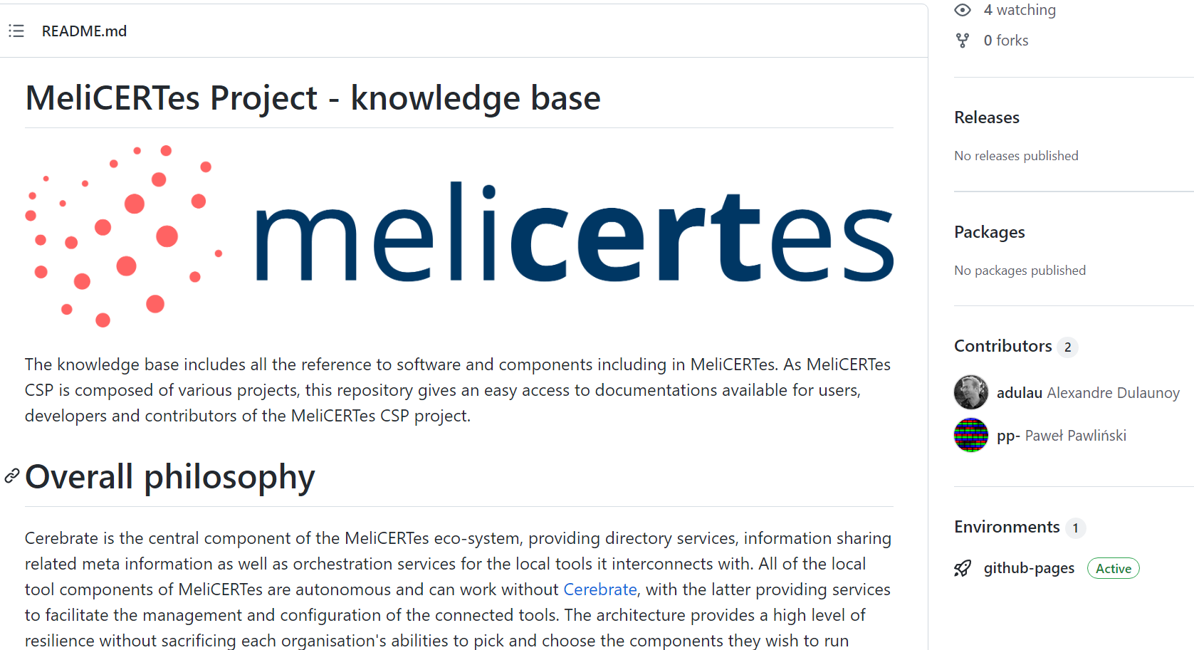
We are not re-inventing the wheel...
MeliCERTes CSP I & II
MeliCERTes CSP II tender project - SMART 2018/1024:
MeliCERTes Facility
NASK/CERT.pl) with CERT.at, CERT.EE, CIRCL, Deloitte.
Further develop and maintain MeliCERTes platform offering sustainable services and collaboration tools to EU CSIRTs
Updated technology stack
In discussion to build synergies, including MISP (CIRCL) and to fully understand the licensing and use information

Slide 8
H2020 PHOENIX I2SP
H2020 PHOENIX project (https://phoenix-h2020.eu/ )
Pan-European Incidents & CTI Information Sharing and Reporting Platform led by Netcompany - Intrasoft
Involves diverse stakeholders (EPES Critical Infrastructures, ISACs, CERTs/CSIRTs, EU Agencies, etc.) with advanced access control, roles/rights management, sharing policies
Enables situational awareness and decision support for coordinated complex and cascading attacks and their effects, in national but also cross-border contexts
Recommends mitigation actions according
Integrates MISP, distributed ledger technologies, STIX 2.1 CTI data, SIEM, etc.
In compliance with relevant regulations and directives (e.g. NIS 2)
Inspired by MeliCERTes and its Trust Circles

Slide 9
Compliance with EU Security / Cybersecurity Regulatory framework (1/2)
EU Cybersecurity strategy
Proposes building a European Cyber Shield via a network of Security Operations Centres across the EU
Directive on Security of Network and Information Systems (the NIS Directive)
Underlines joint activities and knowledge sharing – CSIRTs Network
NIS 2 Directive
Expands on new sectors based on critical role
Imposes stronger security requirements
Enhances Information sharing and cooperation through the establishment of the European Cyber Crises Liaison Organisation Network (EU - CyCLONe)

Slide 10
Compliance with EU Security / Cybersecurity Regulatory framework (2/2)
NCCS – Network Code for cybersecurity aspects of cross-border electricity flows
Cross-border electricity flow governance for cybersecurity risk management, risk assessment, evaluation, and treatment.
Essential Information Flows, Incident and Crisis Management (Art. 37-42)
Describes the Role of Public Authorities concerning information sharing (Art. 38)
Early warning system for threat information gathering, processing, notification, providing right information to right people at right time (Art. 42)
Liaison with CyCLONe, Joint Cyber Unit and CSIRT Network

Slide 11
Dr. Sofia Tsekeridou
E-mail: sofia.tsekeridou@netcompany-intrasoft.com
IRIS Launch Event, 05/07/2022

