Slide 1
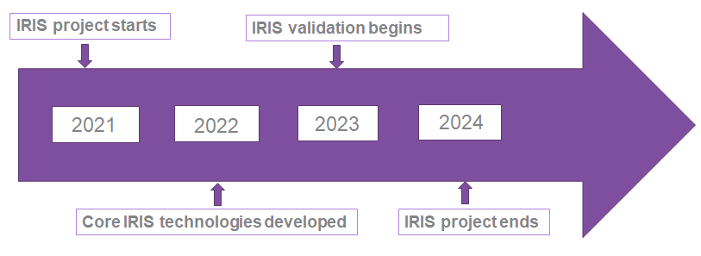
Project at a Glance
Call Identifier: 2020-SU-DS-2020
Topic: SU-DS02-2020 Intelligent security and privacy management
EC Funding: 4 918 790.00 EUR
Duration: 36 months (Sept 2021-Aug 2024)
Consortium: 19 partners
Coordinator: INOV - Instituto de Engenharia de Sistemas e Computadores, Inovacão, (INOV), Portugal
Learn More: www. iris-h2020.eu
Join us: @iris-h2020
IRIS H2020 Project
6 Public organizations
3 SMEs
4 Large ICT industries
6 Research institutions & Universities
Consortium

Slide 2
IRIS Motivation
As existing and emerging SMART CITIES continue to expand their IoT and AI-enabled systems, novel and complex threats are introduced.
Architecture and behaviour of emerging IoT and AI technologies are not currently well understood by security practitioners, such as CERTs and CSIRTs.

Slide 3
IRIS Vision
The H2020 IRIS project aims to deliver a framework that will support European CERT and CSIRT networks detecting, sharing, responding and recovering from cybersecurity threats and vulnerabilities of IoT and AI-driven ICT systems, in order to minimize the impact of cybersecurity and privacy risks.
The IRIS Platform will be made available, free of charge, to the European national CERT and CSIRTs, by the end of the project.

Slide 4
IRIS Objectives
To identify the user, technical and business requirements and design the architecture of an AI threat reporting and incident response system
To analyze the relevant ethics principles and legal framework on privacy concerns
To develop a collaborative platform for ICT stakeholders and European CERTs/CSIRTs for the successful operation of IoT and AI-enabled ICT systems
To demonstrate and validate the integrated IRIS platform across three realistic pilot demonstrators in three smart cities
To ensure wide communication and scientific dissemination of the IRIS results, efficient exploitation and contribution to relevant standardization bodies

Slide 5
IRIS Pilots in Smart Cities
Helsinki City: The use case will make use of an energy distribution system to connect Helsinki and Tallinn energy infrastructures:
Assess the ability of the IRIS platform to detect malicious information.
In addition, this use case will work towards the validation of the Virtual Cyber Range (VCR) component in efficiently educate CSIRT/CERTs on incident response.
Tallinn City: AI-enabled infrastructure of autonomous transport systems, composed of autonomous vehicle shuttles (AV shuttle) for public transportation that operate without human drivers and are monitored by a centralized remote operation centre. Within the infrastructure, an AI/ML module that consumes telemetry data is provided and considered as a critical element of the network.
Barcelona City: AI computer vision system and an IoT infrastructure deployed at a Tramway station to avoid potential accidents between bicycles and pedestrians getting off the train.
Interested in securing the city’s IoT and control systems against confidentiality and integrity breaches.

