Slide 1
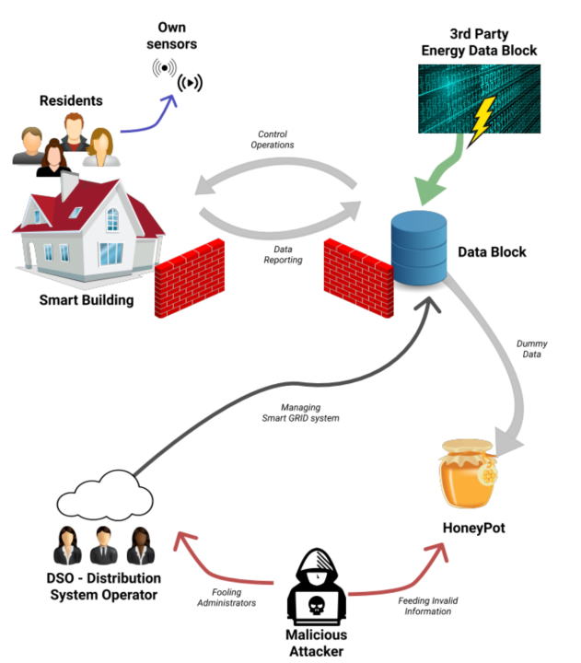
Helsinki pilot
Helsinki City: The use case will make use of an energy distribution system to connect Helsinki and Tallinn energy infrastructures
Kalasatama: Smart Buildings can participate on energy market, since they have a smart meter data interface that provides information on consumption of electricity. Additionally, they provide load control functions that the distribution system operator (DSO) can use in situations where the production has reached its peak.

Slide 2
Helsinki pilot
Goals and Challenges:
Effective incident response and threat intelligence collaboration for cross-border smart grid threats
Secure customer-facing components:
  Against threats to control functions defined for the demand control
Secure APIs:
  Smart Grid API from Kalasatama (district of Helsinki)
  Smart Grid APIs from the city of Tallinn.

Slide 3
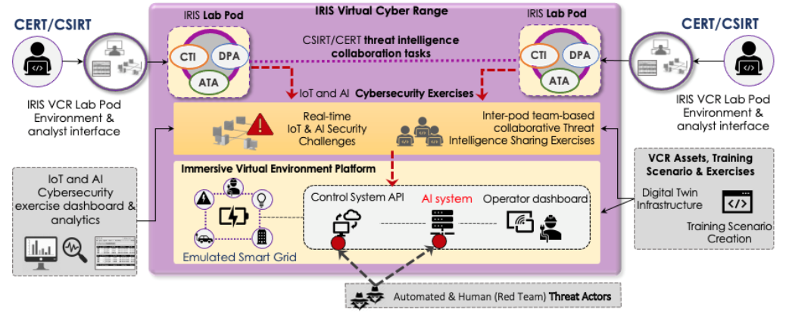
Helsinki pilot: Cyber Range
This demonstration will be emulated as a cross-border crisis management exercise on the Virtual Cyber Range (VCR), with Digital Twins of the target smart grid systems, as well as Digital Twin honeypots

Slide 4
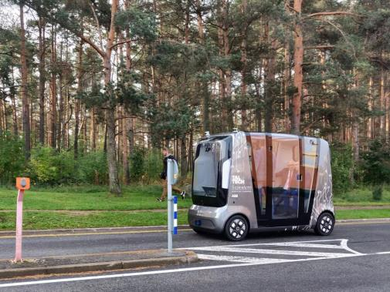
Tallinn pilot
Featuring: AI-enabled autonomous vehicle shuttles (AV shuttle) that are monitored by a centralized remote operation centre.
Goals and Challenges:
Ensuring availability of data and the operations of autonomous vehicle and supporting infrastructure.
Lack of investigation of cyber defence mechanisms that facilitate autonomous detection and risk-based response for privacy breaches.

Slide 5
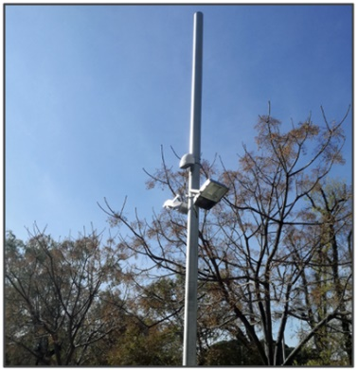
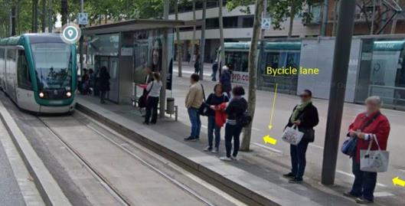
Barcelona pilot
Featuring: AI computer vision system and an IoT infrastructure deployed at a Tramway station to avoid potential accidents between bicycles and pedestrians getting off the train.
Goals and Challenges:
Ensuring availability of IoT and IA infrastructure for the safety of tram users.
Lack of experience as well as of tools, for detecting and reporting IoT & AI attack vectors.

Slide 6

Key takeaways
Smart Cities => novel, cutting edge AI/IoT-driven technology
This implies Emerging Threats ! High risks!
Currently, lack of experience as well as of tools for incident management that tackle IoT & AI attack vectors
IRIS will enhance the capabilities (knowledge, toolset, training) of CERTs/CSIRTs, to address these challenges.

Slide 7
Thank you for your attention!
Gonçalo Cadete (INOV)

Slide 8
IRIS Objectives
To identify the user, technical and business requirements and design the architecture of an AI threat reporting and incident response system
To analyze the relevant ethics principles and legal framework on privacy concerns
To develop a collaborative platform for ICT stakeholders and European CERTs/CSIRTs for the successful operation of IoT and AI-enabled ICT systems
To demonstrate and validate the integrated IRIS platform across three realistic pilot demonstrators in three smart cities
To ensure wide communication and scientific dissemination of the IRIS results, efficient exploitation and contribution to relevant standardization bodies

Slide 9
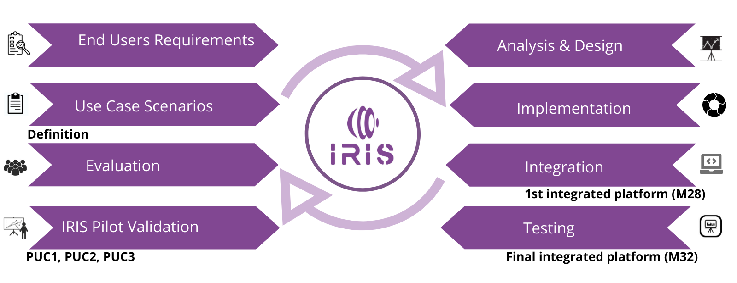
IRIS Methodology

Slide 10
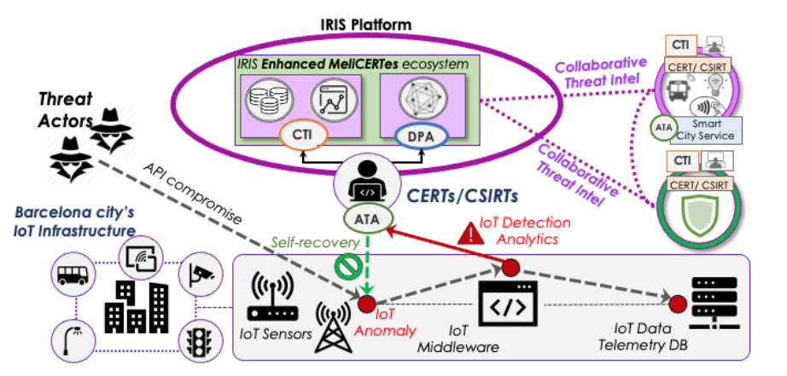
IRIS Pilots: Pilot Use Case 1
  Securing the smart city’s IoT and control systems against confidentiality and
  integrity breaches (Barcelona, Spain)

Slide 11
Barcelona pilot: threat scenarios

Slide 12
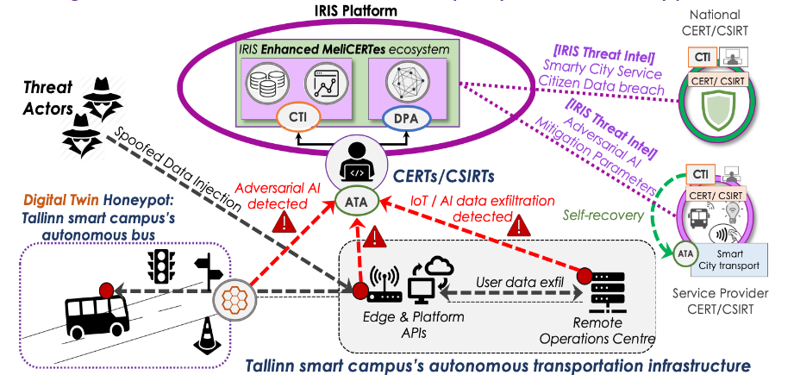
IRIS Pilots: Pilot Use Case 2
  Securing AI-enabled infrastructure of autonomous transport systems in
  a smart city (Tallinn, Estonia)

Slide 13
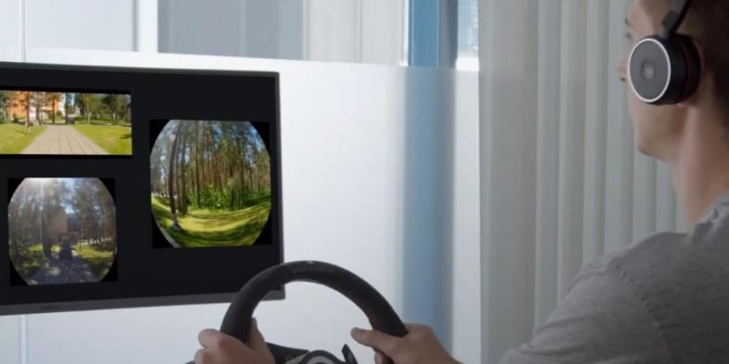
Tallinn Pilot: threat scenarios
Availability of telemetric data from the AV to the Urban Operating Platform (UoP)
False information being fed to disrupt the ML/AI used for autonomous driving

Slide 14
IRIS Pilots: Pilot Use Case 3
Effective incident response and threat intelligence collaboration for critical cross-border smart grid threats (Helsinki, Finland and Tallinn, Estonia)

