Slide 1




IRIS: a Framework for enhancing CERTs and CSIRTs Collaborative Response to Cyberattacks
René Serral (UPC)
Xavier Azemar (Cisco)
Mariano Lamarca (IMI)
Rodrigo Diaz (ATOS)
ETSI Security Conference / 3-5 October 22

Slide 2
Project at a Glance
IRIS project starts
IRIS project validation
2021
2022
2023
2024
Core IRIS technologies developed
IRIS Project ends
Notes:
Call Identifier: 2020-SU-DS-2020
Topic: SU-DS02-2020 Intelligent security and privacy management
EC Funding: 4 918 790.00
Duration: 36 months (Sept 2021-Aug 2024)
Consortium: 19 partners
Coordinator: INOV - Instituto de Engenharia de Sistemas e Computadores, Inovacão, (INOV), Portugal
Learn More: www. iris-h2020.eu
Join us: @iris-h2020
IRIS H2020 Project

Slide 3


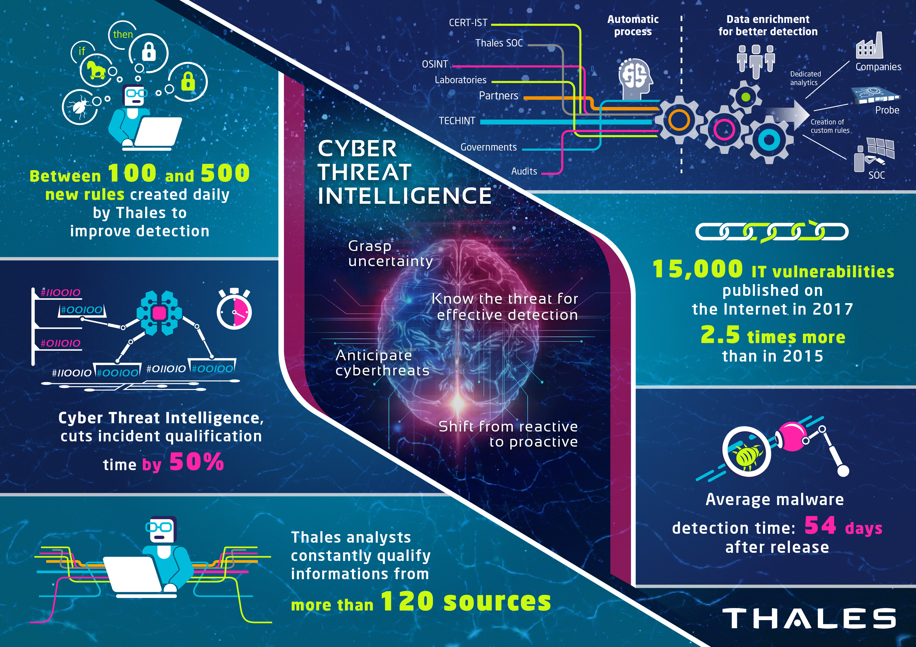
IRIS Motivation
IoT and AI-Enabled
platforms
New Cyber Threat
Intelligence challenges
Emerging Smartcities
Notes:
Motivation
As existing and emerging smart cities continue to expand their IoT and AI-enabled platforms, novel and complex dimensions to the threat intelligence landscape are introduced. These, are linked with identifying, responding and sharing data related to attack vectors, based on emerging IoT and AI technologies, whose architecture and behaviour are not currently well understood by security practitioners, such as CERTs and CSIRTs.
This lack of experience as well as of tools, for detecting and reporting IoT & AI attack vectors is further aggravated by potentially greater safety risks caused by such attacks.
Image Sources:
https://iurban.es/que-es-una-smart-city/
https://www.redseguridad.com/actualidad/enisa-muestra-las-claves-para-mejorar-la-seguridad-iot_20201112.html
https://www.thalesgroup.com/en/markets/defence-and-security/cyberdefence-solutions/cybels-protect/cyber-threat-intelligence

Slide 4


IRIS Vision
Cyber Threat analysis
  Detecting
  Sharing
  Responding
  Recovering
On an IoT and AI-driven environment
Considering privacy risks
Freely available to European CERT and CSIRTs in 2024
Notes:
The H2020 IRIS project aims to deliver a framework that will support European CERT and CSIRT networks detecting, sharing, responding and recovering from cybersecurity threats and vulnerabilities of IoT and AI-driven ICT systems, in order to minimize the impact of cybersecurity and privacy risks.
The IRIS platform will be made available, free of charge, to the European national CERT and CSIRTs, by the end of the project.
Souces:
https://ec.europa.eu/newsroom/informatics/items/632800
https://www.designcrowd.es/design/17702850

Slide 5
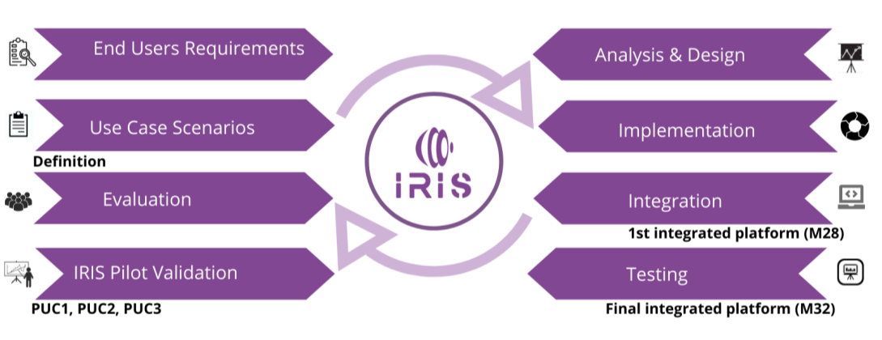
How we do it?

Slide 6

IRIS Objectives
Identify user, technical and business requirements.
Flexible yet powerful architecture to mitigate security threats while driving business with a collaborative platform
Notes:
To identify the user, technical and business requirements and design the architecture of an AI threat reporting and incident response system
To analyze the relevant ethics principles and legal framework on privacy concerns
To develop a collaborative platform for ICT stakeholders and European CERTs/CSIRTs for the successful operation of IoT and AI-enabled ICT systems
To demonstrate and validate the integrated IRIS platform across three realistic pilot demonstrators in three smart cities
To ensure wide communication and scientific dissemination of the IRIS results, efficient exploitation and contribution to relevant standardization bodies
Source
https://images.pexels.com/photos/1684149/pexels-photo-1684149.jpeg

Slide 7

IRIS Objectives
Design the architecture of an AI threat reporting and incident response system to provide an environment agnostic AI based threat detection and mitigation
Notes:
To identify the user, technical and business requirements and design the architecture of an AI threat reporting and incident response system
Source
https://images.pexels.com/photos/271667/pexels-photo-271667.jpeg?cs=srgb&dl=pexels-pixabay-271667.jpg&fm=jpg

Slide 8
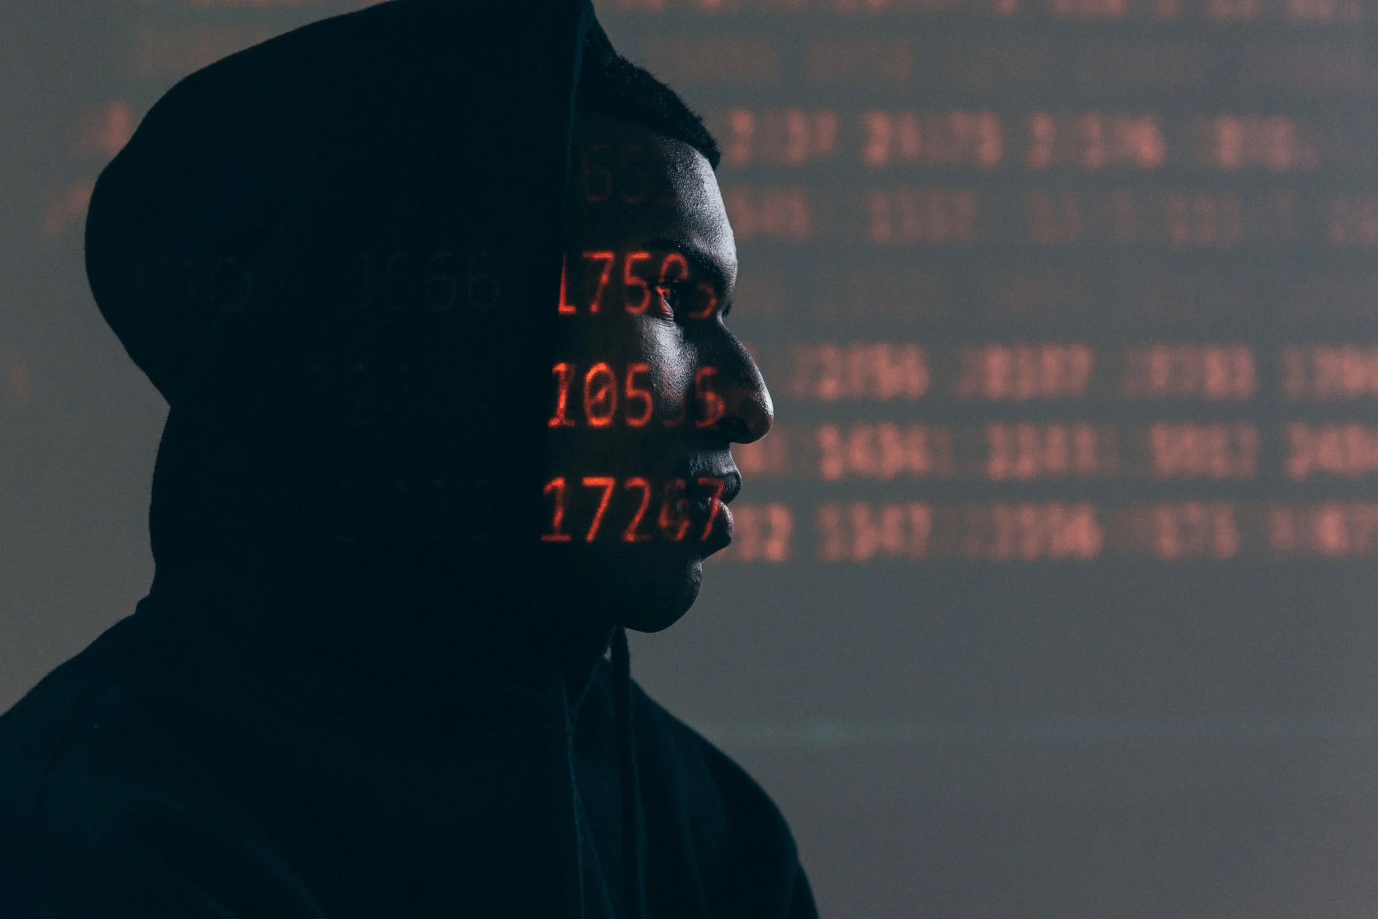
IRIS Objectives
To analyze the relevant ethics principles and legal framework on privacy concerns
Guaranteeing its proper use and privacy requirements
Notes:
To identify the user, technical and business requirements and design the architecture of an AI threat reporting and incident response system
Source
https://images.pexels.com/photos/5952651/pexels-photo-5952651.jpeg?auto=compress&cs=tinysrgb&w=1260&h=750&dpr=2

Slide 9

IRIS Objectives
To develop a collaborative platform for ICT stakeholders and European CERTs/CSIRTs for the successful operation of IoT and AI-enabled ICT systems
Notes:
To identify the user, technical and business requirements and design the architecture of an AI threat reporting and incident response system
Source
https://images.pexels.com/photos/3755440/pexels-photo-3755440.jpeg?cs=srgb&dl=pexels-andrea-piacquadio-3755440.jpg&fm=jpg

Slide 10

IRIS Objectives
To demonstrate and validate the integrated IRIS platform across three realistic pilot demonstrators in three smart cities
Notes:
To identify the user, technical and business requirements and design the architecture of an AI threat reporting and incident response system
To analyze the relevant ethics principles and legal framework on privacy concerns
To develop a collaborative platform for ICT stakeholders and European CERTs/CSIRTs for the successful operation of IoT and AI-enabled ICT systems
To demonstrate and validate the integrated IRIS platform across three realistic pilot demonstrators in three smart cities
To ensure wide communication and scientific dissemination of the IRIS results, efficient exploitation and contribution to relevant standardization bodies
Source
https://images.pexels.com/photos/5945723/pexels-photo-5945723.jpeg?auto=compress&cs=tinysrgb&w=1260&h=750&dpr=2

Slide 11

IRIS Objectives
To ensure wide communication and scientific dissemination of the results, efficient exploitation and contribution to relevant standardization bodies
Democratize access to cybersecurity and threat intelligence
Notes:
To identify the user, technical and business requirements and design the architecture of an AI threat reporting and incident response system
To analyze the relevant ethics principles and legal framework on privacy concerns
To develop a collaborative platform for ICT stakeholders and European CERTs/CSIRTs for the successful operation of IoT and AI-enabled ICT systems
To demonstrate and validate the integrated IRIS platform across three realistic pilot demonstrators in three smart cities
To ensure wide communication and scientific dissemination of the IRIS results, efficient exploitation and contribution to relevant standardization bodies
Source
https://images.pexels.com/photos/1765714/pexels-photo-1765714.jpeg?auto=compress&cs=tinysrgb&w=1260&h=750&dpr=2

Slide 12

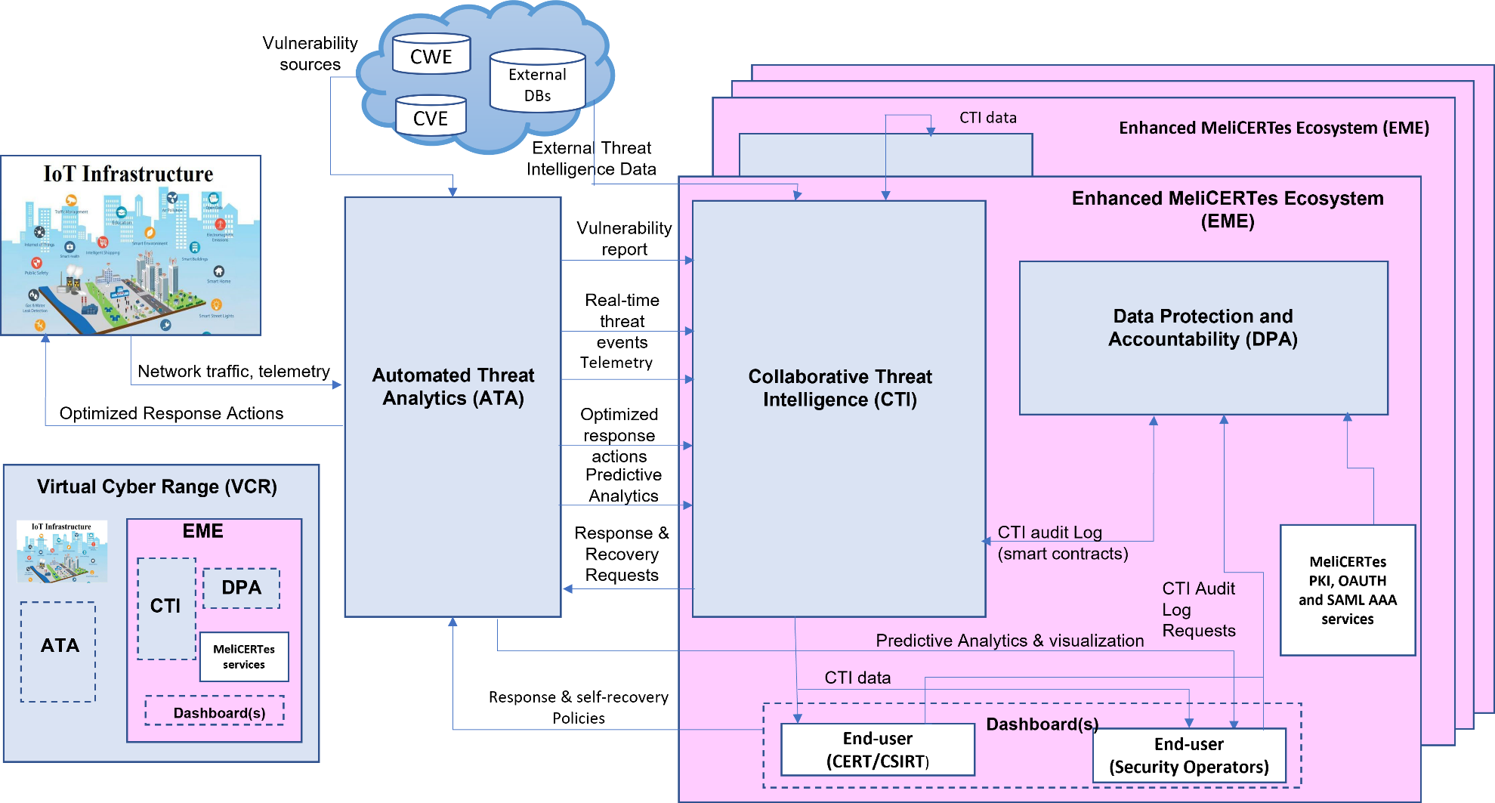

IRIS High Level Architecture
threat
analytics
use cases
ethics
intelligence
emulation
Notes:
Collaborative Threat Intelligence (CTI) that introduces Analytics Orchestration for supervising coordination between incident response and recovery;
an Open Threat Intelligence interface for disseminating taxonomies of IoT and AI threats;
intuitive Threat Intelligence Companion that serves as a key human-in-the-loop interface for collaborative incident response and threat intelligence sharing between CERTs/CSIRTs.
Automated Threat Analytics (ATA) that extends existing intrusion detection tools with a novel threat detection engine for identifying specific IoT and AI attack vectors and includes digital twin honeypots for collecting attack telemetry against end-user systems reliant on these technologies.
Virtual Cyber Range for collaborative CERT/CSIRT training exercises based on real-world environment platforms, providing representative adversarial IoT & AI threat intelligence scenarios.

Slide 13

Tallinn Pilot Use Case

Slide 14
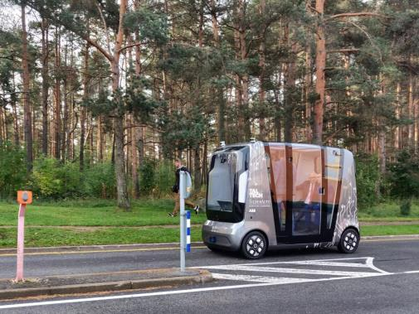
AI Enabled Infrastructure - Transportation
Autonomous Vehicle Shuttles for Public Transportation
Vehicle-to-Everything (V2X) Communication
Teleoperation/Remote Control Operations Center
Autonomous Vehicle Telemetry and Smart City Data fused into Urban Operating Platform (UoP)
Notes:
Importance
The safety and security of passenger of Autonomous Vehicles
Reputation and credibility of autonomous driving
Challenges
Ensuring availability of data and the operations of autonomous vehicle and supporting infrastructure.
Lack of investigation of cyber defence mechanisms that facilitate autonomous detection and risk-based response for privacy breaches.

Slide 15
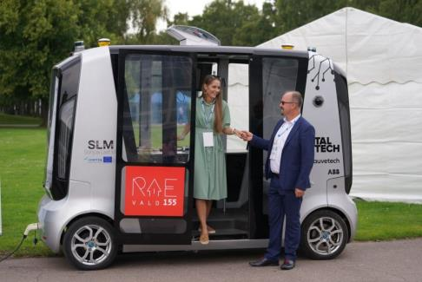
Scenario 1: Telematics and Smart City Data Exchange & Security
The Autonomous Vehicle (AV) Shuttle fleet will navigate around the smart campus environment
Urban Operating Platform (UoP) gathers AV Shuttle telemetry
UoP stores
  Location of the vehicles
  Navigation
  Odometry
  …

Slide 16
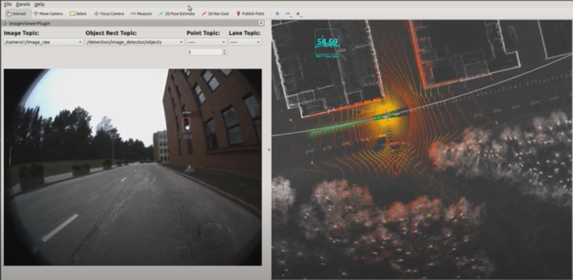
Scenario 2: Trustworthiness of Machine Vision Telemetry
The Autonomous Vehicle (AV) approaches a traffic-light controlled intersection or roadway
The machine vision of the AV focusses on the traffic light
The AV object-detection module detects the traffic light color
Depending on the traffic light the AV will pass-through or stop

Slide 17
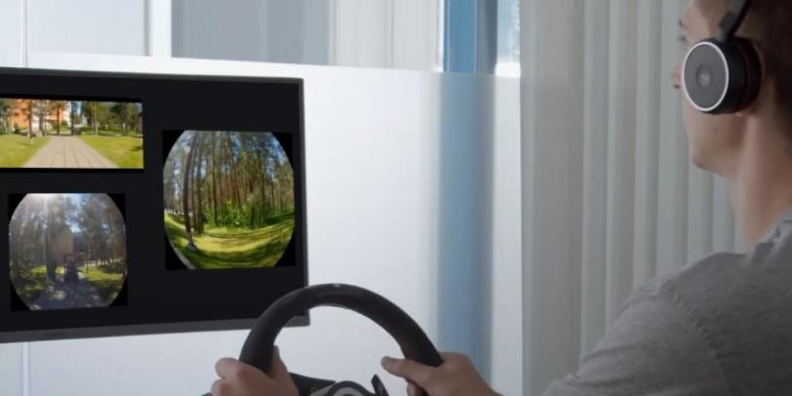
Tallinn Pilot Cyber Threat Scenarios
Availability of telemetric data from the AV to the Urban Operating Platform (UoP)
False information being fed to disrupt the ML/AI used for autonomous driving
Notes:
Identification
Self-Healing
Information Sharing
Enable Cyber Incident Response from CERTS/CSIRTS

Slide 18

Helsinki Pilot Use-Case
Notes:
Work Package 7 , PUC3 – Pilot Use-case 3: Effective incident response and threat intelligence collaboration for critical cross-border smart grid threats
In this task the use case will be focused on protecting the customer facing components of the smart grid against threats to control functions defined for the demand control. The pilot will use two smart grid APIs, the Smart Grid API from Kalasatama, and the smart grid APIs from the city of Tallinn.

Slide 19
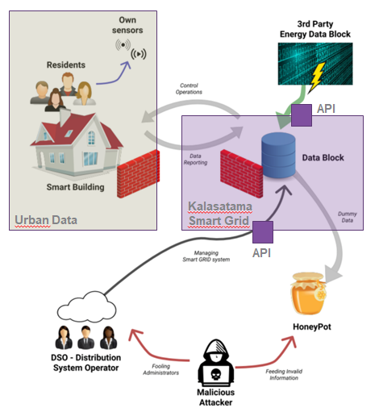
Components
Kalasatama smart grid
Kalasatama smart grid APIs
Kalasatama smart district Digital Twin
Provision of load control
Urban Data Platform (IoT)
Smart grid APIs from the city of Tallinn.
Notes:
Kalasatama smart grid - enabling real time smart metering, electric vehicles network and new storage solutions for electricity.
Kalasatama smart grid APIs (Environmental data to manage energy resources.)
Kalasatama smart district Digital Twin.
Provision of load control functions that the distribution system operator (DSO) can use in situations where the production has reached its peak.
Urban Data Platform, a smart city data platform. Modular IOT platform. Real-time data on urban environments.
Smart grid APIs from the city of Tallinn.
Use Cases:
Environmental noise monitoring
Smart home sensors using LoRaWAN networks
Solar panel monitoring
Smart street lighting
People counters
Electrical vehicle charging monitoring
Maintenance Vehicle Telemetry
Building Automation System
Dynamic Attributes in 3D City Model
Natural Language Processing in Helpdesk

Slide 20
Smart Kalasatama Data Examples
Solar Energy Potential
  Amount of solar radiation in buildings
Heating Demand Prediction
  Heating energy demand prediction until 2050
Geoenergy Potential
  150m / 300m / 1000m deep well potentials, groundwater areas, ...
Energy Data of Buildings
  Municipal register information (e.g., heating method of buildings, usage, ...)
  Repairs and alterations
  Protected buildings
  Calculated energy consumption of buildings by age group
Notes:
Effective incident response and threat intelligence collaboration for critical cross-border smart grid threats
Customer facing components securing
Against threats to control functions defined for the demand control
API securing
Smart Grid API from Kalasatama
Smart grid APIs from the city of Tallinn.

Slide 21
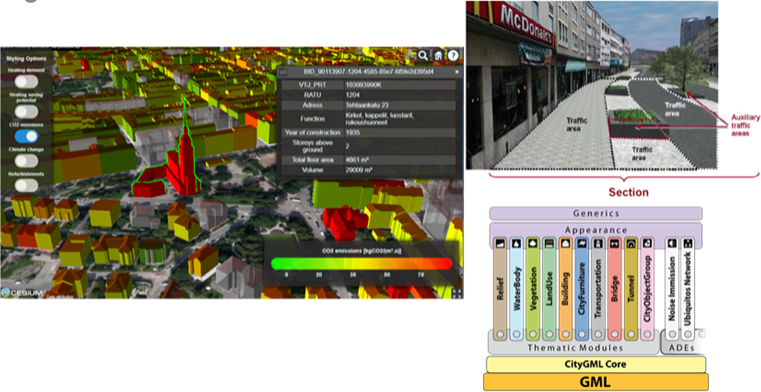
Digital Twin
Notes:
Detect the malicious information through its AI security mechanisms
Attack impact mitigation
Produce and publish systematic threat intelligence
Consumed by IRIS CTI for improving threat datasets
Offer this information to the different CERTS
Notify automatically stakeholders about ongoing attacks

Slide 22
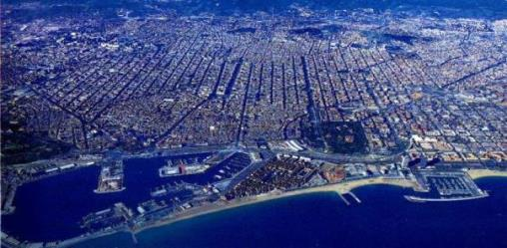



IRIS Barcelona Use Case

Slide 23
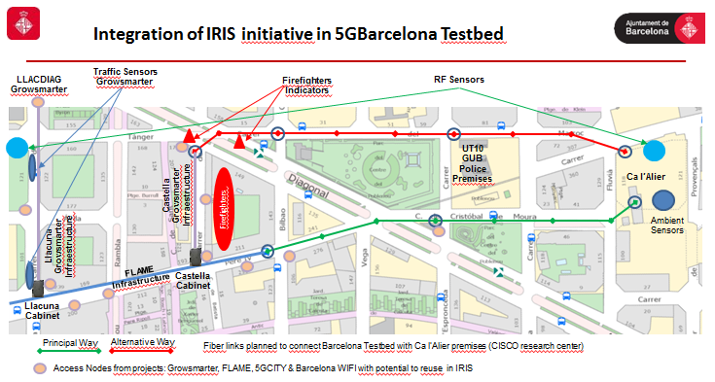


Integration of IRIS initiative in 5GBarcelona Testbed
Tram Station

Slide 24

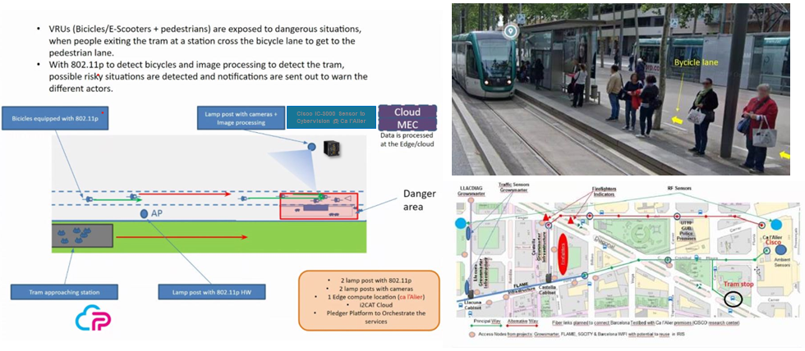
Smart Cities Service: Vulnerable Road Users (VRUs) Protection

Slide 25
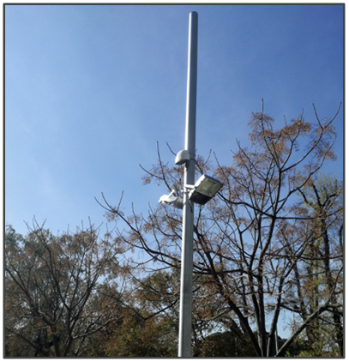
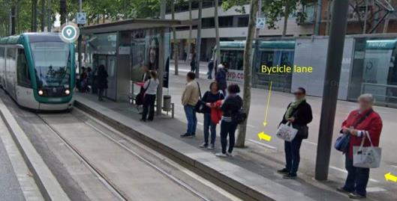
Cybersecurity Challenges
Ensuring availability of IoT and IA infrastructure for the safety of tram users.
Lack of experience as well as of tools, for detecting and reporting IoT & AI attack vectors.

Slide 26







AI & IoT Infrastructure
Leveraging Infrastructure of Horizon 2020 Project Pledger
IoT & AI attack vectors
801.11p Wireless devices
Networking equipment routers and switches
Edge computing
Cameras
AI computer vision

Slide 27
Cyber Threat Scenarios
Notes:
(I2CAT) 2 Nodos radio en las farolas + 1 de backup: Gateworks 6404; Radio acceso "normal" (ath10k); Radio para 11p
(I2CAT) 2 Odroids, modelo H2+; Intel Quad-core processor J4115; 32 GB de RAM
(BSC) 2 edge devices (nvidia) [para el edge/fanal]
(BSC) 2 Cameras BOSCH
(Noudi) 2 Switch+2 Conversors+2 Alimentació
Area Ca l’Alier (CPD nostre):
(HC) Cisco ASR 920; 6 x Transceiver SFP LX
(Italtel) Equip firewall Cisco
(I2CAT) 1 servidor edge: Dell PowerEdge R6402x750W; 2x Intel Xeon Gold 5218R, 20 núc./40T 2.1Ghz; 128GB RAM; 2x 960 GB SSD
(BSC) high performance PC para el core [Ca l'Alier]

Slide 28
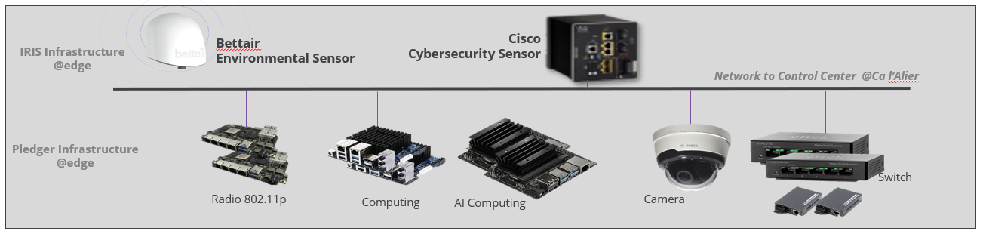
AI & IoT Infrastructure + cybersecurity and environmental sensors
Cybersecurity Sensor and Control Center (CyberVision)
Automated Threat
Analytics
(ATA)
Cyber-Threat
Intelligence
(CTI)
CERT
  Cybersecurity Sensor uses DPI technology to extract meaningful information (data & metadata) for the network devices using 100% passive sensor. Information is sent to CyberVision Control Center and reported to IRIS Automated Threat Analytics (ATA) module that extends existing intrusion detection tools to identify specific IoT and AI attack vectors, then shared through IRIS Collaborative Secure and Trusted Cyber-Threat Intelligence (CTI)
Notes:
1.– Use DPI technology to extract meaningful information (data & metadata) for the network devices using 100% passive sneosors, report Automated Threat Analytics (ATA) that extends existing intrusion detection tools with a novel threat detection engine for identifying specific IoT and AI attack vectors and includes digital twin honeypots for collecting attack telemetry against end-user systems reliant on these technologies.
throught tCyberVision Control Center

Slide 29


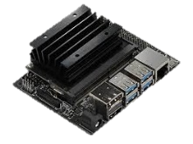
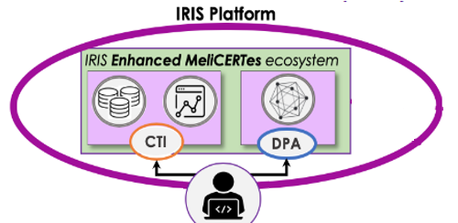



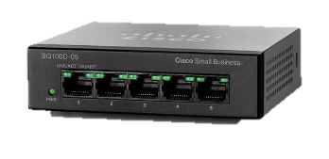
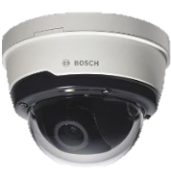
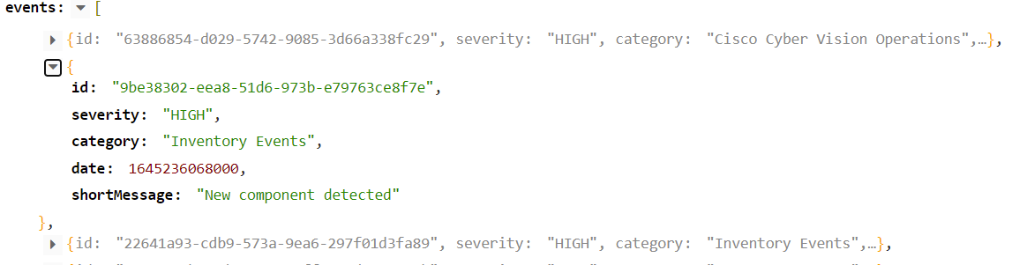
Connecting to IRIS Autonomous Threat Analytics (ATA) and Cyber-Threat Intelligence Sharing (CTI)
Syslog UDP, TCP, TLS - RFC3164
REST API
  i.e /api/3.0/dashboard/events/severities
Sensor
Control Center
Notes:
(I2CAT) 2 Nodos radio en las farolas + 1 de backup: Gateworks 6404; Radio acceso "normal" (ath10k); Radio para 11p
(I2CAT) 2 Odroids, modelo H2+; Intel Quad-core processor J4115; 32 GB de RAM
(BSC) 2 edge devices (nvidia) [para el edge/fanal]
(BSC) 2 Cameras BOSCH
(Noudi) 2 Switch+2 Conversors+2 Alimentació
Area Ca l’Alier (CPD nostre):
(HC) Cisco ASR 920; 6 x Transceiver SFP LX
(Italtel) Equip firewall Cisco
(I2CAT) 1 servidor edge: Dell PowerEdge R6402x750W; 2x Intel Xeon Gold 5218R, 20 núc./40T 2.1Ghz; 128GB RAM; 2x 960 GB SSD
(BSC) high performance PC para el core [Ca l'Alier]

Slide 30
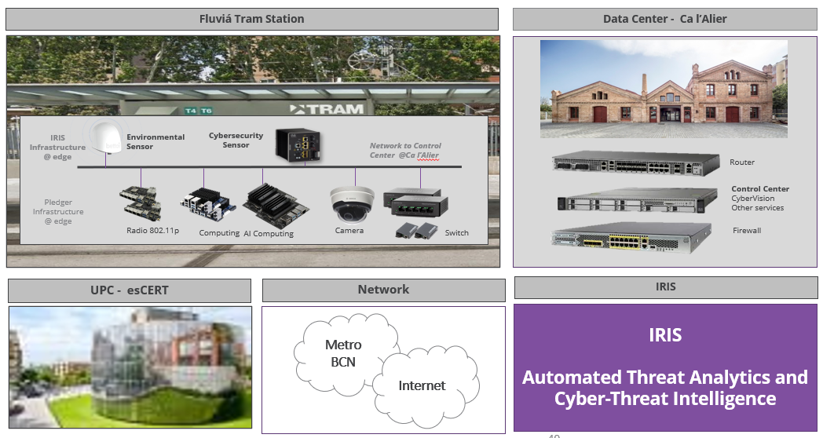
Barcelona Pilot – IRIS Platform Validation
Identification of attacks
Information sharing to IRIS platform of incidents
Enable Cyber Incident Response from CERTS

Slide 31
Thank you for your attention!
Any questions?

