Slide 1
IRIS Architecture
Susana González Zarzosa (ATOS)
22/02/2023

Slide 2
IRIS Methodology

Slide 3
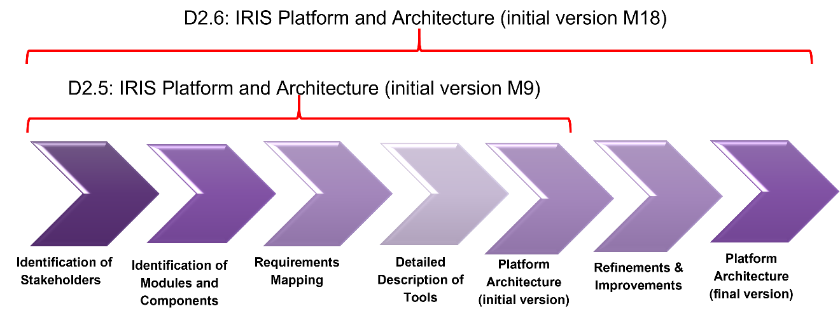
Methodology during the architecture design process
28th Feb 2023
31st May 2022

Slide 4
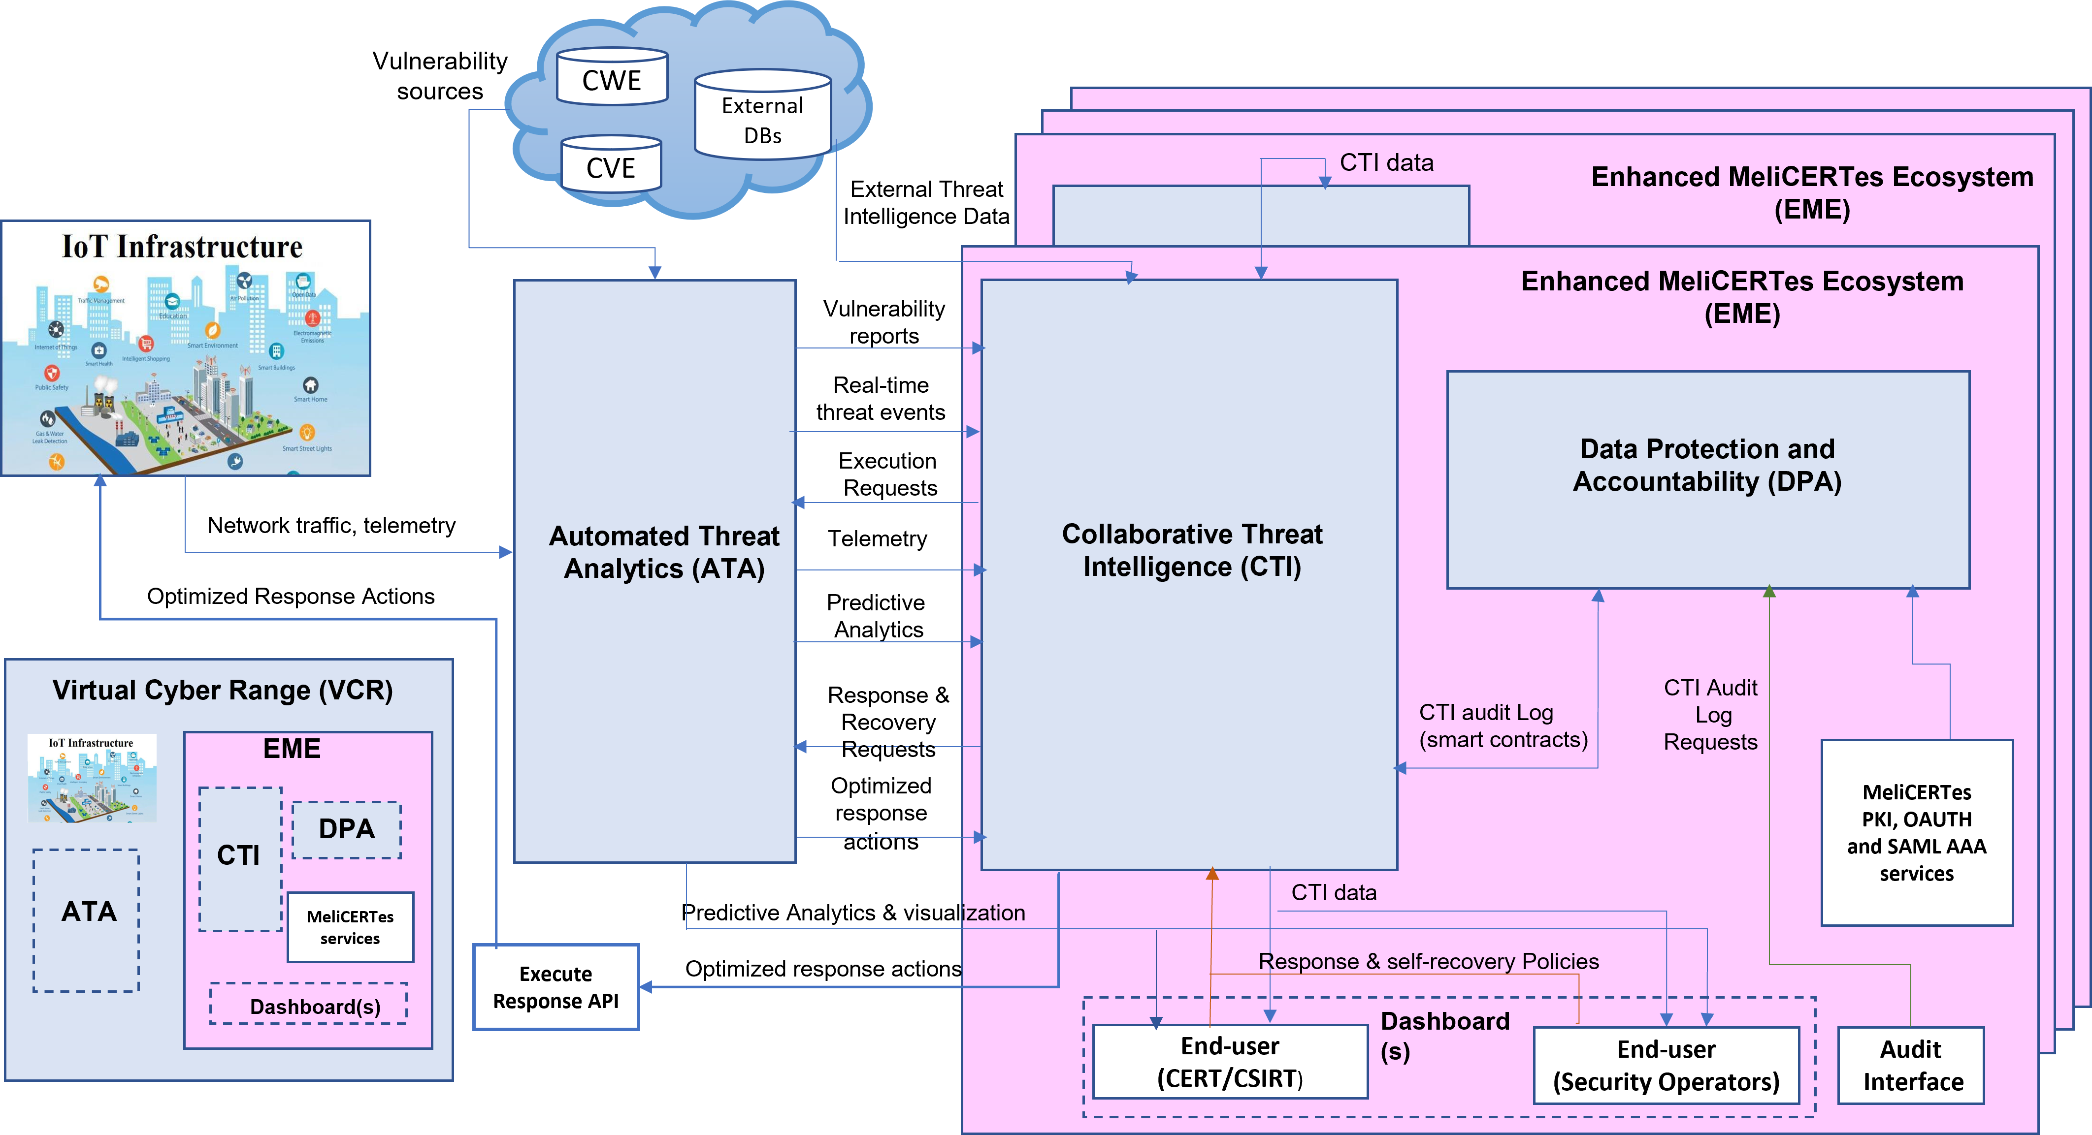
IRIS High Level Architecture
threat
analytics
use cases
ethics
intelligence
emulation
Notes:
Collaborative Threat Intelligence (CTI) that introduces Analytics Orchestration for supervising coordination between incident response and recovery;
an Open Threat Intelligence interface for disseminating taxonomies of IoT and AI threats;
intuitive Threat Intelligence Companion that serves as a key human-in-the-loop interface for collaborative incident response and threat intelligence sharing between CERTs/CSIRTs.
Automated Threat Analytics (ATA) that extends existing intrusion detection tools with a novel threat detection engine for identifying specific IoT and AI attack vectors and includes digital twin honeypots for collecting attack telemetry against end-user systems reliant on these technologies.
Virtual Cyber Range for collaborative CERT/CSIRT training exercises based on real-world environment platforms, providing representative adversarial IoT & AI threat intelligence scenarios.

Slide 5
IRIS Task View Architecture
Notes:
the C TI module that will be the core of the architecture, providing analytics orchestration and supervising coordination between the different components for incident response and recovery.
This module will make use of a Data Protection and Accountability (DPA) module, which will include distributed ledger technology, to provide the privacy and accountability framework for CERTs/CSIRTs and other stakeholders interacting with IoT and AI threat intelligence data through the enhanced MeliCERTes ecosystem.
Automated Threat Analytics (ATA) that extends existing intrusion detection tools with a novel threat detection engine for identifying specific IoT and AI attack vectors and includes digital twin honeypots for collecting attack telemetry against end-user systems reliant on these technologies.
Virtual Cyber Range for collaborative CERT/CSIRT training exercises based on real-world environment platforms, providing representative adversarial IoT & AI threat intelligence scenarios.

Slide 6
IRIS Tool View Architecture

Slide 7
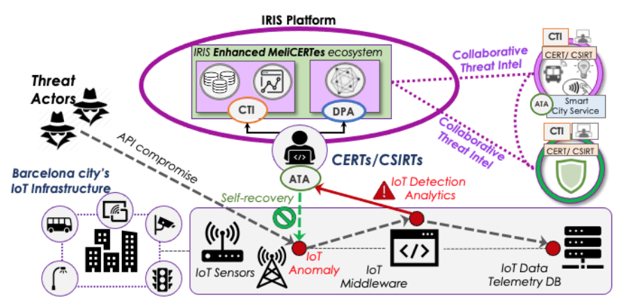
IRIS Pilots: Pilot Use Case 1
Securing the smart city’s IoT and control systems against confidentiality and
integrity breaches (Barcelona, Spain)
Notes:
Tramway monitoring. More specifically, the pilot will monitor an AI computer vision system at the edge and an IoT infrastructure deployed at a Tramway station in Barcelona (Fluvià street) by leveraging the work done in the Pledger and Elastic projects, both of which are also Horizon 2020 funded projects.

Slide 8
IRIS Architecture in PUC1

Slide 9
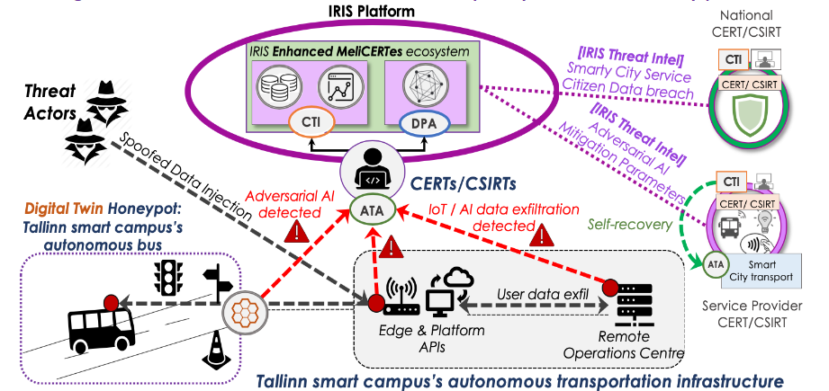
IRIS Pilots: Pilot Use Case 2
Securing AI-enabled infrastructure of autonomous transport systems in
a smart city (Tallinn, Estonia)

Slide 10
IRIS Architecture in PUC2

Slide 11
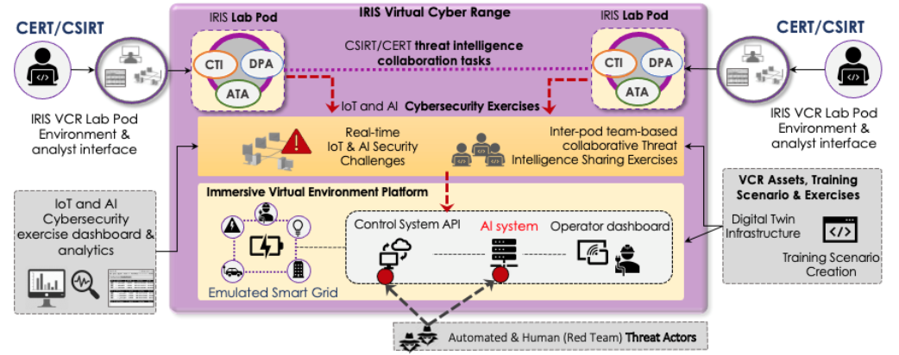
IRIS Pilots: Pilot Use Case 3
Effective incident response and threat intelligence collaboration for critical cross-border smart grid threats (Helsinki, Finland and Tallinn, Estonia)

Slide 12
IRIS Architecture in PUC3

Slide 13
Thank you for your attention!
Susana González Zarzosa (ATOS)

