Slide 1
IRIS-enhanced MeliCERTes Ecosystem
1st Stakeholders and Industrial Workshop | 22nd Feb. 2023
Dr. Sofia Tsekeridou, sofia.tsekeridou@netcompany-intrasoft.com
Dimitrios Skias, M.Sc, dmitrios.skias@netcompany-intrasoft.com

Slide 2
IRIS-enhanced MeliCERTes Ecosystem
Key objective: Extend MeliCERTes v2 open-source platform incorporating IRIS CTI developments to enable:
Secure and efficient security information representation in standardized format
Secure disclosable AI-relevant CTI information sharing with sharing/governance policies
Promote wider awareness, better preparation, detection and response capabilities across all involved stakeholders
Define sharing policies and communities of trust
Online communities' interaction in a trusted manner
Capitalizing on an extended base of stakeholders: Critical Infrastructure/OES owners, ISACs, CERTs/CSIRTs, European Agencies, etc. with diverse roles/rights for access to CTI and own instances with customized dashboards
Securely communicate and collaborate with CERT/CSIRT authorities and CI operators / Security operators

Slide 3
IRIS-enhanced MeliCERTes Ecosystem
Secure storage and augmentation of the IoT and AI focused cybersecurity knowledge base at a European level
Provision of advanced and unified dashboard for situational awareness, incident reporting, response and mitigation actions recommendations
Customized operational views, with incident reporting and response/mitigation actions capabilities per type of user/role
Access control and access rights to shared data based on
the type of user/operator
the type of service/infrastructure they provide or monitor
Advanced and fused interactive information visualization for better situational awareness and decision support
Offering Authentication and Authorization AAA services
OATH2, SAML, PKI etc.
CTI log auditing (via DPA)
Distributed architecture – ecosystem
Instances deployed at diverse stakeholders’ premises

Slide 4
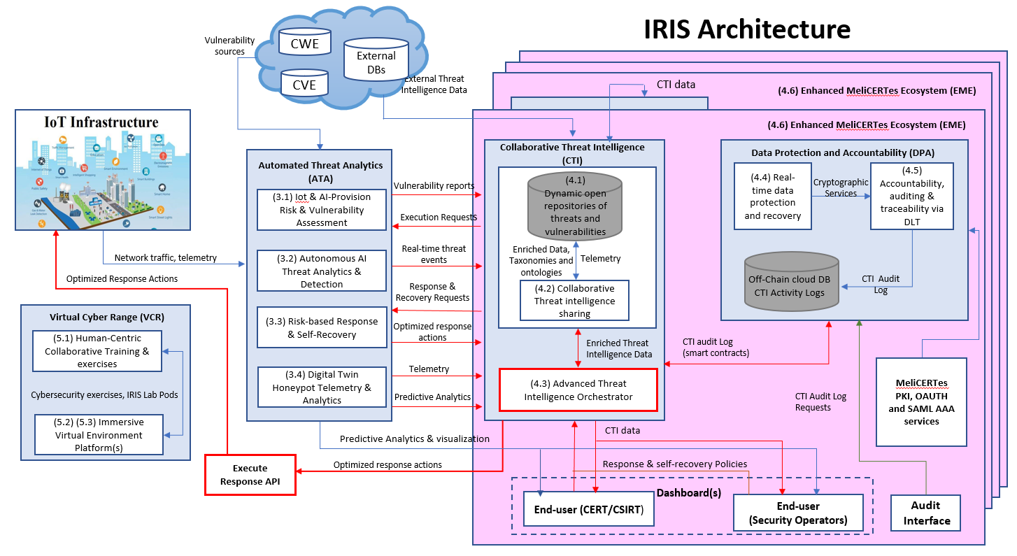
EME in IRIS architecture

Slide 5
IRIS-EME modules overview
Cerebrate
open source platform meant to act as a trusted contact information provider and interconnection orchestrator.
supports the IRIS users and organizations definitions offering a visual environment for managing IRIS roles and entities that results to the description of Trusted Circles (TC).
MISP
open source threat intelligence platform providing effective threat intelligence, by sharing indicators of compromise.
collect enriched IRIS generated CTI data such as threats, attacks and vulnerabilities that are targeted to IoT and AI-driven ICT systems.
EME hosts a MISP instance that will support the CTI communication towards the IRIS users.
INTELMQ
Open source technical solution for IT security teams (CERTs/CSIRTs/SOCs) for collecting and processing security feeds using a message queuing protocol.
EME will incorporate INTELMQ as an auxiliary communication channel that will support the collection and processing of security feeds through a message queuing protocol.

Slide 6
IRIS-EME modules overview
KEYCLOAK
open source software product to allow single sign-on with Identity and Access Management (IAM) aimed at modern applications and services
EME builds its AAA offered services through KEYCLOAK ensuring that the right people in a company have appropriate access to resources.
EME Unified Dashboard (UI) & SIEM
In house developed web application acting as the main visual interface (UI) of the EME ecosystem.
Integrates all the IRIS provided visual environments, safeguarding the coherence of the IRIS platform towards its users.
CTI overview
CTI mitigation actions and associated workflows

Slide 7
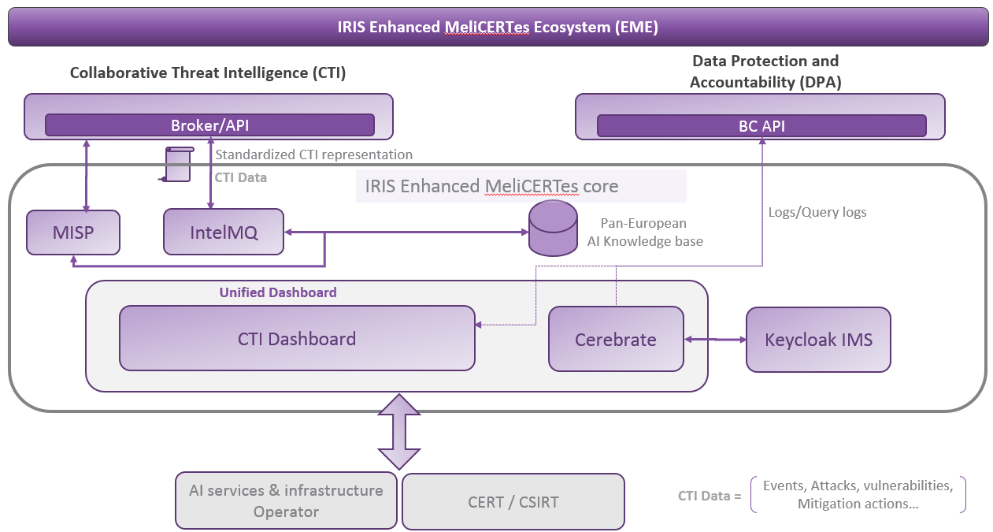
IRIS-EME architecture

Slide 8
IRIS-EME Users
IRIS-EME aims to provide tailored CTI related information to its stakeholders
Customized CTI visualization and content
IRIS-enabled CI
Security operator
Owner/administrator
Cybersecurity authority
CERT
CSIRT
Other?
Additional CI clusters
ISACs

Slide 9
IRIS-EME Cerebrate
Cerebrate is an open-source platform meant to act as a trusted contact information provider and interconnection orchestrator for other security tools
Features
Advanced repository to manage individuals and organisations
Management of individuals and their affiliations to each organisations
Dynamic model for creating new organisational structures (FIRST.org, EU CSIRTs)
Distributed synchronisation model
Key store for public encryption and signing cryptographic keys

Slide 10
IRIS-EME Cerebrate authentication

Slide 11
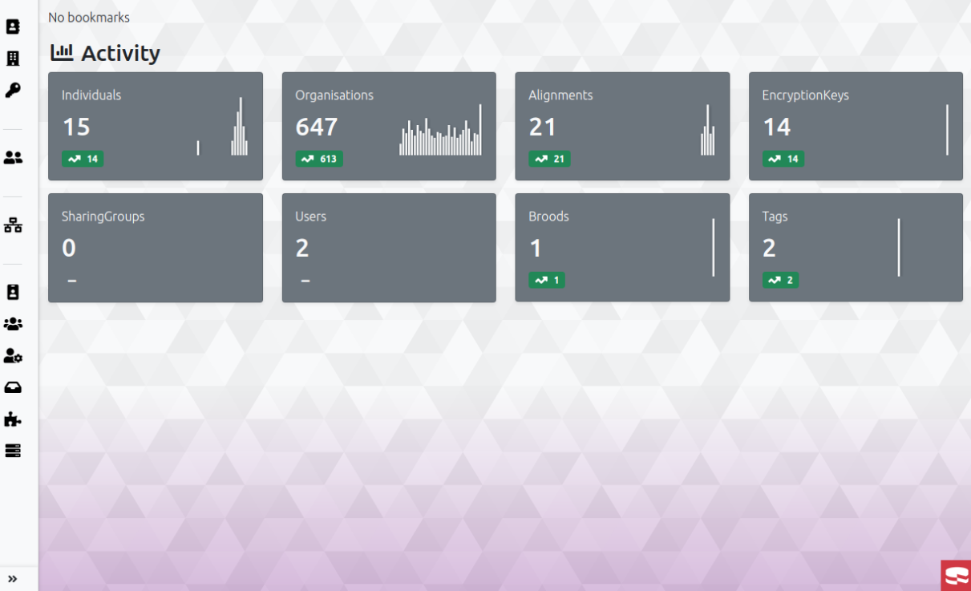
MeliCERTes v2 – Cerebrate

Slide 12
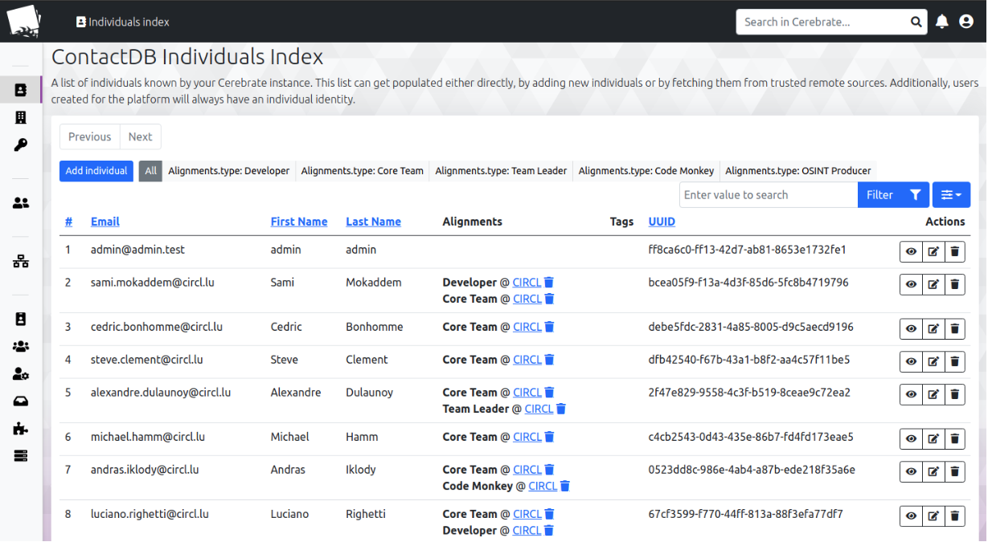
MeliCERTes v2 – Cerebrate (Contact List)

Slide 13
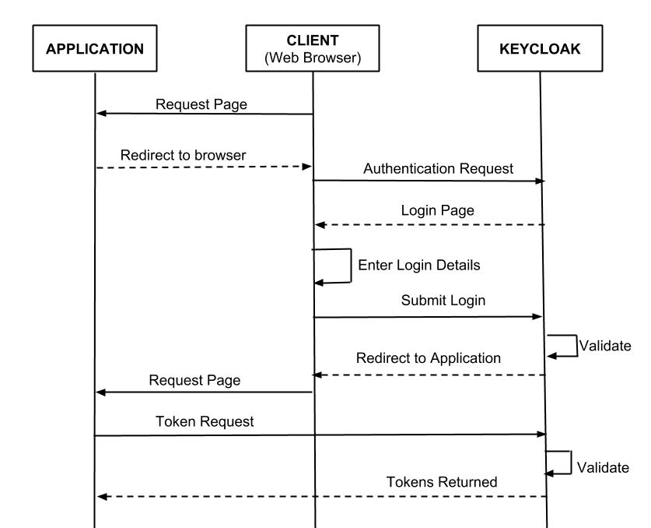
EME – Keycloak Authentication
OpenID Connect
authentication protocol that is an extension of OAuth 2.0
Uses JSON Web Token (JWT) standards
SAML – Security Assertion Markup Language
Cross-domain single sign-on (SSO)
mTLS service authentication

Slide 14
EME – Unified Dashboard
CTI information sharing home page: Presenting the CTI threats detected by the platform
CTI orchestration information
Presenting CTI mitigation actions’ workflows to the IRIS users
Collecting IRIS users’ feedback
IRIS generated AI/IoT CTI relevant information structured in a standardized format.
Information governance models and sharing policies for CTI exchanges and relevant standard operating procedures for the management of threats and attacks

Slide 15
EME – Unified Dashboard design

Slide 16
Collaborative Threat Intelligence (CTI) – Unified Dashboard
CTI events
Organizations and Users sharing policies
CTI Sharing
CTI orchestration
$$⋯$$
$$⋯$$
MISP
Honeypot UI
AI services & infrastructure
Operator
CERT / CSIRT

Slide 17
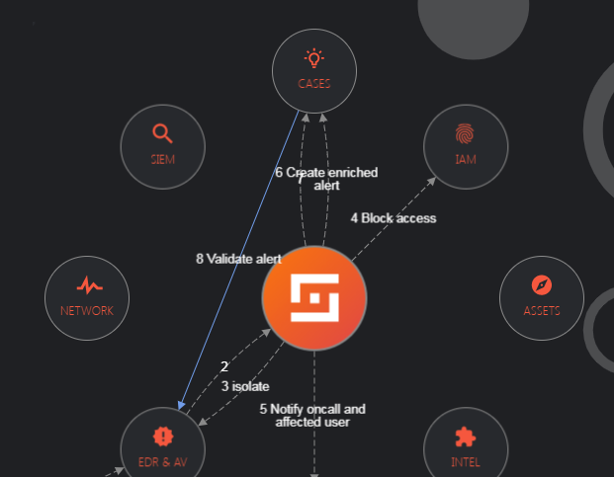
Collaborative Threat Intelligence (CTI) – Unified Dashboard
CTI events
Workflows associated to CTI threat
CTI sharing
CTI orchestration
$$⋯$$
$$⋯$$
MISP
Honeypot UI
AI services & infrastructure
Operator
CERT / CSIRT

Slide 18
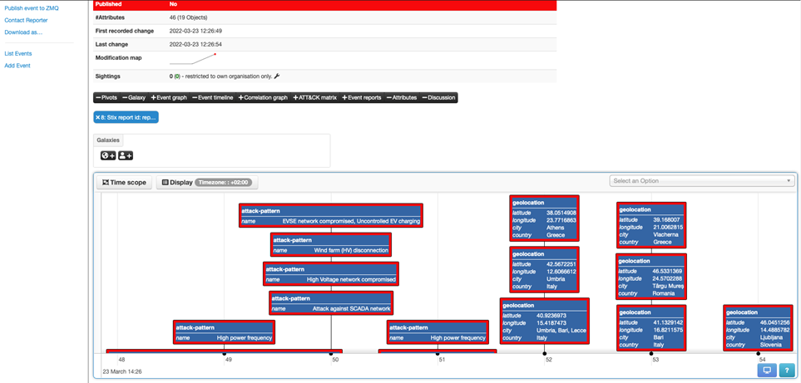
Collaborative Threat Intelligence (CTI) – Unified Dashboard
CTI events
MISP instance
CTI Sharing
CTI orchestration
$$⋯$$
$$⋯$$
MISP
Honeypot UI
AI services & infrastructure
Operator
CERT / CSIRT

Slide 19
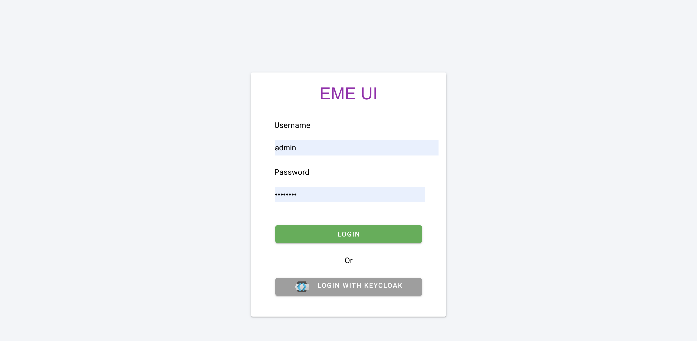

Slide 20
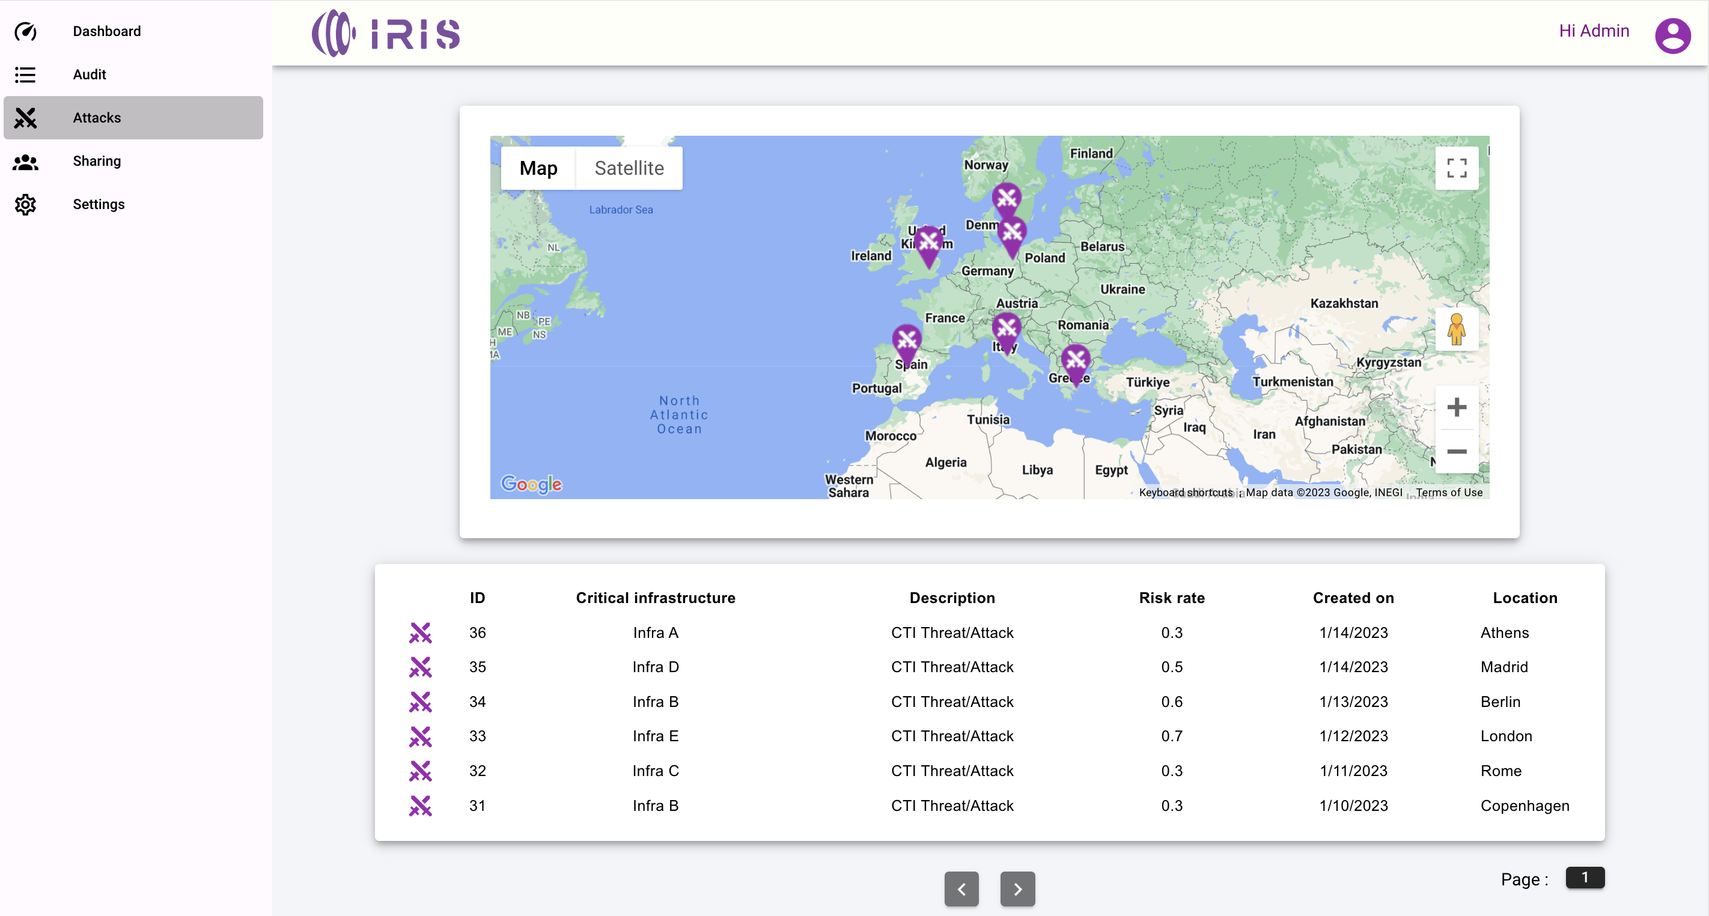

Slide 21
Thank you! Questions?
1st Stakeholders and Industrial Workshop | 22nd Feb. 2023

Slide 22
