Slide 1
IRIS - Plenary Meeting
Cryptotool and DPA
(INOV & TUD)
1

Slide 2
Data Protection and Accountability Module
Data Protection and Accountability Module
Provides auditing functions for incident response, ensuring accountability
Enables secure, immutable and distributed logging for incident response workflows
Sub-Modules
Confidentiality
Integrity
Availability
Self Encryption
Automatic Key Generation method.
From any data, it auto-encrypts and generates a decription key.
Encryption of activity Logs
Secret Sharing
Splits a key into smaller chunks.
To recalculate the key, one must collect almost all the chunks.
More difficult to recover audit log decryption key
No single point of failure
Hyperledger Fabric
Maintain consistency and auditability of data.
Control Access to off-chain database (smart Contract)
Activity log consistency
Read/write access control
No single point of failure
Off-chain Database
Database storing the encrypted data.
Activity log stored outside of blockchain
Maintains blockchain scalability

Slide 3
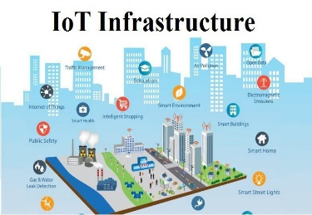
Iris Tool View Architecture
IRIS Architecture (Detailed View)
Vulnerability sources
CWE
External DBs
External Threat Intelligence Data
CVE
CTI data
Enhanced MeliCERTes Ecosystem (EME)
Enhanced MeliCERTes Ecosystem (EME)
Automated Threat Analytics (ATA)
Collaborative Threat Intelligence (CTI)
Data Protection and Accountability (DPA)
Vulnerability Manager (ATOS)
BINSEC (CEA)
DLT Self-encryption Tool (TUD)
Cryptographic Services
Distributed Ledger - Access Control Framework (TUD&INOV)
Vulnerability
reports
Threat Intelligence Sharing and Storage (CERTH)
Sivi (SID)
NIGHTWATCH (CLS)
AI-Threat Detection (CEA)
Real-time
threat events
Network traffic, telemetry
Optimized Response Actions
Execution
Requests
Off-Chain cloud DB
CTI Activity Logs
CTI Audit Log
Threat & vulnerabilities Repositories
Virtual Cyber Range (VCR)
NIGHTWATCH (CLS)
Response & Recovery Requests
CyberTraP (KEMEA)
Vulnerability
reports
CTI Data
Optimized response actions
CTI Audit Log (smart contracts)
Advanced Threat Intelligence Orchestrator (ICCS)
CTI Audit Log Requests
MeliCERTes
PKI, OAUTH
and SAML AAA services
Cybersecurity exercises, IRIS Lab Pods
SiHoneyPots (SID)
Telemetry &
Predictive Analytics
Cyber Range Platform
(THALES)
CTI data
Predictive Analytics & visualization
Kafka Broker / APIs Execution
Optimized response actions
Response & self-recovery Policies
End-user (CERT/CSIRT)
Dashboard(s)
End-user
(Security Operators)
Audit
Interface

Slide 4
DPA Within the Iris Project
Collaborative Threat Intelligence Module
Data Protection and Accountability Module
CERT/CSIRT A
CTI
CTI Activity Log 1
CERT/CSIRT B
CTI
Advanced Threat Intelligence Orchestrator
CTI Activity Log 2
CTI Activity Logs
...
...
CTI
Repository of Threats and Vulnerabilities
Auditors
Notes:
4

Slide 5
DPA Within the Iris Project
Collaborative Threat Intelligence Module
Data Protection and Accountability Module
CERT/CSIRT A
CTI
CERT/CSIRT B
CTI
Advanced Threat Intelligence Orchestrator
CTI Activity Logs
Off-chain database
...
CTI
Repository of Threats and Vulnerabilities
CTI Activity Log 1
CTI Activity Log 2
...
Auditors
Notes:
5

Slide 6
DPA Within the Iris Project
Collaborative Threat Intelligence Module
Data Protection and Accountability Module
CERT/CSIRT A
CTI
Cryptographic Tool
CERT/CSIRT B
Advanced Threat Intelligence Orchestrator
CTI Activity Log 2
CTI
CTI Activity Logs
Off-chain database
...
CTI
Repository of Threats and Vulnerabilities
CTI Activity Log 1
CTI Activity Log 2
...
Auditors
Notes:
6

Slide 7
DPA Within the Iris Project
Collaborative Threat Intelligence Module
Data Protection and Accountability Module
CERT/CSIRT A
CTI
Cryptographic Tool
Hyperledger Fabric Network
CERT/CSIRT B
Advanced Threat Intelligence Orchestrator
CTI Activity Log 2
CTI
CTI Activity Logs
Off-chain database
...
CTI
Repository of Threats and Vulnerabilities
CTI Activity Log 1
CTI Activity Log 2
...
Auditors
Notes:
7

Slide 8
Video
DPA-Encryption.mp4
DPA-Decryption.mp4

Slide 9
Conclusions
Self Encryption
encrypts activity logs and generates particular decryption key
Decrypts data with right decryption key
Secret Sharing
Divides decryption keys into key shares and distributes it among peers
Reconstitutes original keys with sufficient amount of the right key shares
Blockchain
Manages references and integrity of activity logs
Manages read/write accesses to the off-chain database
Off-chain Database
Maintains encrypted activity logs
Blockchain scalability

Slide 10
Appendix

Slide 11
Blockchain in IRIS Project

Slide 12
DPA Development Phases

Slide 13
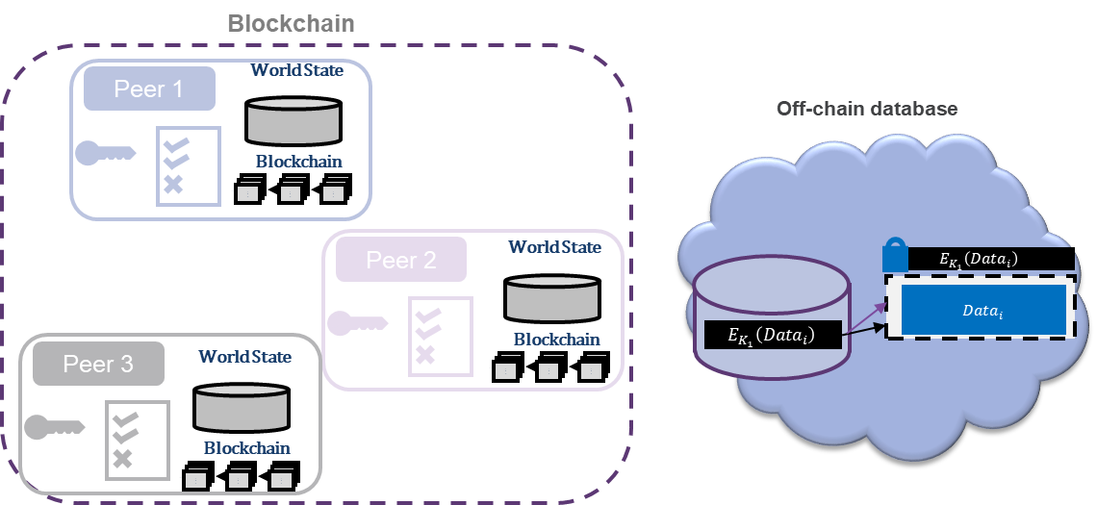
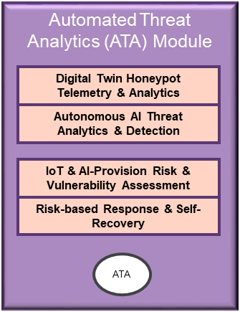
1st Phase
Other Virtual Machines
DPA Virtual Machine
Security Practitioners
Docker Containers
Auditors

Slide 14
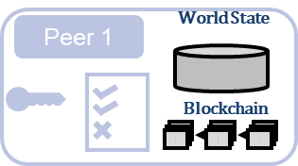
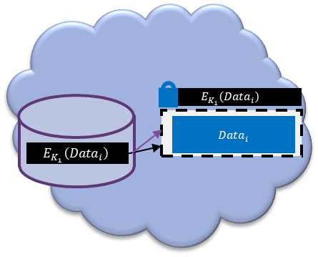
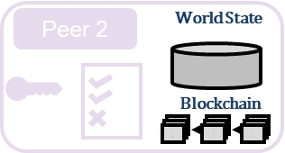
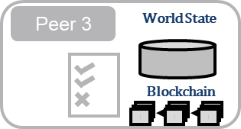
2nd Phase
Other Virtual Machines
DPA Virtual Machines
Security Practitioners
Auditors

Slide 15
3rd Phase
Other Components
Computers/Servers
Different computers/servers
Different computers/servers
Security Practitioners
Auditors

Slide 16
Brief Introduction to Blockchain

Slide 17
What is Blockchain Technology
What is Blockchain Technology
Distributed Ledger (DLT)
Peer-to-Peer Network
Peer Agreement - Consensus
Ledger composed of :
Assets state (world State)
List of transactions (requests for changes in assets states) organized as blockchain
Nodes (e.g., servers, computers) have same privileges
Ledger is distributed among the P2P network
Smart Contracts - Business Logic programmed and run by peers. Generates transactions
Transactions validation are agreed among the peer nodes
Peer nodes agree on transactions:
order
execution outcome
validity
Ledger
Peer
Peer
World State
Peer
World State
Peer
World State
World State
Peer
World State
Peer
Asset
Asset
World State
World State
Blockchain
Blockchain
Blockchain
Asset State
Blockchain
$$⋯$$
txn
txn
txn
Blockchain
$$⋯$$
txn
txn
txn
$$⋯$$
txn
txn
txn
Blockchain
$$⋯$$
txn
txn
txn
✓
Blockchain
$$⋯$$
txn
txn
txn
$$⋯$$
txn
txn
txn
$$⋯$$
txn
txn
txn
✓
tx
✓
Integrity
tx
Blockchain integrity maintained cryptographically by hash function
tx
Notes:
17

Slide 18
What is Blockchain Technology
What is Blockchain Technology
Distributed Ledger (DLT)
Peer-to-Peer Network
Peer Agreement - Consensus
Ledger composed of :
Assets state (world State)
List of transactions (requests for changes in assets states) organized as blockchain
Nodes (e.g., servers, computers) have same privileges
Ledger is distributed among the P2P network
Smart Contracts - Business Logic programmed and run by peers. Generates transactions
Transactions validation are agreed among the peer nodes
Peer nodes agree on transactions:
order
execution outcome
validity
Blockchain Technology Features
Integrity
Consensus
Programmable Business Logic
Information is immutable:
Ledger integrity maintained cryptographically by hash function
Decentralized ledger, distributed among a peer-to-peer network
Peer nodes agree on transactions:
validity
order
execution outcome
Business Logic can be programmed and run by peers of the network – Smart Contracts
Program output verified and agreed by peers with consensus mechanism
Properties
Immutability
Transparency
Desintermediation
Auditability
Notes:
18

Slide 19
Self-Encryption

Slide 20
Self Encryption
$$C_{1}$$
$$C_{2}$$
$$C_{3}$$
$$AES{\left(C_{1}\right)}_{H\left(C_{3}\right)}$$
$$H\left(C_{1}\right)$$
$$AES{\left(C_{2}\right)}_{H\left(C_{1}\right)}$$
$$H\left(C_{2}\right)$$
$$AES{\left(C_{2}\right)}_{H\left(C_{2}\right)}$$
$$H\left(C_{3}\right)$$
Encryption
$${EX}_{1}$$
$${EX}_{2}$$
$${EX}_{3}$$
$$H\left(C_{1}\right)$$
$$H\left(C_{2}\right)$$
$$H\left(C_{3}\right)$$
$$AES^{−1}$$
$$H\left(C_{3}\right)$$
$$AES^{−1}$$
$$H\left(C_{1}\right)$$
$$AES^{−1}$$
$$H\left(C_{2}\right)$$
Decryption
$$C_{1}$$
$$C_{2}$$
$$C_{3}$$
Notes:
20

Slide 21
Shamir Secret Sharing

Slide 22
Shamir’s Secret Key Sharing
Dealer
Parties
Requester
Secret
$$v∈_{R}Z_{q}$$
$$f\left(z\right)=v+\sum_{k=1}^{t−1}{a_{k}z^{k}}$$
Polynomial coefficients
$$a_{i}∈_{R}Z_{q}$$
Shared Secret Key
$$s_{1}=f\left(1\right)=v+\sum_{k=1}^{t−1}{a_{k}j^{k}}$$
Party 1
$$s_{1}$$
Lagrange Interpolation Formula
$$s_{1}$$
$$f\left(o\right)=v$$
$$s_{j}=f\left(j\right)=v+\sum_{k=1}^{t−1}{a_{k}j^{k}}$$
Party j
$$s_{t}$$
$$s_{j}$$
$$s_{n}=f\left(n\right)=v+\sum_{k=1}^{t−1}{a_{k}j^{k}}$$
Party n
$$s_{n}$$
Lagrange Interpolation Formula
$$f\left(z\right)=\sum_{k=1}^{t}{f\left(k\right)}\prod_{j=1, j≠k}^{t}{\frac{z−j}{k−j}}=v+\sum_{k=1}^{t−1}{a_{ik}z^{k}}$$

Slide 23
DPA – sub-module gradual explanation

Slide 24
Self Encryption
Off-chain database (audit logs)
$$E_{K_{i}}\left(Data_{i}\right)$$
$$Data_{i}$$
Self Encryption
$$K_{i}=K\left(Data_{i}\right)$$
$$E_{K_{1}}\left(Data_{1}\right)$$
$$E_{K_{2}}\left(Data_{2}\right)$$
$$K_{i}$$
$$Data_{i}$$
Self Encryption
$$E_{K_{i}}\left(Data_{i}\right)$$

Slide 25
Secret Sharing Scheme – Sharing Keys
Off-chain database (audit logs)
$$E_{K_{i}}\left(Data_{i}\right)$$
$$Data_{i}$$
Self Encryption
$$K_{i}=K\left(Data_{i}\right)$$
KH 1
Secrete Sharing
$$E_{K_{1}}\left(Data_{1}\right)$$
$$E_{K_{2}}\left(Data_{2}\right)$$
KH 2
Secrete Sharing
KH 3
$$K_{i}$$
$$Data_{i}$$
Self Encryption
$$E_{K_{i}}\left(Data_{i}\right)$$
Notes:
25

Slide 26
Secret Sharing Scheme – Decrypting
Off-chain database (audit logs)
$$E_{K_{i}}\left(Data_{i}\right)$$
$$Data_{i}$$
Self Encryption
$$K_{i}=K\left(Data_{i}\right)$$
KH 1
Secrete Sharing
$$E_{K_{1}}\left(Data_{1}\right)$$
$$E_{K_{2}}\left(Data_{2}\right)$$
KH 2
Secrete Sharing
KH 3
$$K_{i}$$
$$Data_{i}$$
Self Encryption
$$E_{K_{i}}\left(Data_{i}\right)$$

Slide 27
Secret Sharing Scheme
Off-chain database (audit logs)
$$E_{K_{i}}\left(Data_{i}\right)$$
$$Data_{i}$$
Self Encryption
$$K_{i}=K\left(Data_{i}\right)$$
KH 1
Secrete Sharing
$$E_{K_{1}}\left(Data_{1}\right)$$
$$E_{K_{2}}\left(Data_{2}\right)$$
KH 2
Secrete Sharing
KH 3
$$K_{i}$$
$$Data_{i}$$
Self Encryption
$$E_{K_{i}}\left(Data_{i}\right)$$

Slide 28
Hyperledger Fabric – Blockchain within the path to encrypted log files
DPA – Data Protection and Accountability
Off-chain database (audit logs)
$$E_{K_{i}}\left(Data_{i}\right)$$
$$Data_{i}$$
Self Encryption
$$K_{i}=K\left(Data_{i}\right)$$
Blockchain
Peer 1
World State
Secrete Sharing
gRPC
(too much maybe)
$$E_{K_{1}}\left(Data_{1}\right)$$
Blockchain
$$⋯$$
$$E_{K_{2}}\left(Data_{2}\right)$$
txn
txn
txn
Peer 2
World State
Secrete Sharing
World State
Blockchain
Peer 3
$$⋯$$
txn
txn
txn
$$K_{i}$$
Blockchain
$$⋯$$
Self Encryption
txn
txn
txn
$$Data_{i}$$
$$E_{K_{i}}\left(Data_{i}\right)$$

Slide 29
DPA – Simplified View
DPA – Data Protection and Accountability
Off-chain database
$$Data_{i}$$
Secret Sharing Scheme Encryption / decryption
Hyperledger Fabric network
Access Control Enforcement
Smart Contract
(Audit Log)
Ledger
$$Data_{i}$$
Blockchain
$$E_{K_{1}}\left(Data_{i}\right)$$
$$⋯$$
txn
txn
txn
CTI data reference
World State
DB location
Additional data info.
Data Ref.
data hash
Distributed Key Shares
$$Data_{i}$$

