Slide 1


Slide 2
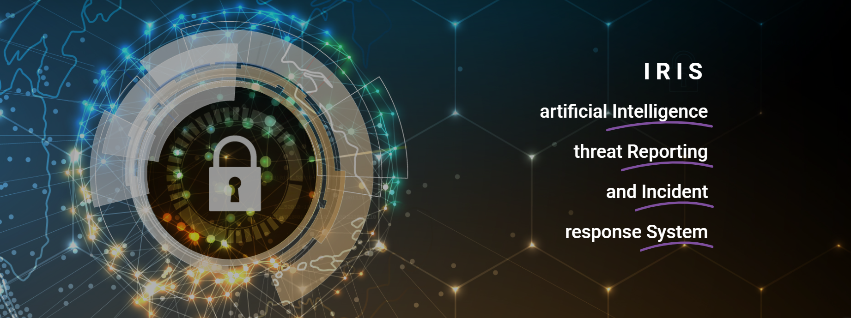

Slide 3

IRIS
A collaborative CERT/CSIRT platform to combat cyber-threats in IoT and AI-driven systems
Gonçalo Cadete (INOV)
30/05/2023

Slide 4
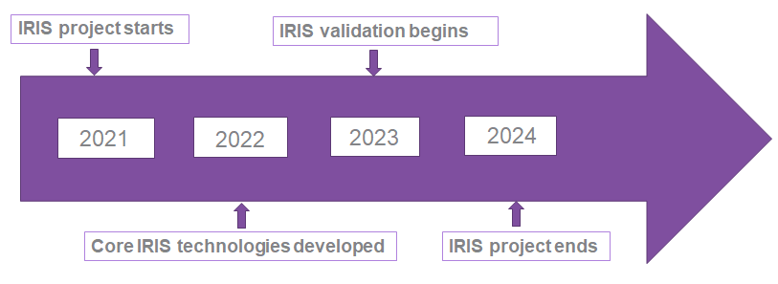
Project at a Glance
Call Identifier: 2020-SU-DS-2020
Topic: SU-DS02-2020 Intelligent security and privacy management
EC Funding: 4 918 790.00 EUR
Duration: 36 months (Sept 2021-Aug 2024)
Consortium: 19 partners
Coordinator: INOV - Instituto de Engenharia de Sistemas e Computadores, Inovacão, (INOV), Portugal
Learn More: www. iris-h2020.eu
Join us: @iris-h2020
IRIS H2020 Project
6 Public organizations
3 SMEs
4 Large ICT industries
6 Research institutions & Universities
Consortium

Slide 5
IRIS Motivation
As existing and emerging SMART CITIES continue to expand their IoT and AI-enabled systems, novel and complex threats are introduced.
Architecture and behaviour of emerging IoT and AI technologies are not currently well understood by security practitioners, such as CERTs and CSIRTs.

Slide 6

IRIS Vision
The H2020 IRIS project aims to deliver a framework that will support European CERT and CSIRT networks detecting, sharing, responding and recovering from cybersecurity threats and vulnerabilities of IoT and AI-driven systems.
Complement the existing MeliCERTes open platform and tools.
The IRIS Platform will be made available, free of charge, to the European national CERT and CSIRTs, by the end of the project.

Slide 7
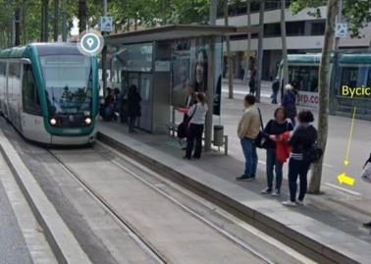
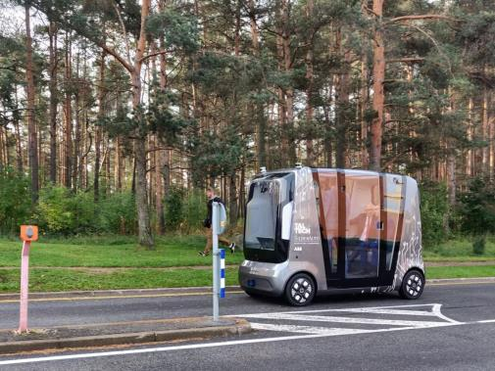
Key takeaways
Smart Cities => novel, cutting edge AI/IoT-driven technology
This implies Emerging Threats ! High risks!
Currently, lack of experience as well as of tools for incident management that tackle IoT & AI attack vectors
IRIS will enhance the capabilities (knowledge, toolset, training) of CERTs/CSIRTs, to address these challenges.

Slide 8
What to expect from this Workshop
Get to know IRIS development status, at month 21 (out of 36 months).
YOUR FEEDBACK MATTERS !
  What are your drivers, needs, and pain points?
  Where should IRIS focus its research efforts, for the 2nd part of the project?
Join the Stakeholder Community, and influence the IRIS roadmap.

Slide 9
Agenda
Time (Greece) | 2nd Stakeholders and Industrial Workshop (SIW) Presentations | Partners
09:10 | IRIS Pilots | UPC
09:25 | IRIS Platform use in a Smart City (Pilot Use Case #1) | ATOS
09:55 | Q&A | ATOS + CEL
10:10 | Enhanced MeliCERTes ecosystem featuring single sign-on, SIEM, data governance, and customized dashboards | INTRA
10:20 | Q&A | INTRA + CEL
10:30 | Audit system for multi-entity environment: the Data Protection and Accountability (DPA) component | INOV
10:40 | Q&A | INOV + CEL

Slide 10
Thank you for your attention!
Gonçalo Cadete (INOV)

Slide 11
IRIS Objectives
To identify the user, technical and business requirements and design the architecture of an AI threat reporting and incident response system
To analyze the relevant ethics principles and legal framework on privacy concerns
To develop a collaborative platform for ICT stakeholders and European CERTs/CSIRTs for the successful operation of IoT and AI-enabled ICT systems
To demonstrate and validate the integrated IRIS platform across three realistic pilot demonstrators in three smart cities
To ensure wide communication and scientific dissemination of the IRIS results, efficient exploitation and contribution to relevant standardization bodies

