Slide 1
IRIS Pilots
René Serral Gracià (UPC)
30/05/2023

Slide 2
IRIS Pilots
The Project is composed by 3 Pilots
With the goal of
Identifying business requirements
Demonstrating the AI driven threat detection
Providing a collaborative european threat reporting environment
of the IRIS platform
Helsinki
Tallinn
Barcelona

Slide 3
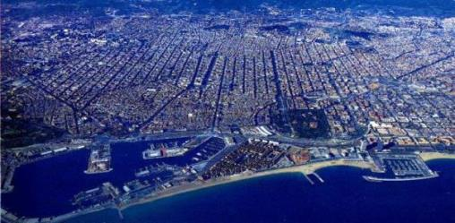
IRIS Barcelona Use Case

Slide 4
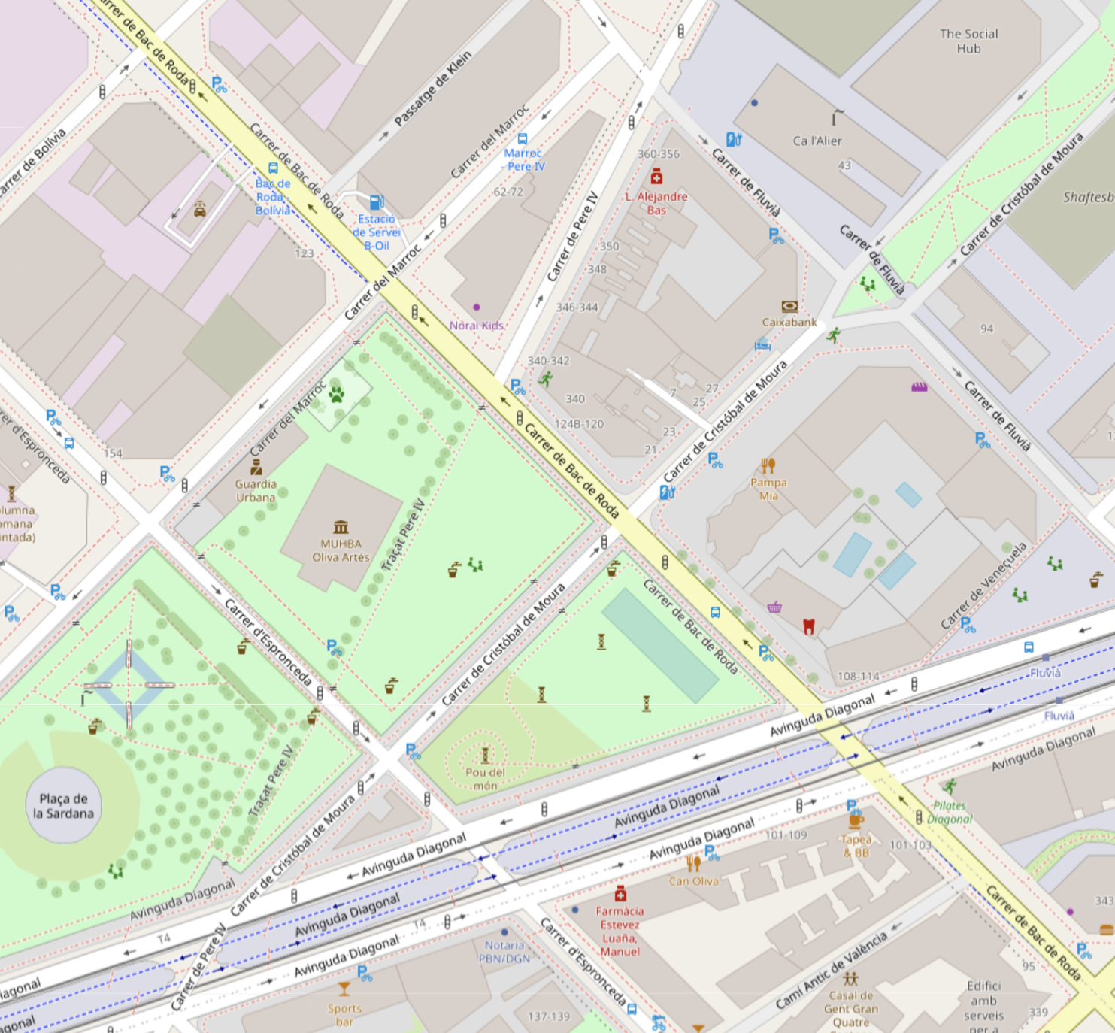
Integration of IRIS initiative in 5GBarcelona Testbed
Ca L’Alier
RF Sensors
Datapath
PLEDGER
Surveilance Camera
To Cabinets

Slide 5
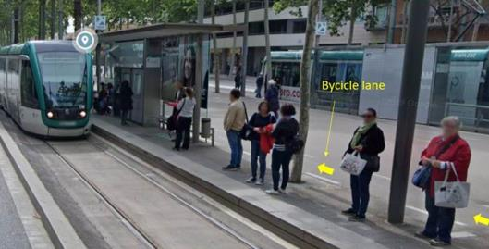
Smart Cities Service: Vulnerable Road Users (VRUs) Protection
VRU (Bicycles/E-Scooters + Pedestrians) are exposed to dangerous situations when people exiting the tram cross the bicycle lane
802.11p allows detecting bicycles, while image processing allows to detect the Tram
The system automatically notifies when a possible hazard is detected

Slide 6
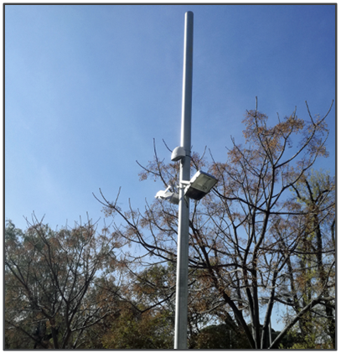
Cybersecurity Challenges
Ensuring availability of IoT and IA infrastructure for the safety of tram users
Ensuring confidentiality on the communications of the IoT infrastructure
Lack of experience as well as of tools, for detecting and reporting IoT & AI attack vectors

Slide 7
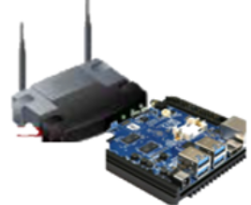
User Story 1: Enhancing safety of vulnerable road users
All different sensors and actors send telemetry data to the Pledger infrastructure
A malicious actor creates a DoS attack by flooding the network
IRIS sets the necessary firewall rules to mitigate the attack
Pedestrian and bike
Telemetry
Service Disruption
(DoS)
Tram
Telemetry

Slide 8
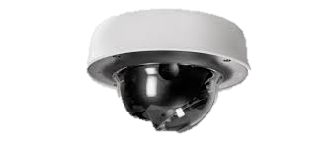
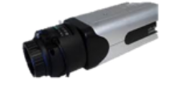
User Story 2: Protecting the confidentiality of the data-center infrastructure
Videocamera sends video feed to protect the data-center
A malicious actor connects to the network to eavesdrop
IRIS detects it and sets the rules to force the malicious actor to disconnect from the network
Other sensor
Telemetry
Videocamera
feed
Malicious actor
Eavesdroping

Slide 9
Tallinn Pilot Use Case

Slide 10
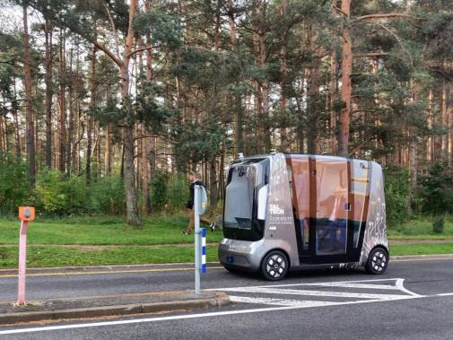
AI Enabled Infrastructure - Transportation
Autonomous Vehicle Shuttles for Public Transportation
Vehicle-to-Everything (V2X) Communication
Teleoperation/Remote Control Operations Center
Autonomous Vehicle Telemetry and Smart City Data fused into Urban Operating Platform (UoP)

Slide 11
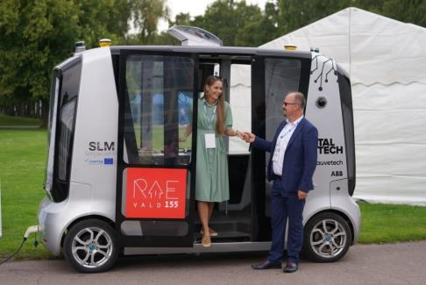
Scenario 1: Telematics and Smart City Data Exchange & Security
The Autonomous Vehicle (AV) Shuttle fleet will navigate around the smart campus environment
Urban Operating Platform (UoP) gathers AV Shuttle telemetry
Data to protect
Location of the vehicles
Navigation
Odometry
…

Slide 12
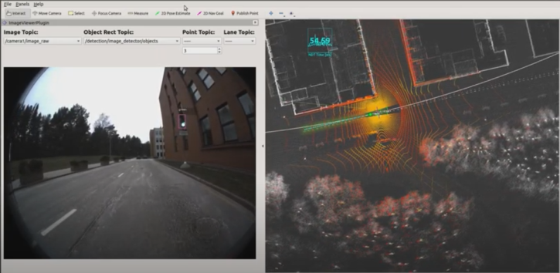
Scenario 2: Trustworthiness of Machine Vision Telemetry
The Autonomous Vehicle (AV) approaches a traffic-light controlled intersection or roadway
The machine vision of the AV focusses on the traffic light
The AV object-detection module detects the traffic light color
Depending on the traffic light the AV will pass-through or stop

Slide 13
Helsinki Pilot Use-Case

Slide 14
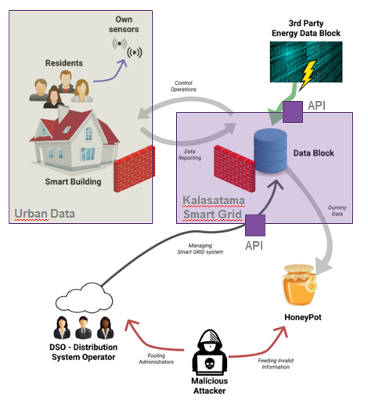
Kalasatama smart grid
Kalasatama smart grid APIs
Kalasatama smart district Digital Twin
Provision of load control
Urban Data Platform (IoT)
Smart grid APIs from the city of Tallinn.
Notes:
Kalasatama smart grid - enabling real time smart metering, electric vehicles network and new storage solutions for electricity.
Kalasatama smart grid APIs (Environmental data to manage energy resources.)
Kalasatama smart district Digital Twin.
Provision of load control functions that the distribution system operator (DSO) can use in situations where the production has reached its peak.
Urban Data Platform, a smart city data platform. Modular IOT platform. Real-time data on urban environments.
Smart grid APIs from the city of Tallinn.
Use Cases:
Environmental noise monitoring
Smart home sensors using LoRaWAN networks
Solar panel monitoring
Smart street lighting
People counters
Electrical vehicle charging monitoring
Maintenance Vehicle Telemetry
Building Automation System
Dynamic Attributes in 3D City Model
Natural Language Processing in Helpdesk

Slide 15
Smart Kalasatama Data Examples
Solar Energy Potential
Amount of solar radiation in buildings
Heating Demand Prediction
Heating energy demand prediction until 2050
Geoenergy Potential
150m / 300m / 1000m deep well potentials, groundwater areas, ...
Energy Data of Buildings
Municipal register information (e.g., heating method of buildings, usage, ...)
Repairs and alterations
Protected buildings
Calculated energy consumption of buildings by age group
Notes:
Effective incident response and threat intelligence collaboration for critical cross-border smart grid threats
Customer facing components securing
Against threats to control functions defined for the demand control
API securing
Smart Grid API from Kalasatama
Smart grid APIs from the city of Tallinn.

Slide 16
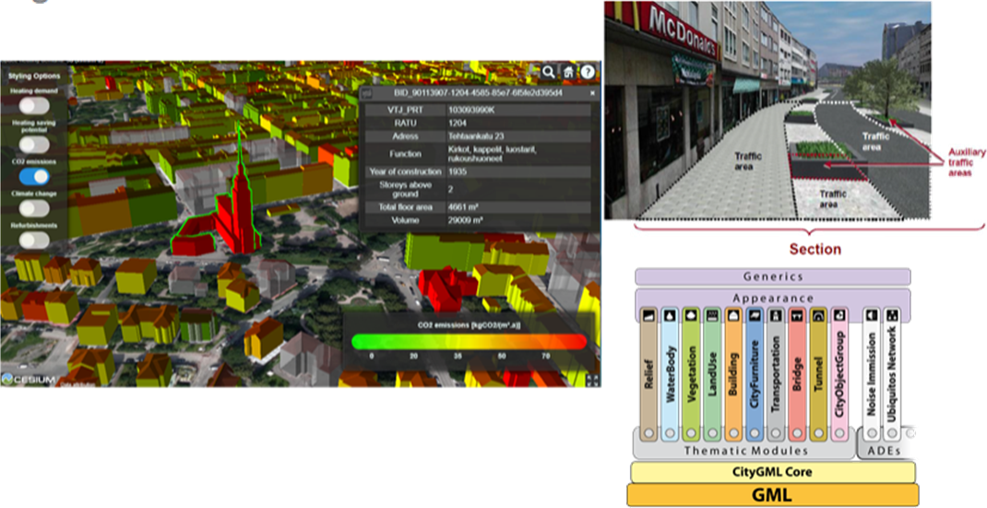
Digital Twin
Notes:
Detect the malicious information through its AI security mechanisms
Attack impact mitigation
Produce and publish systematic threat intelligence
Consumed by IRIS CTI for improving threat datasets
Offer this information to the different CERTS
Notify automatically stakeholders about ongoing attacks

