Slide 1
IRIS Platform Use:
Advanced threat reporting, sharing and incident response in a Smart City
ATOS | CLS, ICCS, CERTH, TUD, INOV, INTRA, UPC, CISCO
2nd SIW|31/05/2023

Slide 2



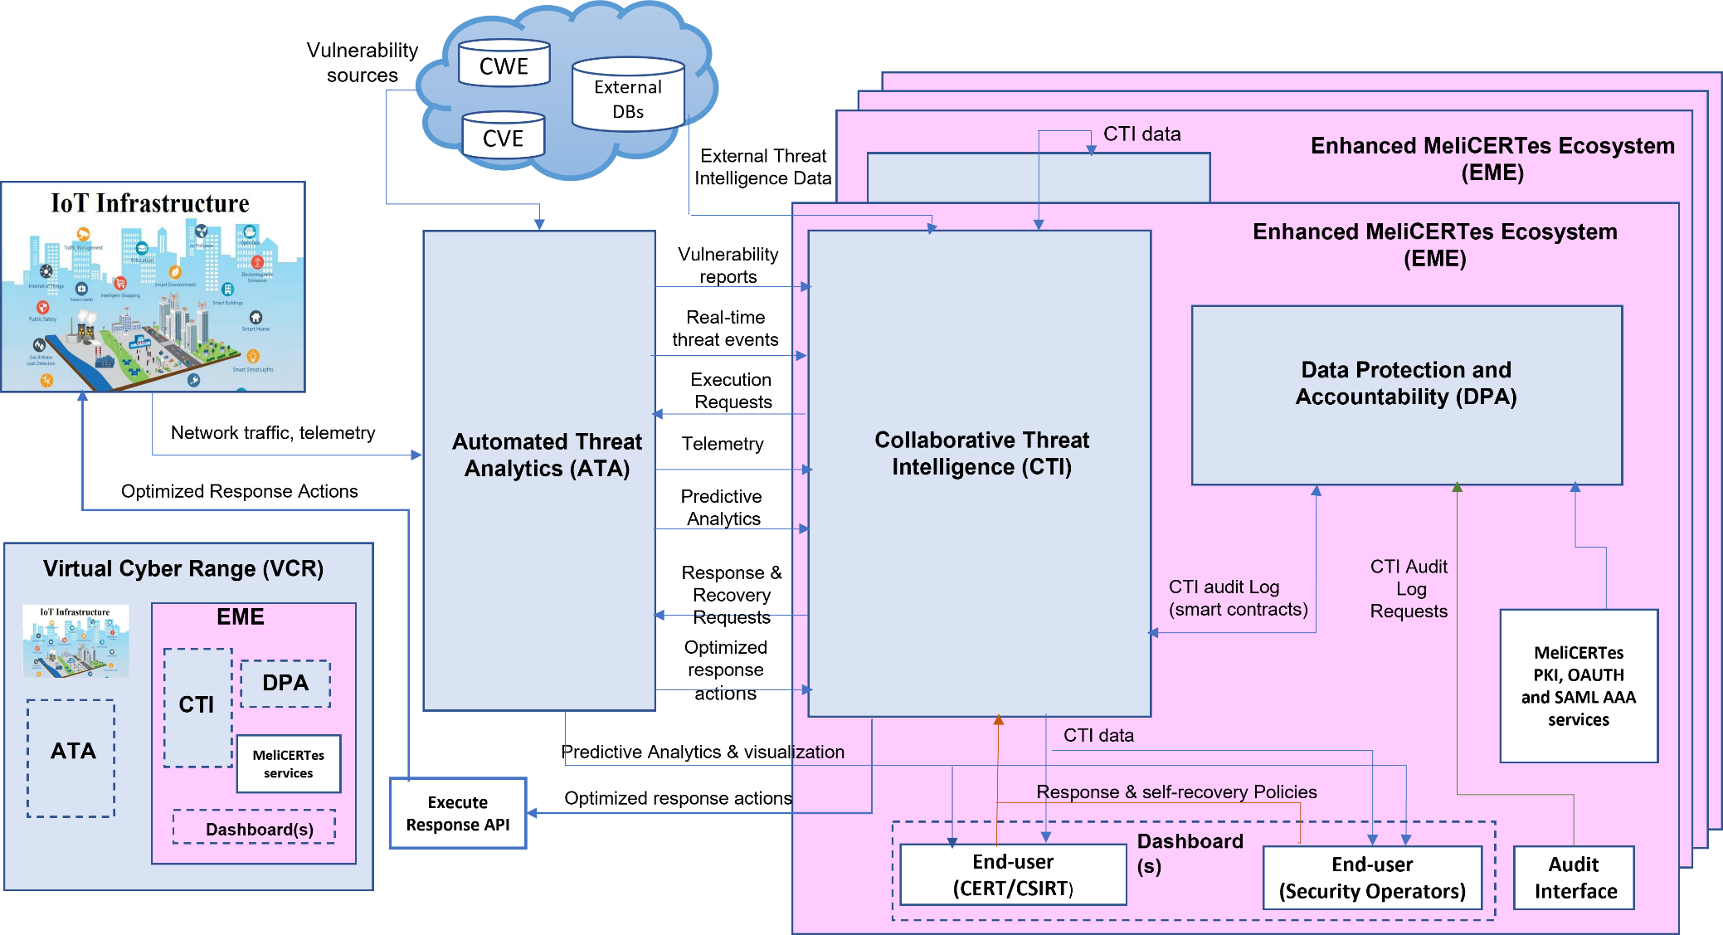





IRIS High Level Architecture
Threat
analytics
Validation
Privacy
Intelligence
Training
Collaboration
Notes:
IRIS platform has been conceived from the beginning as a federated threat intelligence architecture for automated threat analytics, detection, response and recovery. This architecture is based on three main pillars that will be integrated into the threat intelligence ecosystem.
Automated Threat Analytics (ATA) that extends existing intrusion detection tools with a novel threat detection engine for identifying specific IoT and AI attack vectors and includes digital twin honeypots for collecting attack telemetry against end-user systems reliant on these technologies.
IRIS Enhanced MeliCERTes ecosystem: The capabilities of the existing MeliCERTes platform will be enhanced with the CTI module that will be the core of the architecture, providing analytics orchestration and supervising coordination between the different components.
This module will make use of a Data Protection and Accountability (DPA) module, which will include distributed ledger technology, to provide the privacy and accountability framework for CERTs/CSIRTs and other stakeholders interacting with IoT and AI threat intelligence data through the enhanced MeliCERTes ecosystem.
Virtual Cyber Range for collaborative CERT/CSIRT training exercises based on real-world environment platforms, providing representative adversarial IoT & AI threat intelligence scenarios.

Slide 3
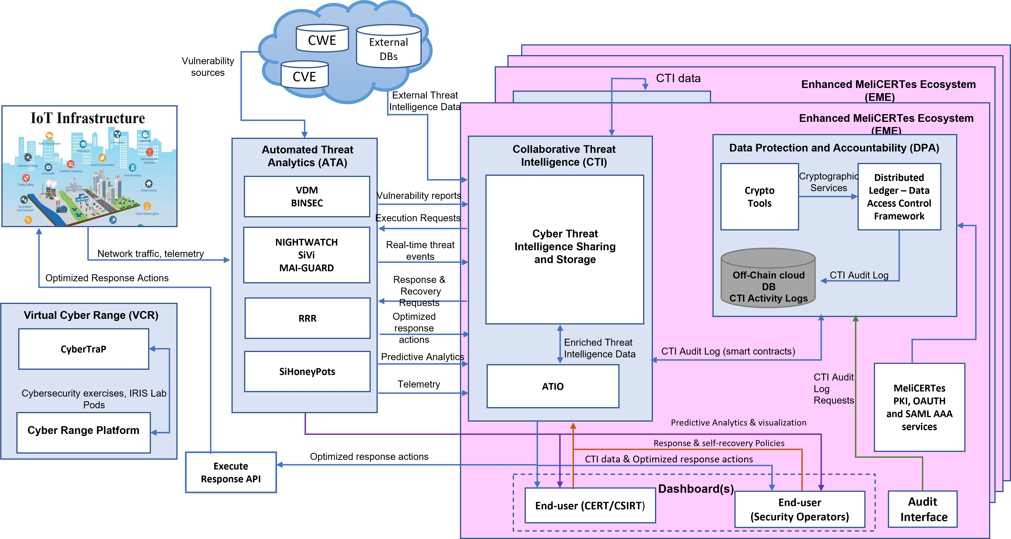
IRIS Architecture – Tool View

Slide 4
Demonstration Goals
  Showcase use of IRIS platform integrated in a Smart City (PUC1)
  Showcase ATA module capabilities:
    Vulnerability assessment
    Threat analytics and detection
    Risk-based response and self-recovery
  Showcase CTI module capabilities:
    Advanced Threat Intelligence orchestration
    Generation of taxonomies and ontologies
    Cyber Threat Intelligence sharing
  Showcase Enhanced MeliCERTes Ecosystem
Notes:
Showcase Data Protection and Accountability (DPA) module → later in the workshop

Slide 5
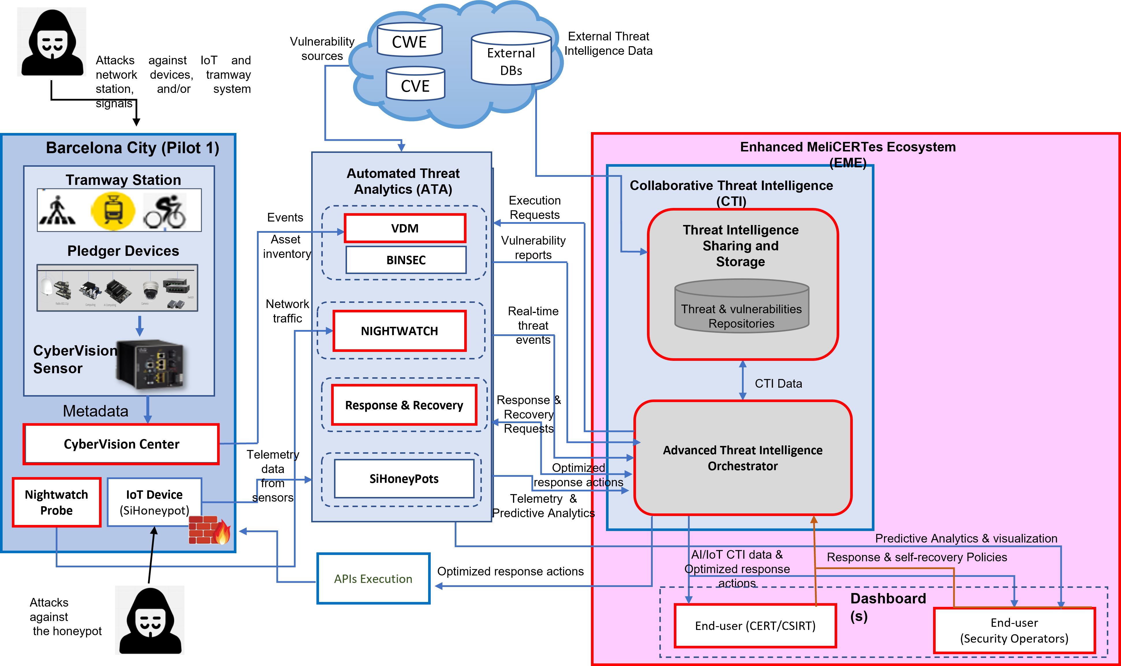
IRIS Tools Involved
Notes:
CyberVision – CISCO - Detection of new device in the infrastructure
VDM – ATOS - Provision of vulnerability report on new device in the infrastructure
Nightwatch- CLS - Provision and analysis of IoT network traffic for detection of real-time threat events
RRR – CLS - Provision of optimized response recommendation and actions
ATIO – ICCS - Orchestration of the incident response workflow
CTIM – CERTH - Cyber Threat Intelligence Sharing & Storage
EME - INTRA - Configuration of response policies and show response actions to end-users/CERTs

Slide 6
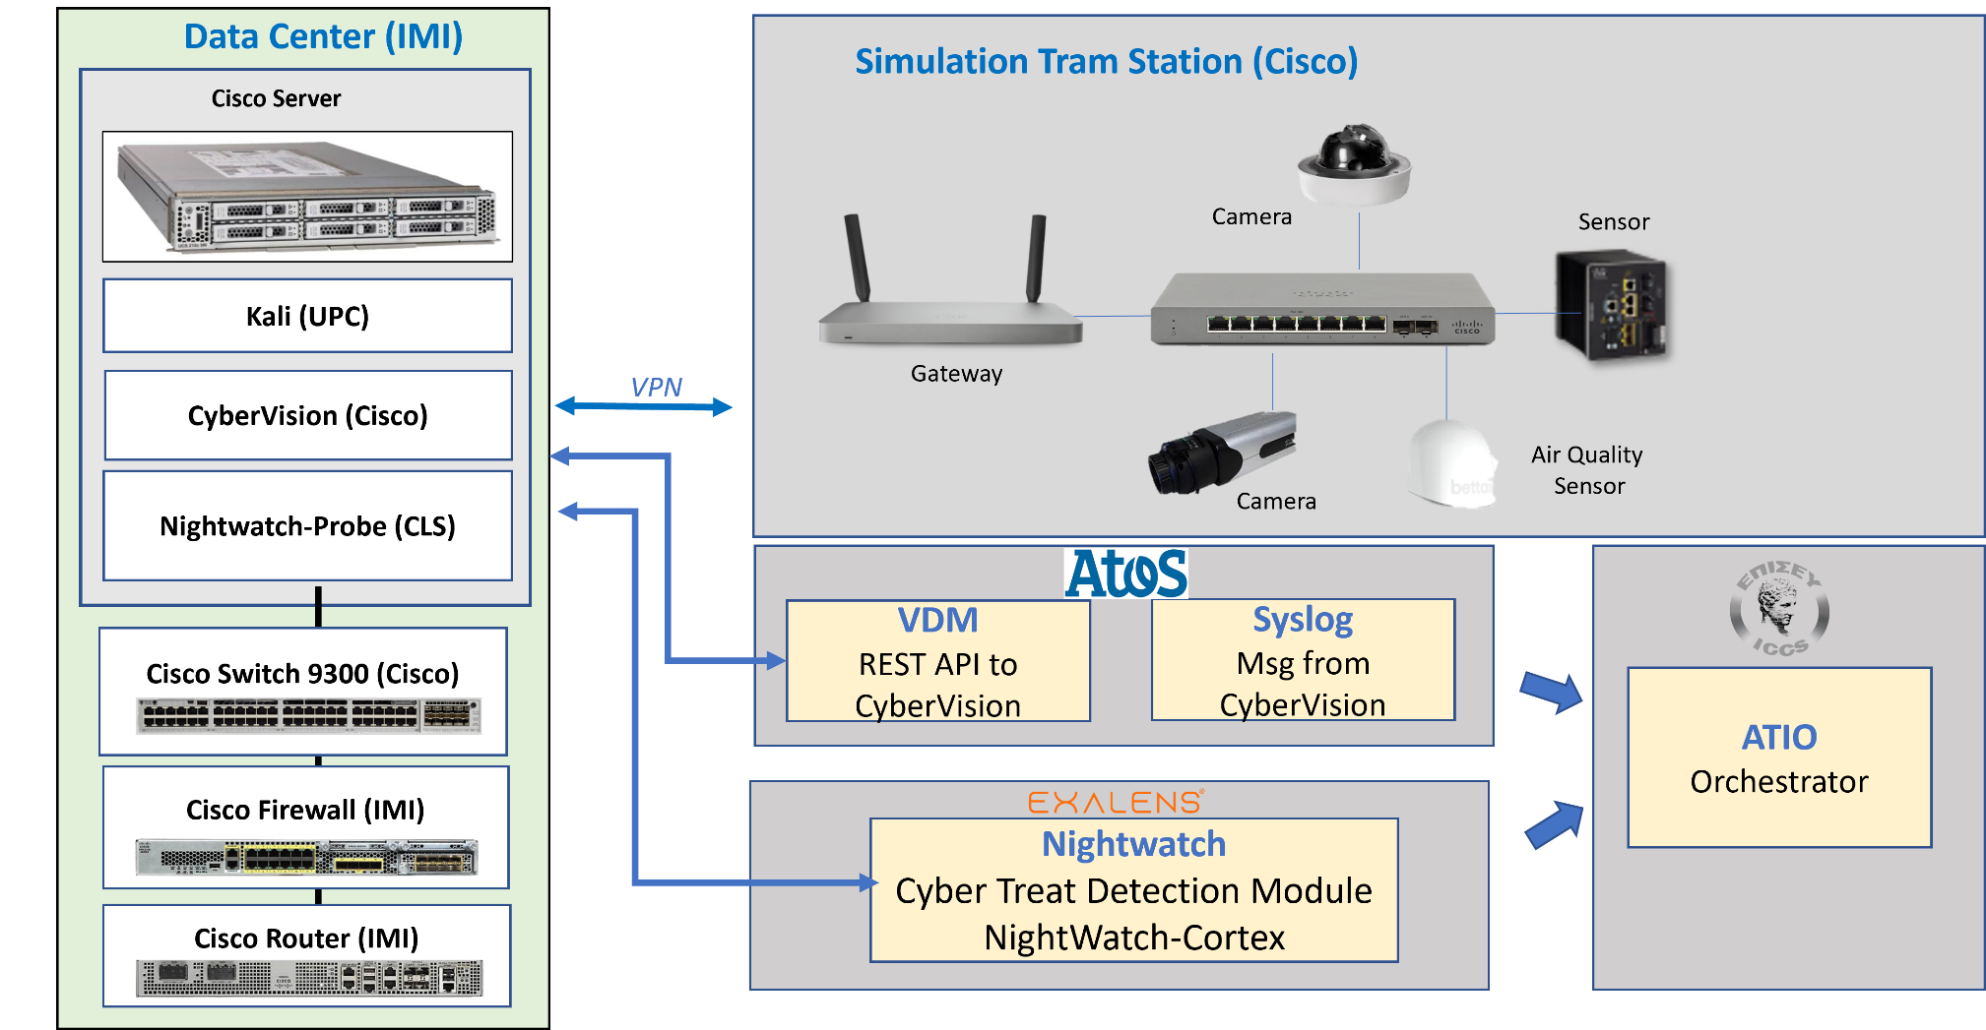
IRIS – PUC1 Demo Scenario

Slide 7



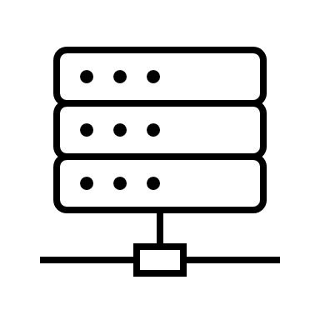
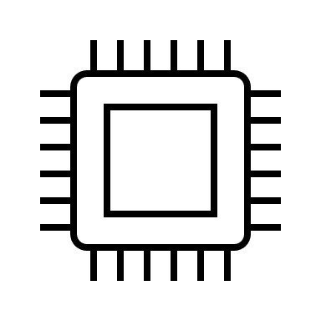




Demo: Starting Point
Malicious device is connected to the PUC1 infrastructure

Slide 8


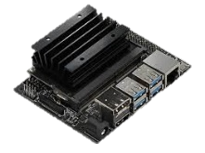



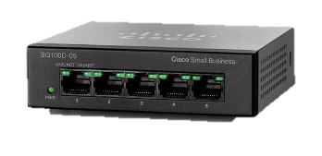
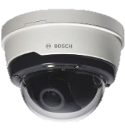

Demo: First Stage
CyberVision (Cisco)
Automated Threat Analytics (ATA)
Syslog
Vulnerability Discovery Manager (VDM)
CyberVision detects the new device and reports it to IRIS Platform
192.168.2.200

Slide 9

Demo: Report of Vulnerabilities
Automated Threat Analytics (ATA)
Collaborative Threat Intelligence (CTI)
Vulnerability Report
(JSON)
Vulnerability Discovery Manager (VDM)
Advanced Threat Intelligence Orchestrator (ATIO)
Scan
192.168.2.200
IRIS
Incident Response Workflow Started
VDM scans the new device and send the vulnerability report to CTI module

Slide 10
Demo: Second Stage
192.168.2.200
192.168.2.103
Nightwatch
Probe
Automated Threat Analytics (ATA)
Network Traffic
ICMP Network Flooding
Attack against Sensors
NightWatch
Cortex

Slide 11
Demo: Report of Threat Event
Automated Threat Analytics (ATA)
Collaborative Threat Intelligence (CTI)
Network Traffic
Real-time Threat Event
(JSON)
Nightwatch
Probe
Nightwatch
Cortex
Advanced Threat Intelligence Orchestrator (ATIO)
Detection of attack by Nightwatch and notification to CTI module
IRIS
Incident Response Workflow Started

Slide 12
IRIS’s Incident Response Schema (part 1)
Execute Response API
Incidents >>>
IRIS Risk-based Response & Self-Recovery
(RRR)
IRIS Orchestrator
(ATIO)
Risk Score
Normalisation
Response >>>
IoT infrastructure
Always display the detection telemetry
and the response actions
Events >>>
Policies >>>
Action
Vulnerability & Threat Detection Telemetry
(part of ATA module)
IRIS CI Operator Dashboard
(EME)
If policy necessitates, ask for approval
If policy allows, automate response
Notes:
12

Slide 13
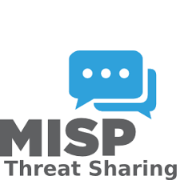


IRIS’s Incident Response Schema (part 2)
Threat Intelligence Sharing & Storage
(CTIM)
IRIS CI Operator EME Core
(EME)
Enriched
CTI Data >>>
IRIS CI Operator Dashboard
(EME)
IRIS Orchestrator
(ATIO)
Events >>>
CTI Audit Logs>>>
IoT infrastructure
Data Protection and Accountability
(DPA)
Vulnerability & Threat Detection Telemetry
(part of ATA module)
Notes:
DPA - Support accountability, auditing and traceability for the purpose of the ATIO
13

Slide 14
IRIS’s CTI Incident Sharing and collaboration
Threat Intelligence Sharing & Storage
(CTIM)
IRIS CI Operator EME Core
(EME)
IRIS Orchestrator
(ATIO)
CTI Data >>>
IRIS CI Operator EME Core
(EME)
IRIS CI Operator EME Core
(EME)
IRIS CI Operator EME Core
(EME)
IRIS CI Operator EME Core
(EME)
IRIS CERT Operator EME Core
(EME)
IRIS CSIRT Operator EME Core
(EME)
IRIS Enhanced MeliCERTes Ecosystem follows a distributed architecture schema
IRIS detected CTI Data are shared among the IRIS stakeholders
  CI Operators
  CERTs/CSIRTs cybersecurity authorities
    Regional
    National
    Pan-European level
Notes:
14

Slide 15
IRIS’s CTI Incident Sharing and collaboration
Threat Intelligence Sharing & Storage
(CTIM)
IRIS CI Operator EME Core
(EME)
IRIS Orchestrator
(ATIO)
CTI Data >>>
IRIS CI Operator EME Core
(EME)
IRIS CI Operator EME Core
(EME)
IRIS CI Operator EME Core
(EME)
IRIS CI Operator EME Core
(EME)
IRIS CERT Operator EME Core
(EME)
IRIS CSIRT Operator EME Core
(EME)
IRIS Enhanced MeliCERTes Ecosystem enables Online communities’ interaction
  Collaboration and Coordination in a trusted manner
  IRIS EME communication orchestration is driven by Cerebrate OS platform developed in the framework of MeliCERTes v2.0
    Distributed synchronization model
IRIS detected CTI Data are shared within defined Sharing Groups
  Following the notion of Trusted Circles (TC) introduced in MeliCERTes CSP
  supports the IRIS users and organizations definitions offering a visual environment for managing IRIS roles and entities
Notes:
15

Slide 16
Video Demo
Notes:
16

Slide 17
Thank you for your attention!

