Slide 1

IRIS-enhanced MeliCERTes Ecosystem
RISE-SD| 30th May 2023
Netcompany – Intrasoft
Dimitrios Skias, M.Sc, dimitrios.skias@netcompany-intrasoft.com
Dr. Sofia Tsekeridou, sofia.tsekeridou@netcompany-Intrasoft.com

Slide 2
IRIS-enhanced MeliCERTes Ecosystem
Key objectives: Extend MeliCERTes v2 open-source platform incorporating IRIS CTI developments to enable:
Secure and efficient security information representation in standardized format
Secure disclosable AI-relevant CTI information sharing
  Promote wider awareness, better preparation, detection and response capabilities
  Define sharing policies and communities of trust
  Securely communicate and collaborate with CERT/CSIRT authorities

Slide 3
IRIS-enhanced MeliCERTes Ecosystem
Secure storage and augmentation of the AI focused cybersecurity knowledge base at a European level
Provision of advanced and unified dashboard for incident reporting & situational awareness
Offering Authentication and Authorization AAA services
  OATH2, SAML, PKI etc.
  CTI log auditing (via DPA)
Distributed architecture – ecosystem
  Instances deployed at stakeholders’ premises

Slide 4
IRIS-EME modules overview
EME Unified Dashboard (UI) & SIEM
  In house developed web application acting as the main visual interface (UI) of the EME ecosystem.
  Integrates all the IRIS provided visual environments, safeguarding the coherence of the IRIS platform towards its users.
    Customized views and incident reporting capabilities
      CI Operator view
      CERT/CSIRT cybersecurity operator view
    Access control and access rights to shared data based on
      The type of user/operator
      The type of service/infrastructure they provide
      The sensitivity of the information to be shared / communicated
    CTI overview
    CTI response (mitigation) actions and associated workflows
    Automated response actions policy management
Cerebrate
  open source platform meant to act as a trusted contact information provider and interconnection orchestrator.

Slide 5
IRIS-EME modules overview
KEYCLOAK
  open source software product to allow single sign-on with Identity and Access Management (IAM) aimed at modern applications and services
  EME builds its AAA offered services through KEYCLOAK ensuring that the right people in a company have appropriate access to resources.
MISP
  open source threat intelligence platform providing effective threat intelligence, by sharing indicators of compromise.
    collect enriched IRIS generated CTI data such as threats, attacks and vulnerabilities that are targeted to IoT and AI-driven ICT systems.
INTELMQ
  Open source technical solution for IT security teams (CERTs/CSIRTs/SOCs) for collecting and processing security feeds using a message queuing protocol.

Slide 6
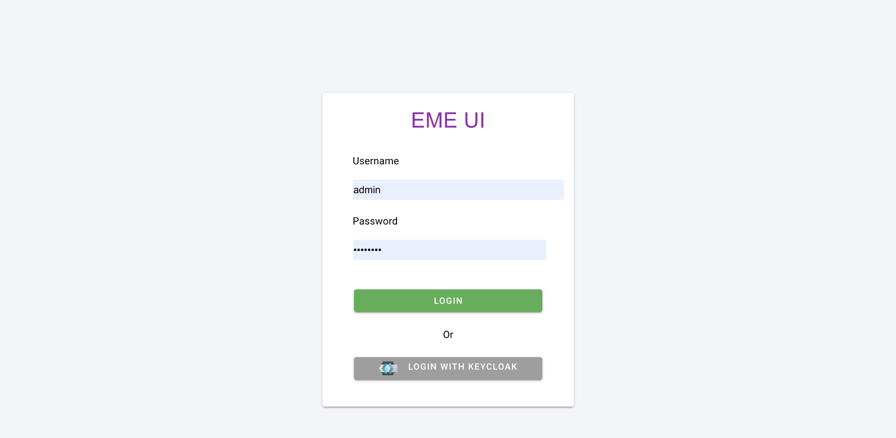
EME – IRIS user Authentication

Slide 7
IRIS-EME Cerebrate
Cerebrate is an open-source platform developed in the framework of MeliCERTes v2.0
  Acts as a trusted contact information provider and interconnection orchestrator for other security tools
Features
  Advanced repository to manage individuals and organisations
    Management of individuals and their affiliations to each organisation
    Sharing groups as Trusted Circle
    Dynamic model for creating new organisational structures (FIRST.org, EU CSIRTs)
  Distributed synchronisation model
  Key store for public encryption and signing cryptographic keys

Slide 8
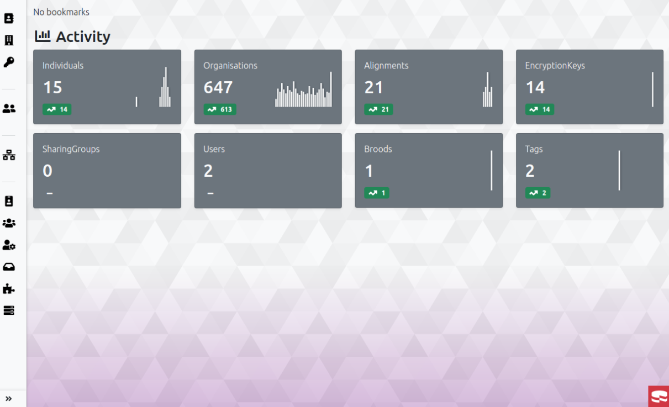
MeliCERTes v2 – Cerebrate

Slide 9
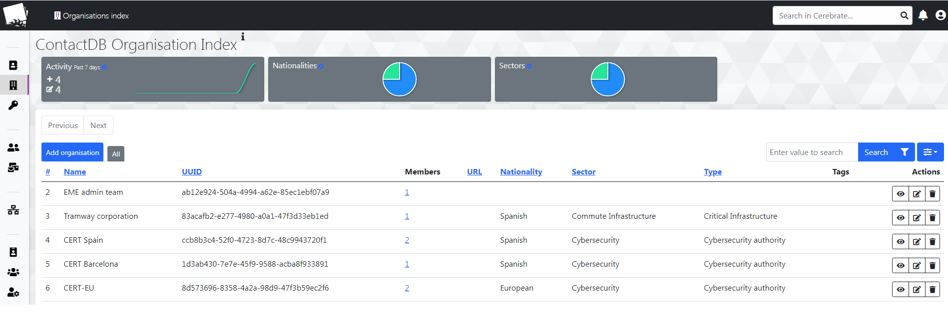
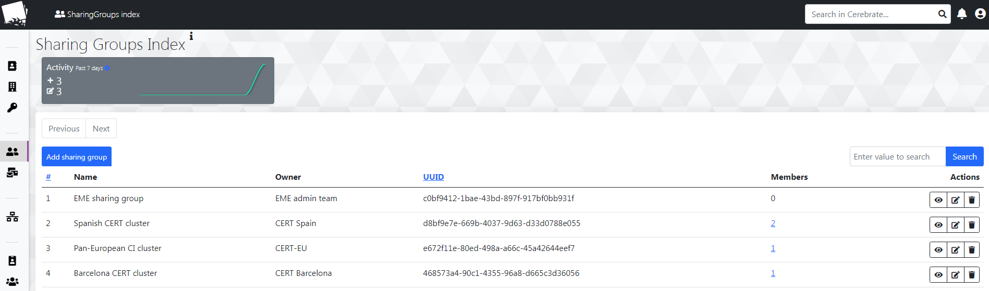
MeliCERTes v2 – Cerebrate

Slide 10
EME – Unified Dashboard & SIEM
AI/IoT CTI event overview, management, response.
Distinct views for the CI operator and the CERT/CSIRT authority operator
  Aggregated and Detailed view of the detected events
CTI orchestration information
  Presenting CTI mitigation/response actions
    Including automated response policy
  CTI response workflows design
  Collecting IRIS users’ feedback enabling effective cooperation and collaboration
    Capitalizing on standardized CTI tools
IRIS generated AI/IoT CTI relevant information structured in a standardized format.

Slide 11
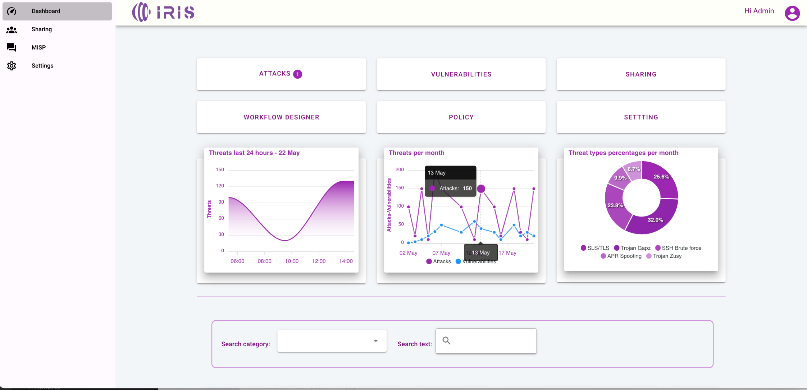
EME – CI operator view

Slide 12
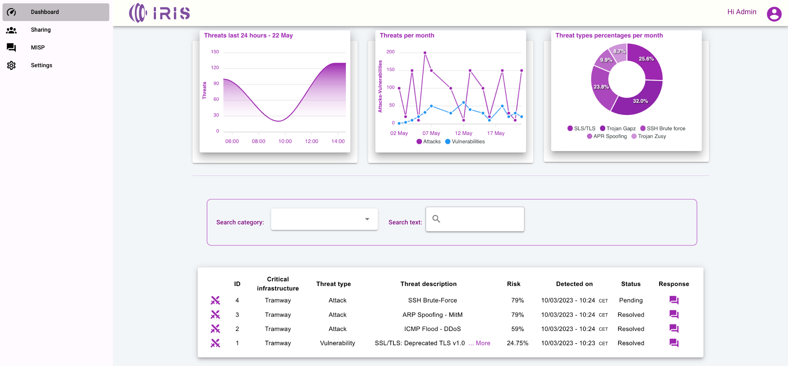
EME – CI operator view

Slide 13
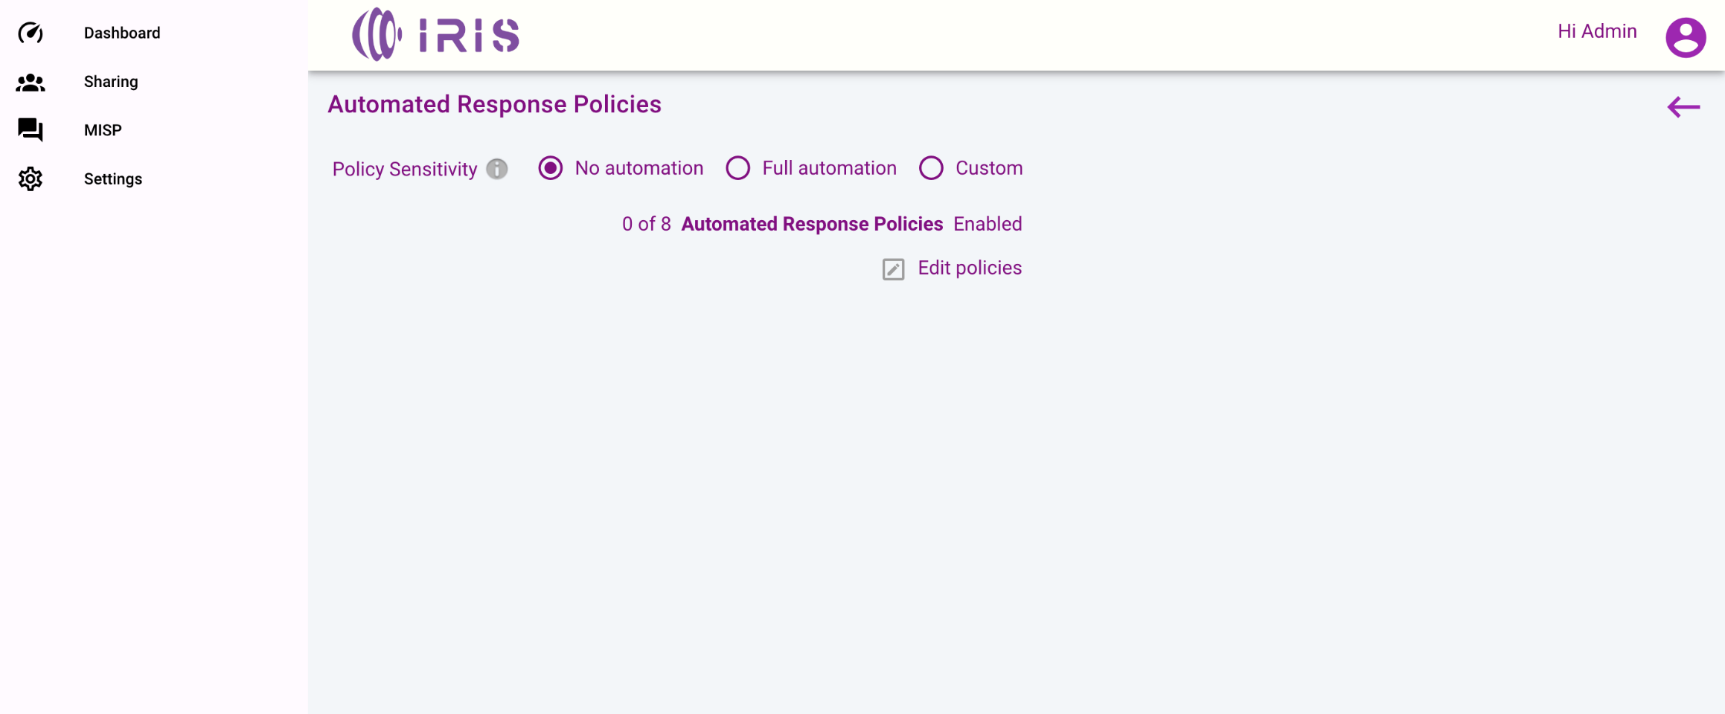
EME – Automated response Policy management

Slide 14
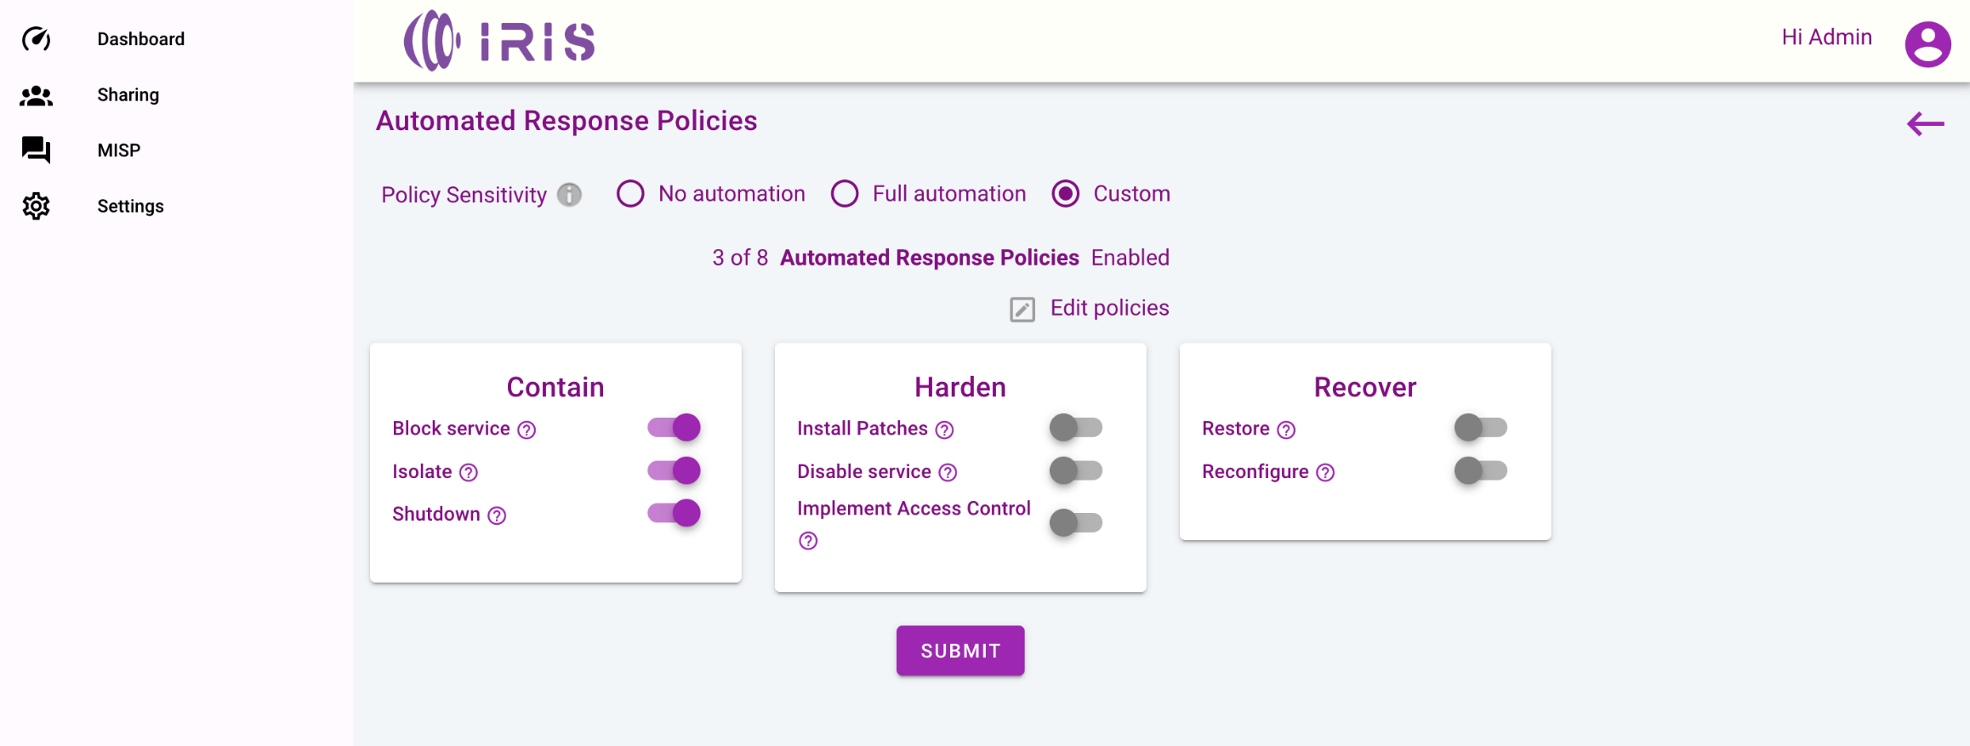
EME – Automated response Policy management

Slide 15
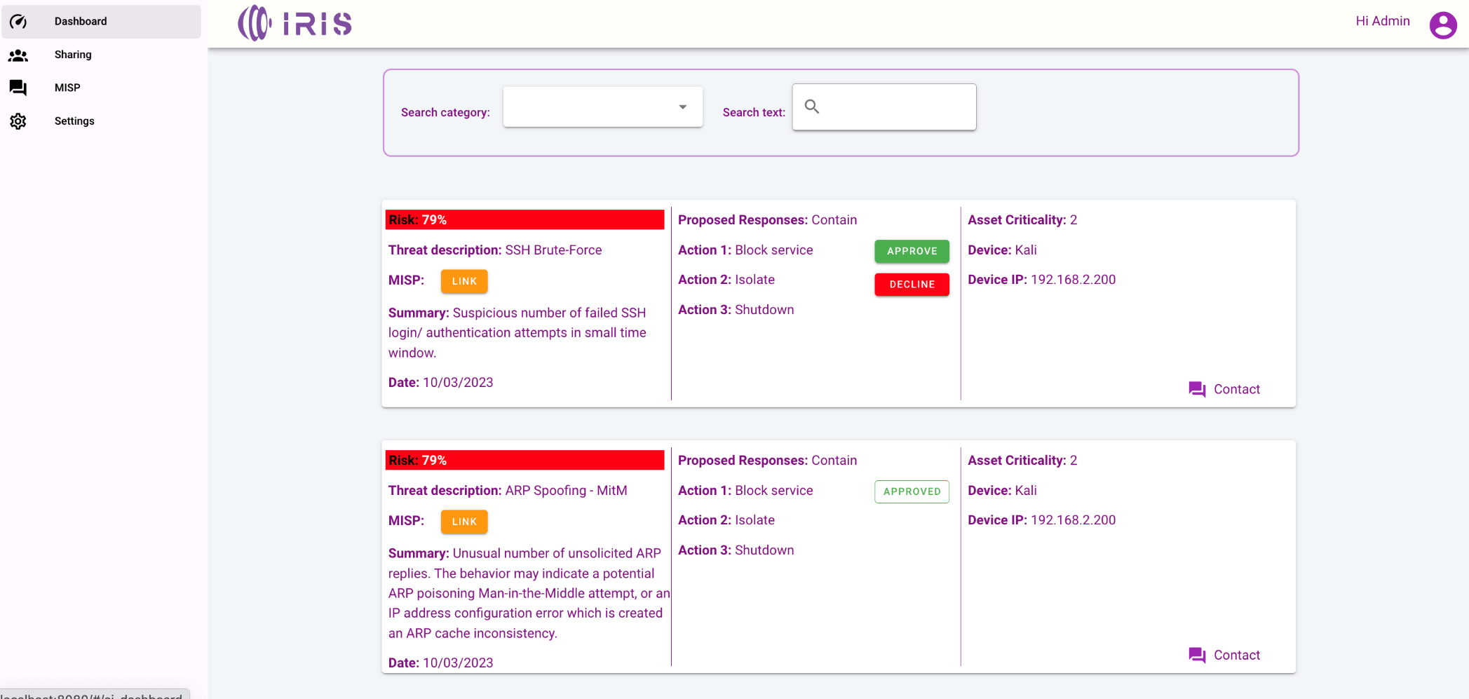
EME – CI Operator Attacks view

Slide 16
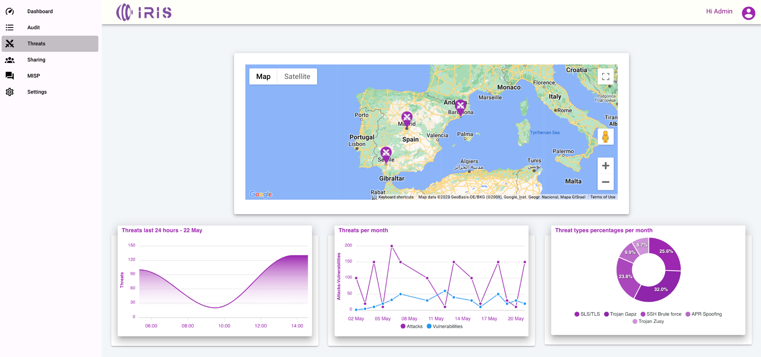
EME – CERT/CSIRT authority view

Slide 17
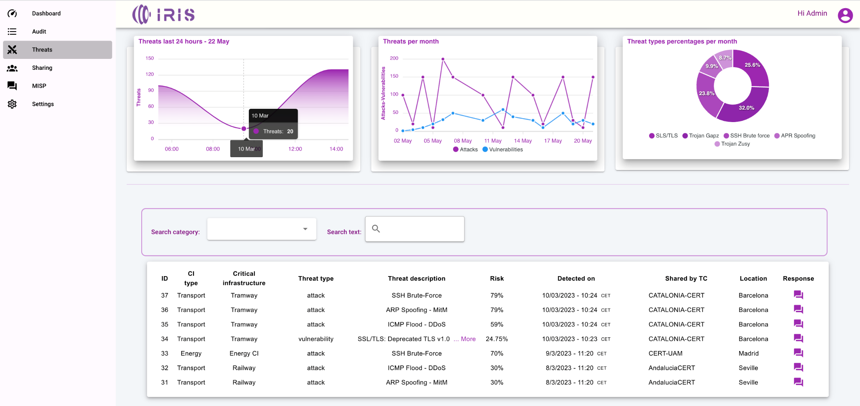
EME – CERT/CSIRT authority view

Slide 18
ATIOs Workflow Designer
Workflow Designer - Shuffle
  Graphical environment (based on SHUFFLE open source tool)
  Allows the creation of multiple scenario workflows.
    the definition of various incident response scenarios is the digitized form of the associated runbooks/playbooks that are executed.

Slide 19
Workflow Designer Functionalities
Integration of multiple tools and interfaces into one consolidated workflow.
Creation of workflows (playbooks) customized on users needs.
Bundle of workflows based on attack types.
Automated execution processes.
Usage of cyber security predefined workflows (playbooks).
Monitoring in real time processes status.

Slide 20
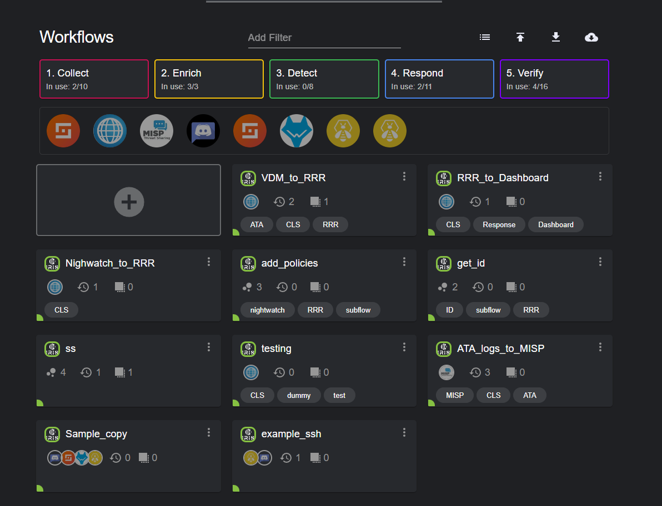
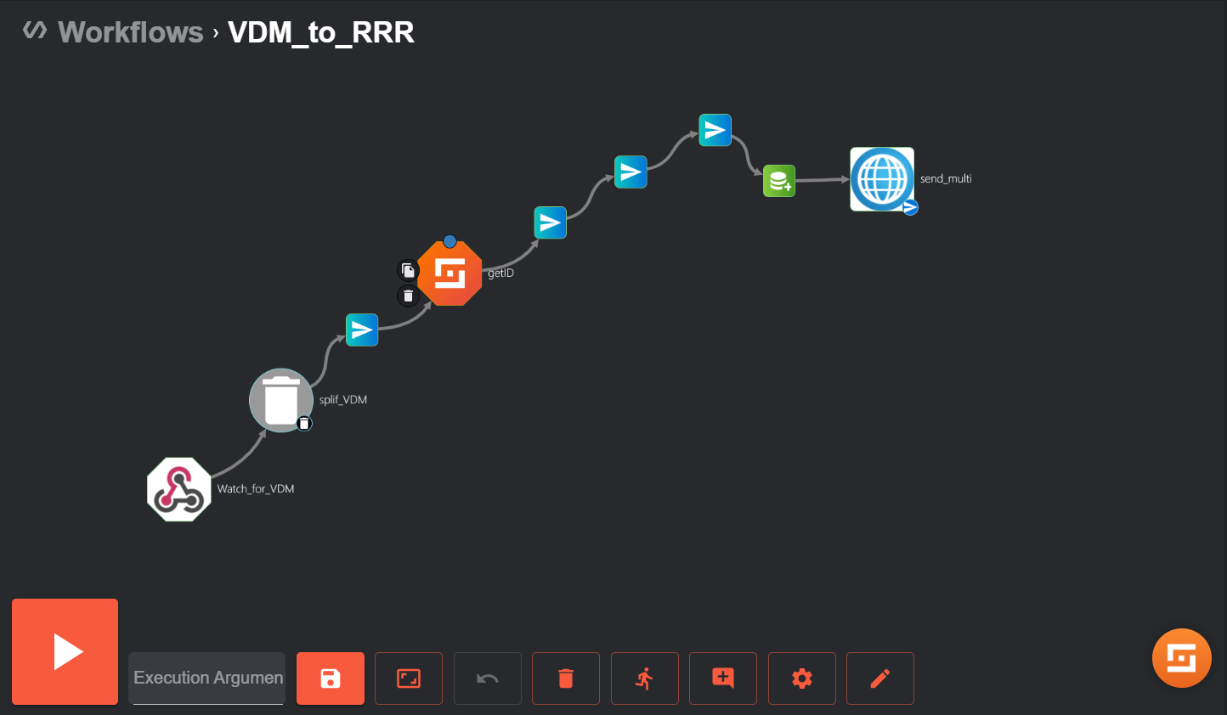
Advanced Threat Intelligence Orchestrator (ATIO)- Workflow Designer
Panel grid visualized on SHUFFLE
Page of an indicative workflow in SHUFFLE

Slide 21
IRIS-EME Discussion Questions
Current CERTs/CSIRTs and CI collaboration and coordination activities
  How is the communication achieved? What tools (e.g. secure communications) are used to report incidents, exchange information such as best practices or guidance on response actions?
  What type of information is communicated? Data model defined? STIX formatted?
    What are the governance rules for sharing information? What information is shared? Which users/roles have access to what type of information?
    Is some part of this information considered confidential to be communicated to CERTs/CSIRTs?
    From CERTs/CSIRTs to CI security operators
    From CI security operators to CERTs/CSIRTs
  What is the current contact information repository? For Critical Infrastructures and CERTs/CSIRTs (regional, national, pan-European level)
    Are there Trusted Circles (TC) or Sharing Groups defined? Is MeliCERTes used in practice? If yes, which? 1 or 2? And for what purpose?
What type of additional tools and corresponding functionality is missing from the IRIS EME?
  Comments on the current EME UI design? What types of aggregate information visualization would be further needed? Any other types of interaction that are currently not considered?

Slide 22

Thank you! Questions?
Dimitrios Skias, M.Sc, dimitrios.skias@netcompany-intrasoft.com
Dr. Sofia Tsekeridou, sofia.tsekeridou@netcompany-Intrasoft.com
RISE-SD| 30 May 2023

Slide 23
Back-up slides
RISE-SD| 30 May 2023

Slide 24
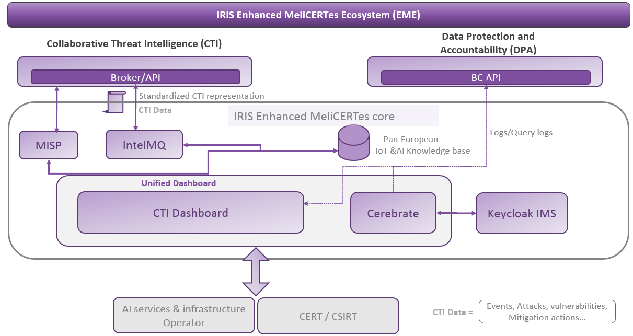
IRIS-EME architecture

