Slide 1
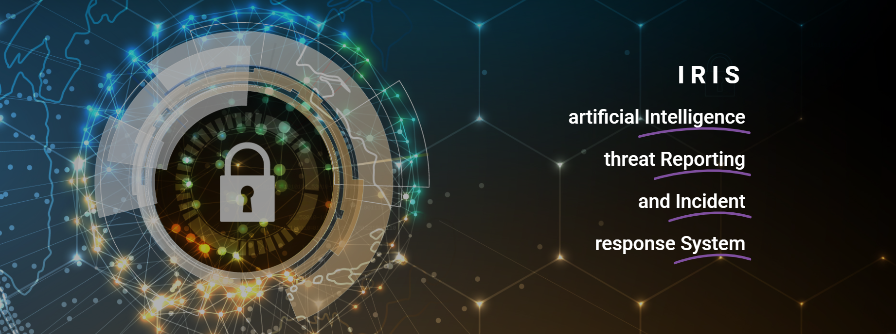

Slide 2

IRIS
A collaborative CERT/CSIRT platform to combat cyber-threats in IoT and AI-driven systems
João Rodrigues (INOV)
21/03/2024

Slide 3
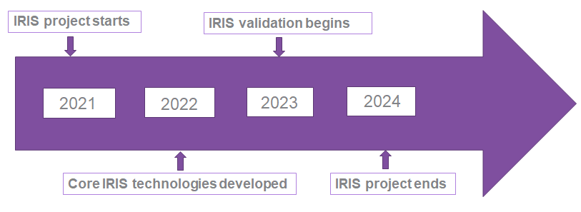
Project at a Glance
Call Identifier: 2020-SU-DS-2020
Topic: SU-DS02-2020 Intelligent security and privacy management
EC Funding: 4 918 790.00 EUR
Duration: 36 months (Sept 2021-Aug 2024)
Consortium: 19 partners
Coordinator: INOV - Instituto de Engenharia de Sistemas e Computadores, Inovacão, (INOV), Portugal
Learn More: www. iris-h2020.eu
Join us: @iris-h2020
IRIS H2020 Project
6 Public organizations
3 SMEs
4 Large ICT industries
6 Research institutions & Universities
Consortium

Slide 4
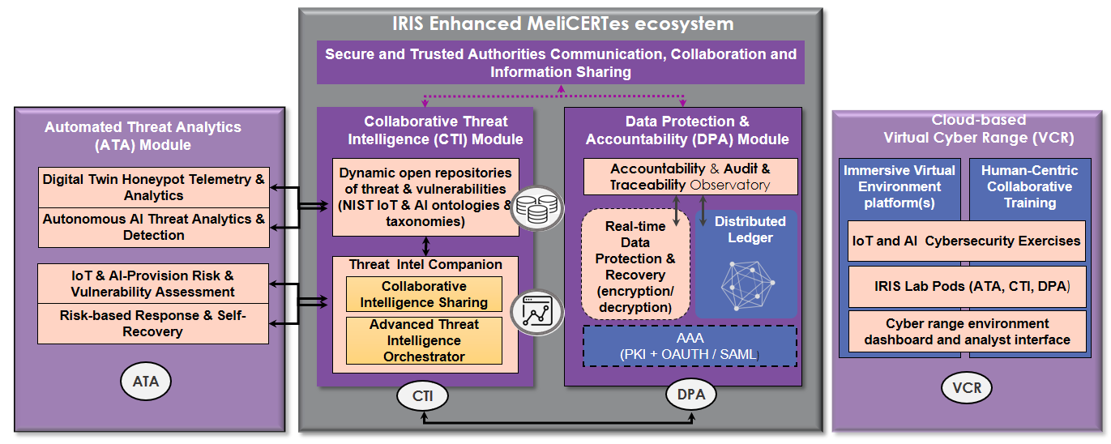

IRIS Project - Overview
Motivation
IRIS Vision
As existing and emerging SMART CITIES continue to expand their IoT and AI-enabled systems, novel and complex threats are introduced.
Aims to deliver a framework that will support European Incident Response Teams detecting, sharing, responding and recovering from cybersecurity threats and vulnerabilities of IoT and AI-driven ICT systems, in order to minimize the impact of cybersecurity and privacy risks.
Architecture and behaviour of emerging IoT and AI technologies are not currently well understood by security practitioners.
IRIS Platform
Project Output
ATA Module
Organize knowledge
IoT devices
AI technology
Cybersecurity measures
The IRIS Platform will be made available, free of charge, to the European national CERT and CSIRTs, by the end of the project.
CERT – Computer Emergency Response Team
CSIRT – Computer Security Incident Response Team
IRIS Enhanced MeliCERTes
Disseminate intelligence
Enable cooperation among incident response teams
VCR Module
Training environment for
Cybersecurity professionals
Incident Response Teams

Slide 5
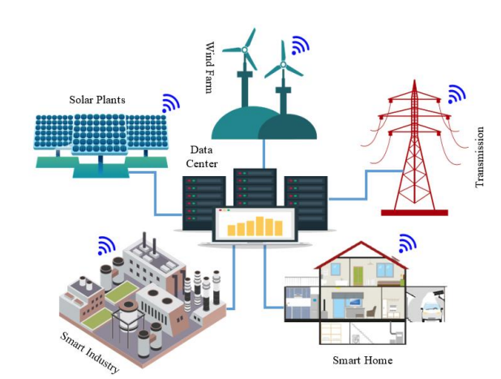
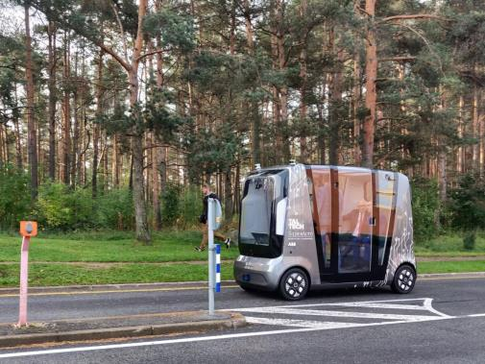
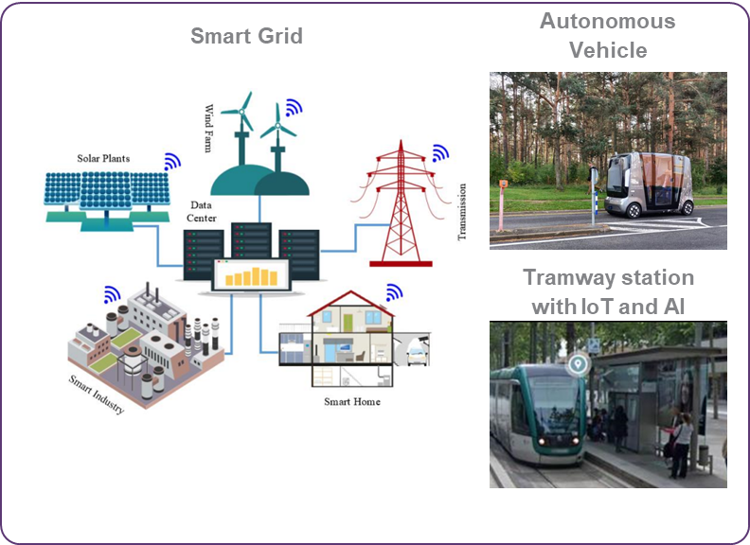
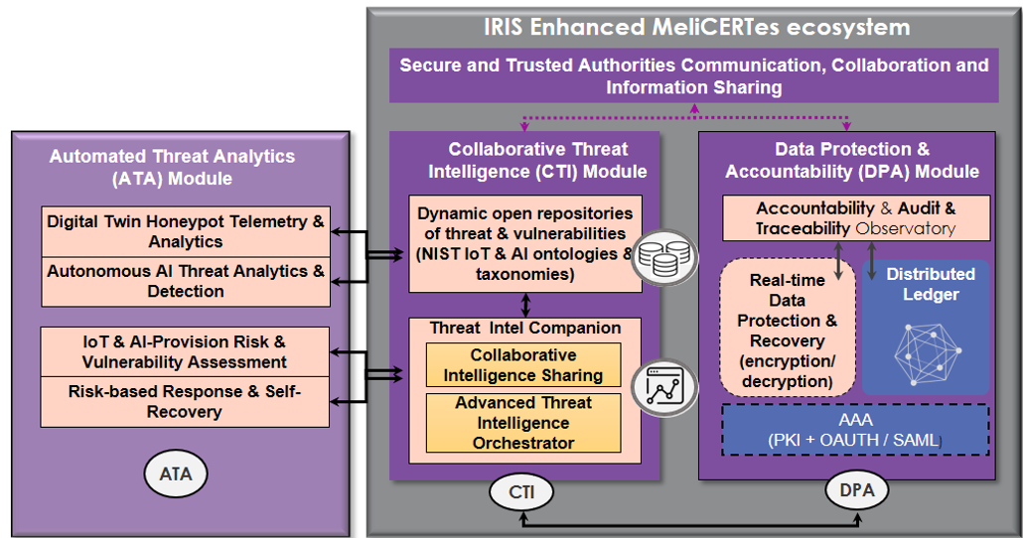
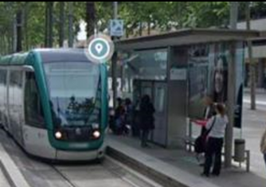
What is Virtual Cyber Range (VCR)
Smart Cities
Virtual Cyber Range
Smart Grid
Autonomous Vehicle
CERT – Computer Emergency Response Team
CSIRT – Computer Security Incident Response Team
Cybersecurity professionals
Enhance the capabilities (knowledge, toolset, training) for incident management of IoT & AI attack vectors
Smart City Simulation
IRIS Platform
Tramway station with IoT and AI
Simulate smart city
Introduce training / attack scenarios
Simulate IRIS platform
Operators of Critical Infrastructure (CI)
Essential Entities/Services
Municipatilies
Learn
How to operate
Who/what/when to communicate
Smart grid image source: Saleem, Muhammad Usman & Usman, Muhammad Rehan & Shakir, Mustafa. (2021). Design, Implementation, and Deployment of an IoT Based Smart Energy Management System. IEEE Access. PP. 1-1. 10.1109/ACCESS.2021.3070960.

Slide 6
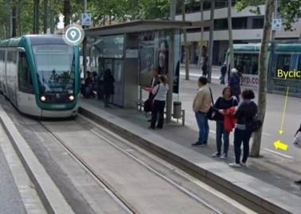
Key takeaways
Smart Cities => novel, cutting edge AI/IoT-driven technology
This implies Emerging Threats ! High risks!
Currently, lack of experience as well as of tools for incident management that tackle IoT & AI attack vectors
IRIS will enhance the capabilities (knowledge, toolset, training) of CERTs/CSIRTs, to address these challenges.
Smart grid image source: Saleem, Muhammad Usman & Usman, Muhammad Rehan & Shakir, Mustafa. (2021). Design, Implementation, and Deployment of an IoT Based Smart Energy Management System. IEEE Access. PP. 1-1. 10.1109/ACCESS.2021.3070960.

Slide 7
IRIS Objectives
To identify the user, technical and business requirements and design the architecture of an AI threat reporting and incident response system
To analyze the relevant ethics principles and legal framework on privacy concerns
To develop a collaborative platform for ICT stakeholders and European CERTs/CSIRTs for the successful operation of IoT and AI-enabled ICT systems
To demonstrate and validate the integrated IRIS platform across three realistic pilot demonstrators in three smart cities
To ensure wide communication and scientific dissemination of the IRIS results, efficient exploitation and contribution to relevant standardization bodies

Slide 8
What to expect from this Pilot
Knowledge of advanced tools to address IoT and AI threats, in Smart Cities.
YOUR FEEDBACK MATTERS !
  What are your drivers, needs, and pain points?
  Are there social acceptance benefits or issues?
Join the Stakeholder Community, and influence the IRIS roadmap.

Slide 9
Agenda

Slide 10
Thank you for your attention!
João Rodrigues (INOV)

Slide 11
Helsinki PUC3 Demo: 1st Round of pilots
Effective incident response and threat intelligence collaboration for critical cross-border smart grid threats
FVH – Nikita Akmaikin
PUC3 Demo Meeting | 21/03/2024

Slide 12

PUC #3 Overview
Effective incident response and threat intelligence collaboration for critical cross-border smart grid threats

Slide 13
PUC #3 Description
In this pilot the aim is (a) to evaluate the capabilities of IRIS in mitigating cyber threats that target energy smart grids; and (b) assess the cyber range capabilities of IRIS to help train and exercise coordinated mitigation and prevention of threats.
1. PUC3 Aim
Exercises between CERT/CSIRT and energy stakeholders.
Simulate / evaluate / train via cyber threats and cybersecurity measures in the context of energy infrastructure. (VCR)
Enhance the security of smart grids by detecting behavioral anomalies
Share threat intelligence
2. PUC3 Benefits
  Enhanced Smart Grid Security
  Hands-On Incident Response Training

Slide 14
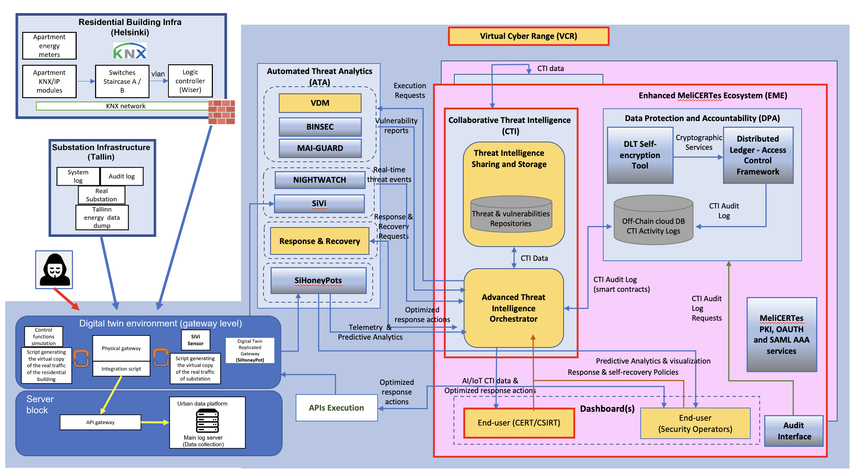
PUC #3 and IRIS platform Architecture

Slide 15
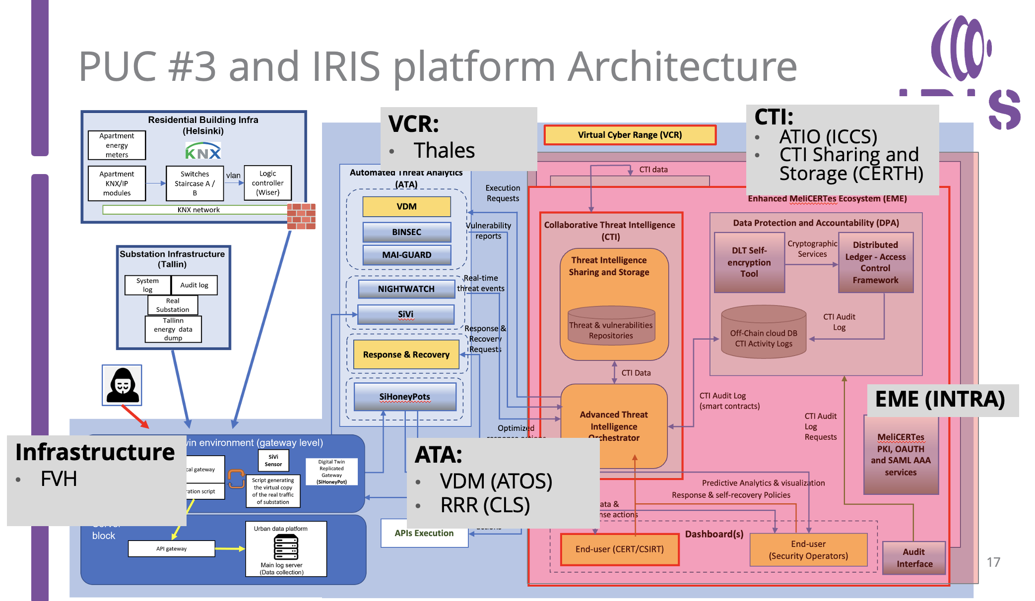

Slide 16
PUC #3 and IRIS platform Architecture
VCR:
Thales
CTI:
ATIO (ICCS)
CTI Sharing and Storage (CERTH)
EME (INTRA)
Infrastructure
FVH
ATA:
VDM (ATOS)
RRR (CLS)

Slide 17
IRIS PUC 3 – User Story

Slide 18


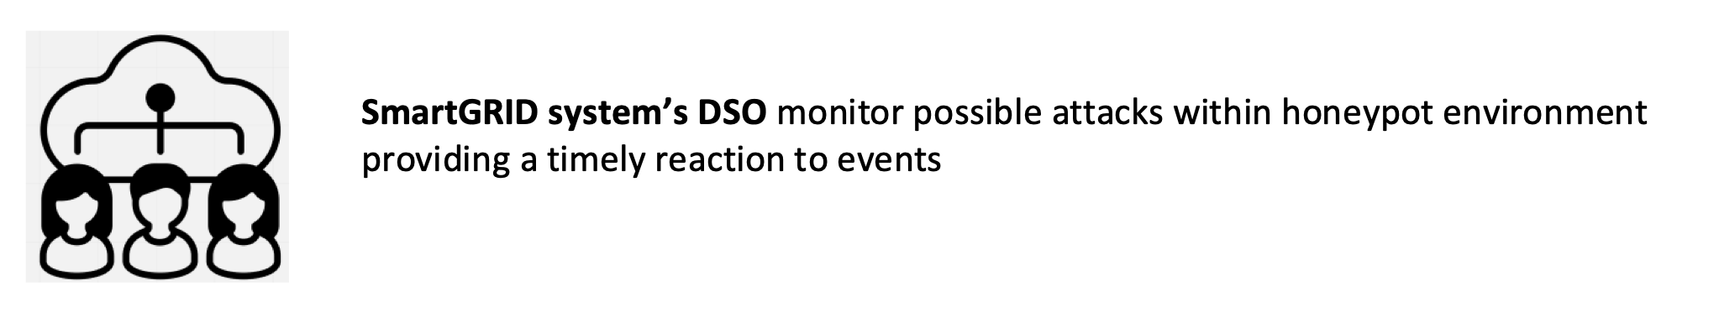
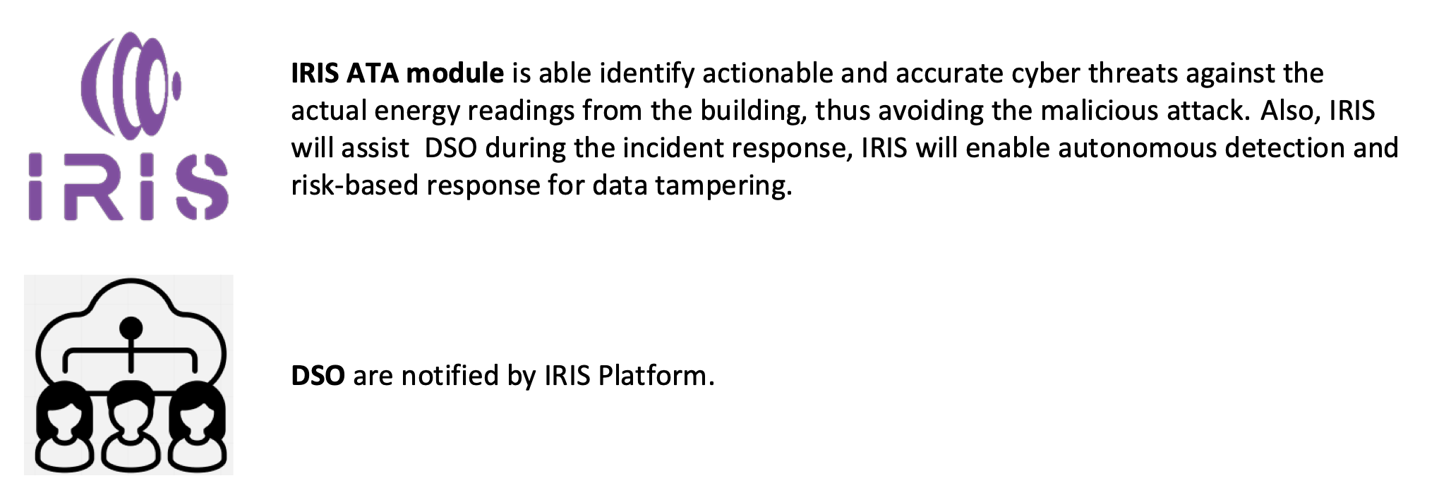
User story
Threat actor aims to gain the unauthorized access to the Helsinki Smart Grid environment. Exploiting vulnerabilities such as weak Unix system passwords and SSH protocol weaknesses, the attacker uses brute-force tactics to infiltrate the system.
SmartGRID’s DSO keeps track of the infrastructure operational environment.
IRIS VCR extension will provide an environment for collaborative CERTs/CSIRTs training exercises based on real-world environment platforms. The Cyber Range (VCR) emulates the data transmission and receiving of smart grid data including cross-border data exchange.
VDM (Vulnerability Detection and Management): Scans customer-facing components for vulnerabilities, analyzes detected vulnerabilities, and generates a vulnerability report. VDM is capable of detecting the SSH protocol weaknesses. The IRIS tools may also identify additional vulnerabilities during the scanning process, providing further insights into potential security weaknesses within the Helsinki Smart Grid environment.
ATIO (Automated Threat Intelligence Orchestration): Stores and enriches the vulnerability report, and shares it across the IRIS platform.
Building residents. The manipulation of smart grid data could negatively impact the reliability and affordability of energy services for building residents.

Slide 19
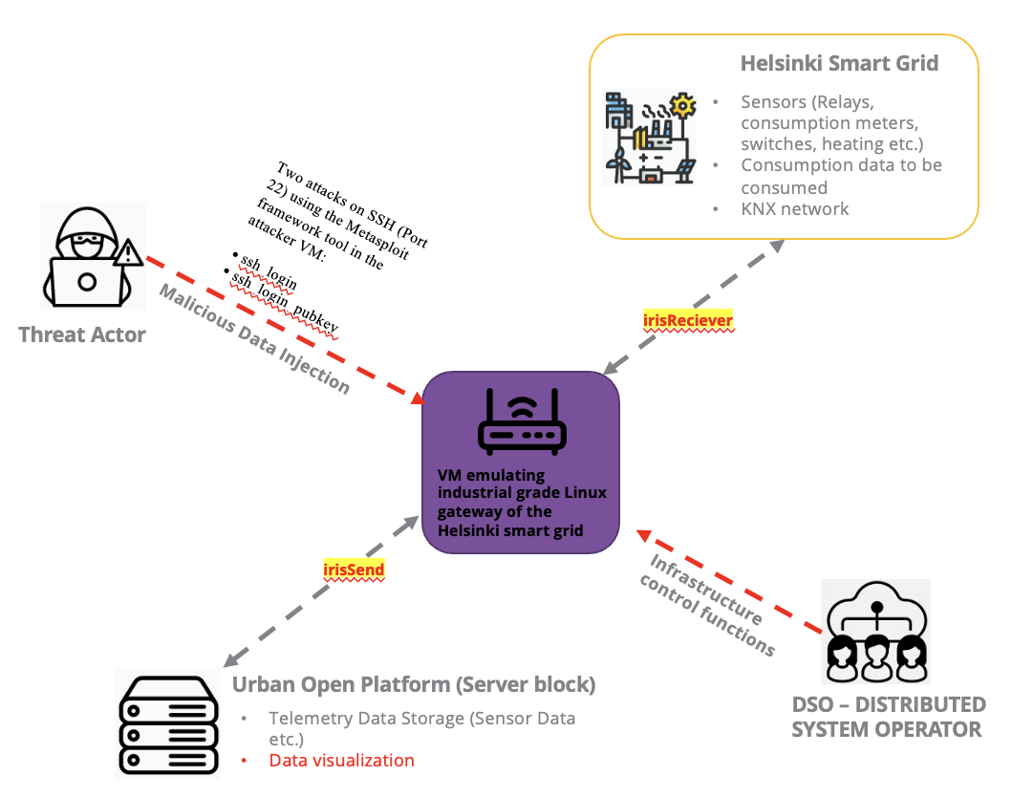
User story PUC 3
The goal of IRIS PUC 3 is to provide an energy infrastructure to #1 demonstrate the capabilities of Virtual Cyber Range in training CERTs/CSIRTs #2 validate the capabilities of the IRIS platform safeguarding the Helsinki Smart Grid environment against cyber threats and vulnerabilities.
We will demonstrate
  Training exercises for CERTs/CSIRTs
  Scanning vulnerabilities within energy infrastructure gateways

Slide 20
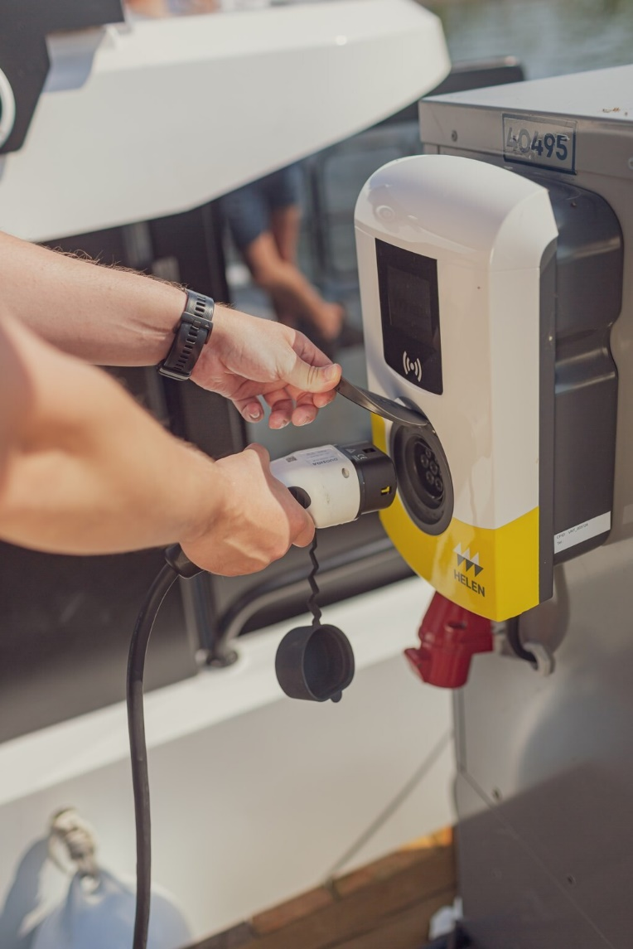
User Story: Why is this user story important?
For PUC3, focusing on energy-related cybersecurity threats, one can outline the following potential risks:
Unauthorized Access: Threat actors may compromise the integrity and security of energy transmission and distribution systems.
Data Breach: Sensitive energy consumption data, billing information, and infrastructure details could be compromised, leading to privacy violations and financial losses of the building residents.
Device Manipulation: Hackers might tamper with energy metering devices or control systems, allowing them to manipulate energy consumption data, disrupt service delivery, or cause damage to critical infrastructure.

Slide 21



PUC 3 – Infrastructure view
Residential building infra (Helsinki)
Actor block
Apartment energy meters
Apartment water meters
Building car chargers
Apartment KNX/IP modules
Switches Staircase A / B
vlan
Logic controller (Wiser)
BUILDING RESIDENTS
KNX network
Two attacks on SSH (Port 22) using the Metasploit framework tool in the attacker VM:
• ssh_login
• ssh_login_pubkey
Digital twin environment (Operating on VM)
Wrong
Billing
Virtual gateway (linux)
Virtual copy of the real traffic of the residential building
THREAT ACTOR
Confuse
operators
Access to External
network
Confuse the
automated Smart
Grid System
Client router – TOSIBOX LOCK 500
Server block
Report accurate energy demand for increasing and decreasing the load
Urban data platform
DSO – DISTRIBUTED
SYSTEM OPERATOR
API gateway
Main log server (Data collection)

Slide 22
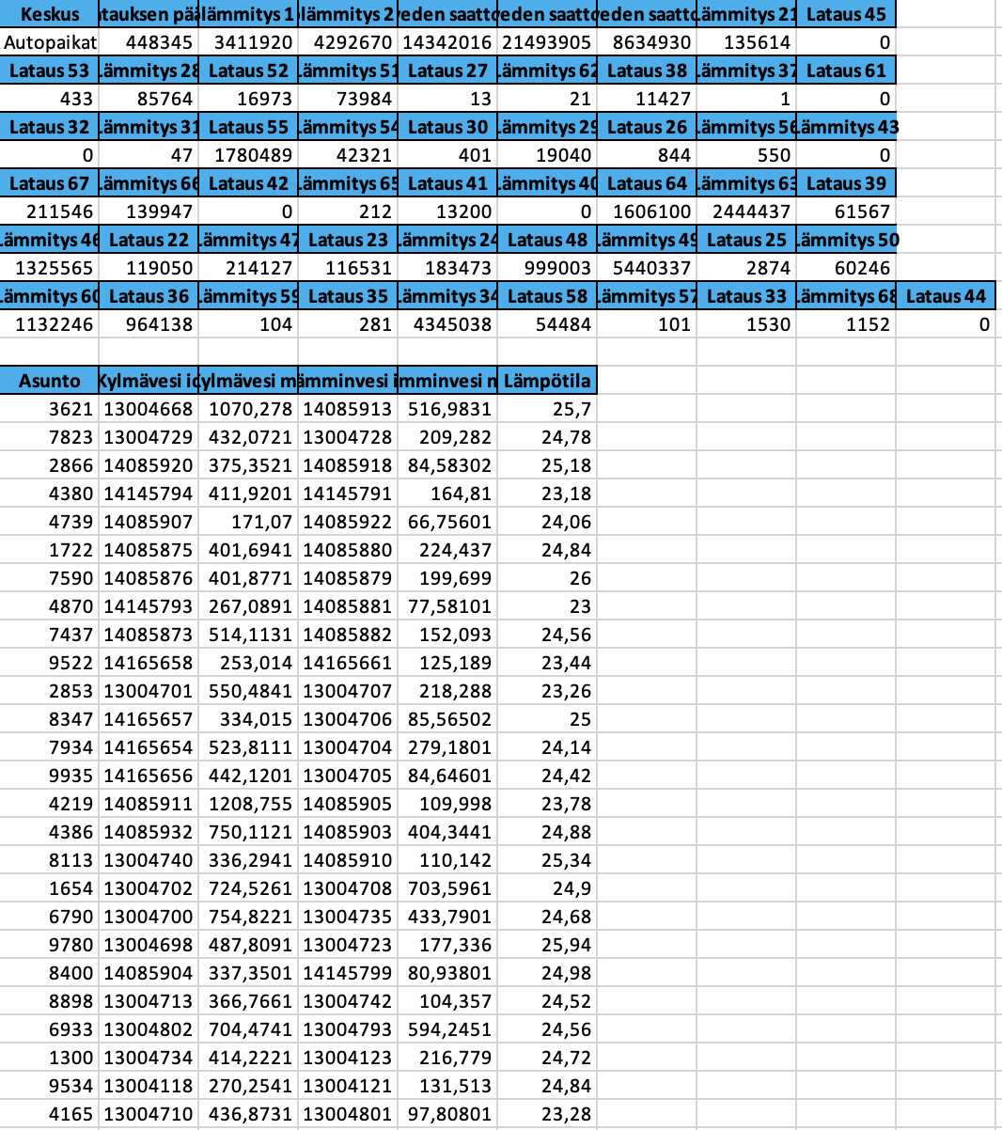
Helsinki Infrastructure overview (consumption end)
The data originating from the Smart Kalasatama infrastructure in Helsinki includes real-time information on energy consumption, water usage, and electric vehicle charging sessions. These datasets enables energy management, resource allocation, and billing.
That could lead to a Falsification of Consumption Data: Threat actors could tamper with the energy consumption, water usage, or electric vehicle charging session data, leading to inaccurate reporting of usage metrics. This could result in incorrect billing for consumers or misallocation of resources.

Slide 23
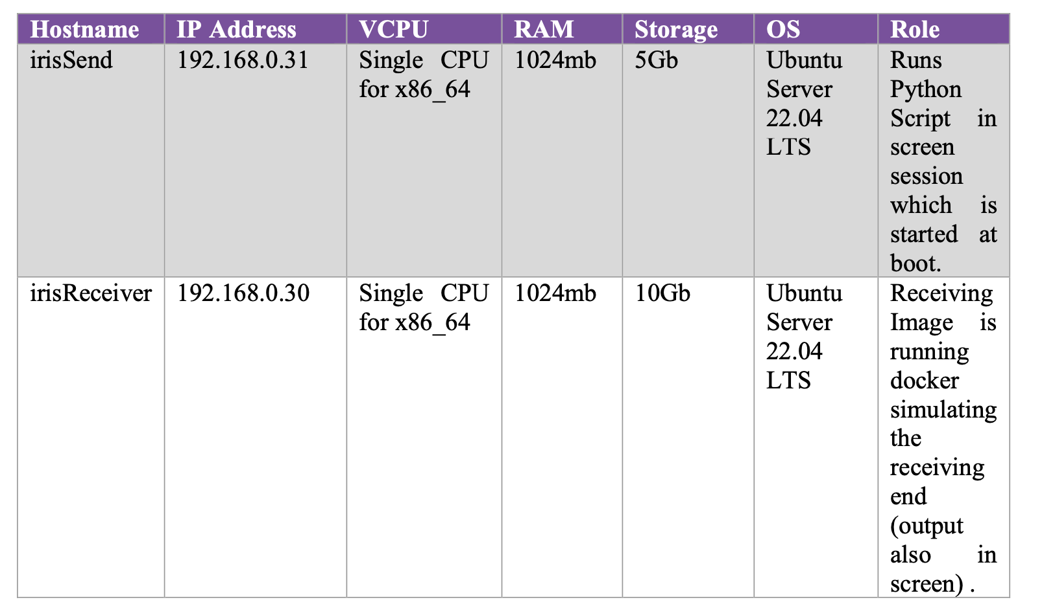
VCR deployment
VCR - delivers an immersive virtual environment for collaborative CERTs/CSIRTs training exercises based on real-world environment platforms
So far, VCR is supplied with two virtual machines (VMs) from the Helsinki infrastructure:
irisReceiver – Helsinki infra Receiving end
irisSend – Helsinki infra Sending end

Slide 24
Attack explanation
To manipulate the data of the Helsinki Smart Grid environment the attacker needs to gain access. The attacker exploits CVE-1999-0502, which is a vulnerability related to weak, null or missing passwords in Unix systems. Also, the smart grid environment is using a SSH protocol which is vulnerable to brute-force guessing. The attacker uses the SSH Login exploit (available from Metasploit framework) to brute-force the SSH password and gain access to the smart grid environment. From there, the attacker manipulates the smart grid data stream.
Attack sequence
The two VMs aforementioned, irisSend and irisReceiver are used within the scenario. Both machines are configured to allow SSH for remote access. The VMs are using a version of SSH which has demonstrated vulnerabilities (v2.00 etc.).
An attacker acts as a player within the scenario using a virtual machine configured with Kali Linux.
Reconnaissance is conducted on the Smart Grid Environment (nmap etc.)
Access is attempted through remote access protocols.
Attacker persists on the network and uses the legitimate systems to obtain the smart grid data streams.
Attacker manipulates the smart grid data streams (Consumption data, Distribution dates)
Attacker implants malicious data.
The Smart City AI Application running on the UoP takes the malicious data as input and displays on the Smart City Dashboard visualisation, incorrect smart grid data, or the malicious data crashes the Smart City Dashboard AI application.

Slide 25
Training scenario (VCR)
Objective –
to simulate a cyber attack on the Helsinki Smart Grid environment and assess the response capabilities of CERTs/CSIRTs/CI participants within the IRIS VCR extension.
Capture the Flag Challenge-
- Conclude the training scenario with a "capture the flag" challenge, where participants compete to identify and capture flags representing specific cybersecurity objectives.
- Flags could include detecting and patching vulnerable systems, preventing unauthorized access, and restoring compromised services.
Flow-
Within the VCR environment, a simulated cyber attack is initiated, simulating a threat actor attempting unauthorized access to the Smart Grid system. (including exploiting vulnerabilities in Unix system passwords and weaknesses in the SSH protocol.)
CI participants will overview the VDM scanning within the VCR environment, scanning customer-facing components for vulnerabilities.
Guide participants in analyzing the vulnerabilities detected by the VDM tool and generating a comprehensive vulnerability report.
Showcase how the ATIO tool within the VCR environment tracks/stores/processes the vulnerability report generated by the VDM.
ATIO shares the report to CTI. Tool enriches the report. Showcases the results in the EME dashboard
Demonstrate how the enriched vulnerability report propagates across the IRIS platform within the VCR, enabling collaboration and information sharing among participants.
Direct CERTs/CSIRTs/CI participants within the VCR to overview the executed response plan to mitigate the simulated cyber attack.
* CI – critical infrastructure
* CERT - Computer Emergency Response Team
* CSIRT - Computer Security Incident Response Team

Slide 26




Helsinki Smart Grid
Sensors (Relays, consumption meters, switches, heating etc.)
Consumption data to be consumed
KNX network
Two attacks on SSH (Port 22) using the Metasploit framework tool in the attacker VM:
• ssh_login
• ssh_login_pubkey
Threat Actor
irisReciever
Malicious Data Injection
VM emulating industrial grade Linux gateway of the Helsinki smart grid
irisSend
Infrastructure control functions
Urban Open Platform (Server block)
Telemetry Data Storage (Sensor Data etc.)
Data visualization
DSO – DISTRIBUTED
SYSTEM OPERATOR

Slide 27
IRIS PUC 3 – Functional workflow
PUC3 | 21/03/2024

Slide 28
Functional workflow (slide option 1)
This is the process of a functional workflow designed for PUC3, focusing on demonstrating the IRIS platform's capabilities in cross-border threat intelligence sharing scenarios involving energy data manipulation.
Within the VCR environment, the trainee initiates a search for vulnerabilities in the Smart Grid infrastructure using the Enhanced MeliCERTes Ecosystem (EME).
The EME forwards the vulnerability scan request to the Orchestrator (ATIO).
Orchestrator (ATIO) directs the request to the Vulnerability Detection and Management (VDM) tool.
The VDM tool conducts scans on the customer-facing components, detecting vulnerabilities within the infrastructure.
Upon detection, the VDM tool analyzes the vulnerabilities and generates a comprehensive vulnerability report.
The vulnerability report is transmitted to the Orchestrator (ATIO) for further processing.
ATIO stores and enriches the vulnerability report, enhancing its content.
The enriched vulnerability report is shared across the IRIS platform, facilitating collaboration and information sharing.
Finally, the vulnerability is displayed on the EME dashboard for the end-user's review and analysis.

Slide 29
Functional workflow
This is the process of a functional workflow designed for PUC3, focusing on demonstrating the IRIS platform's capabilities in cross-border threat intelligence sharing scenarios involving energy data manipulation.
Trainee searches for Smart Grid vulnerabilities using EME dashboard.
EME forwards request to ATIO.
ATIO directs request to VDM.
VDM scans customer-facing components, detects vulnerabilities.
VDM analyses and generates comprehensive report.
Report sent to ATIO for enrichment.
Enriched report shared across IRIS platform.
Vulnerability displayed on EME dashboard for review.

Slide 30
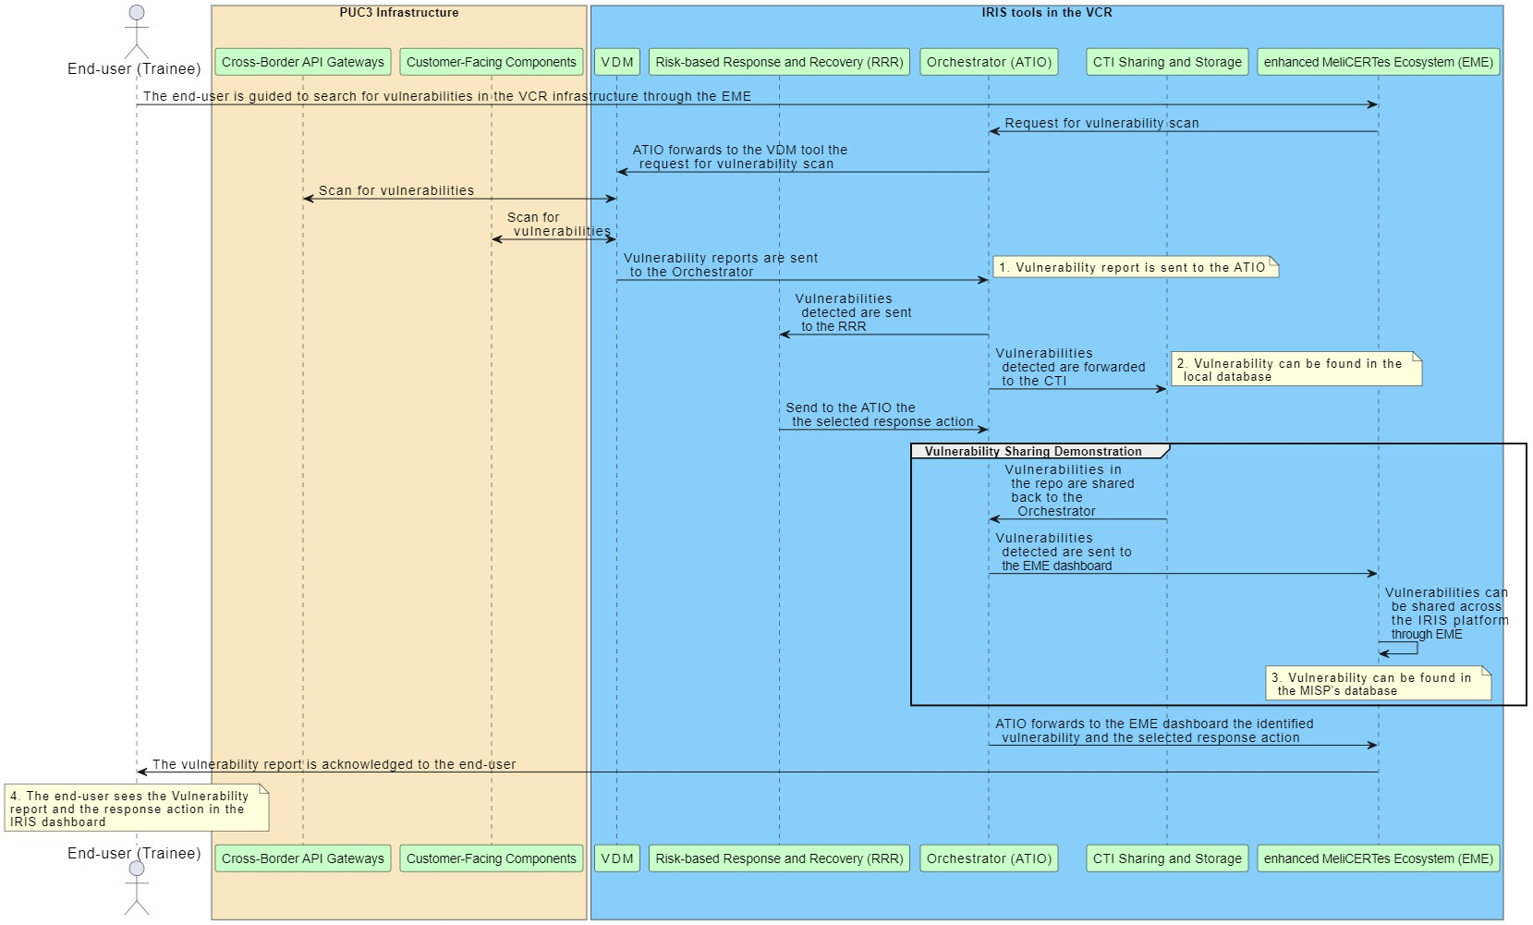

Slide 31
IRIS PUC 3 – SAT
PUC3 | 21/03/2024 | CEL

Slide 32

Social Acceptance Assessment
This session is also part of our research on the social acceptance of IRIS project
The aim is to get a feedback on the demonstration based on your perceptions
Today you will see the demos, followed by a Q&A session and a survey

Slide 33
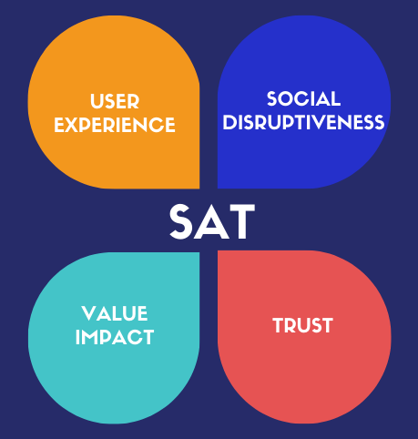
Social Acceptance of Technology
IRIS model
BASED ON 3 PRINCIPLES
Human centredness,
Leave no one behind
Ethics-by-design
WHO: CERTs/Csirts, Energy sector stakeholders to assess the IRIS technology
WHAT: perceptions on the IRIS Platform.
HOW: demos + Q&A + survey to assess different dimensions of social acceptance
Notes:
We focus on social acceptance because it has become clear that the acceptance of innovation is not only due to technical features of a product or of a solution but also to other variables such as behavior, opinions, awareness, attitudes and beliefs.
At cybersecurity Lab we elaborated a model to assess Social Acceptance at different stages of the research and design process.
CyberEthics Lab. developed a methodology to assess social acceptance of technology SAT (Occhipinti et al. 2022) which takes social acceptance as a function of user experience, combined with perceived disruptiveness of the technical solution, its impact on values and trustworthiness.
Out model is based on three principles: We take the social acceptance of a solution as a function of four components, called bubbles.
SAT can be applied not only with end-users but also with other stake holders
SO today you are the experts we would like to assess the iris technology, and we are interested in your expectations perception… we will conduct this focus groups and then ask you to fill in a survey.

Slide 34
IRIS PUC 3 – General context
PUC3 | 21/03/2024 | KEMEA

Slide 35
IRIS Pilots - Key Objectives
The demonstration pilots of IRIS target to:
Secure the smart city’s IoT and control systems against confidentiality breaches, detecting interception and compromise of IoT systems and reporting efficiently the breach (PUC1 in Barcelona).
Securing a smart city's AI-enabled infrastructure of transport systems (autonomous buses), illustrating IRIS capabilities to identify the threat, self-recover and share the threat intelligence with other system operators and platforms (PUC2 in Tallin).
Protect the customer facing components of the smart grid against threats to control functions defined for the control of the demand, demonstrating IRIS capabilities to manage a cross-border crisis exercise on the Virtual Cyber Range (PUC3 in Helsinki/Tallin).
IRIS platform focuses on:
  Real-time estimation of cybersecurity and privacy risks
  Automated threat detection, response and recovery
  Threat intelligence sharing
  Measures for effective cybersecurity incidents and crises management
Notes:
CLS:CYBERLENS BV
SID: SIDROCO HOLDINGS LIMITED

Slide 36
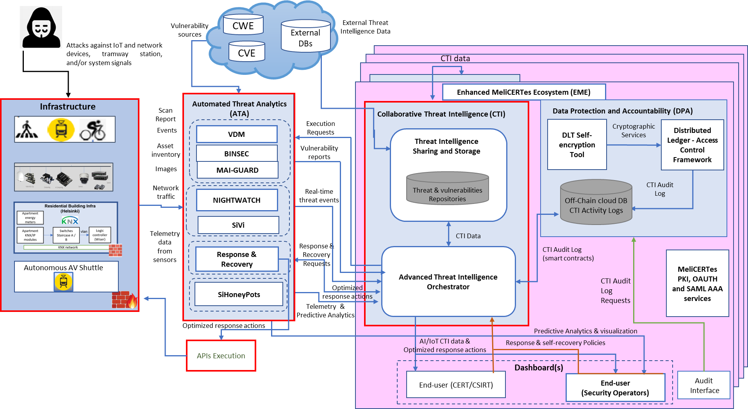
IRIS General Architecture

Slide 37
PUC3 and Virtual Cyber Range
In PUC3, we use the Virtual Cyber Range to:
Deploy specific IRIS tools or the integrated IRIS platform in a controlled environment
Train CERT/CSIRT (IRIS platform users) to coordinate threat mitigation to network connected components of the smart grid
Validate the capabilities of IRIS platform in mitigating cyber threats that target cross border attacks against energy smart grids
Assess the virtual cyber range capabilities of the IRIS platform to help train CERT/CSIRT personnel and energy grid cyber security stakeholders
Design and implement additional Cyber Security Training and Exercises for the IRIS VCR, considering:
  Aspects of real-world platforms and attacks.
  Adversarial AI threat intelligence scenarios.
  Hands-on training for IoT ecosystems, enabling collaborative online training in challenges of cross-border threats.
Notes:
CLS:CYBERLENS BV
SID: SIDROCO HOLDINGS LIMITED

Slide 38

Virtual Cyber Range and Training Environment
PUC3 | 21/03/2024 | THALES

Slide 39
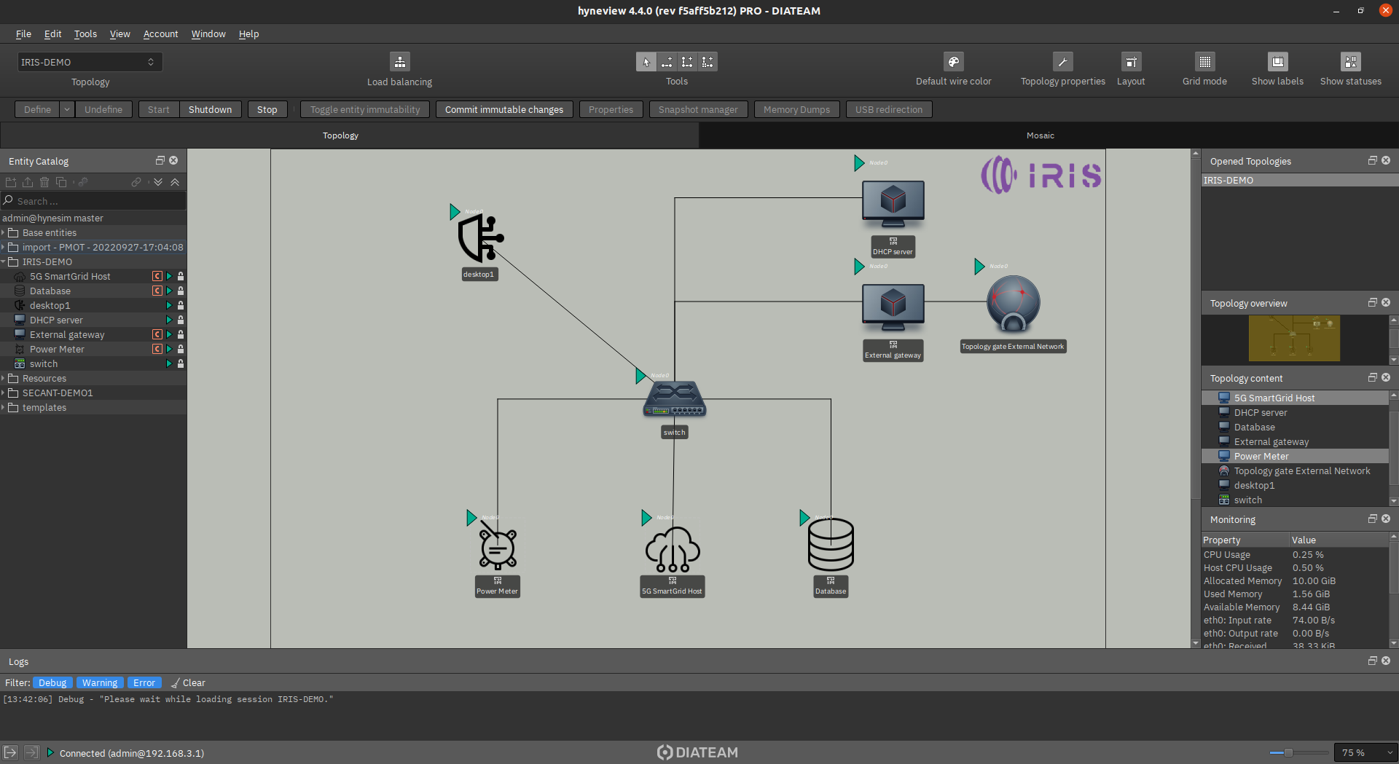
Cyberrange tool
graphical topology representation
available
entities
ressources
usage

Slide 40
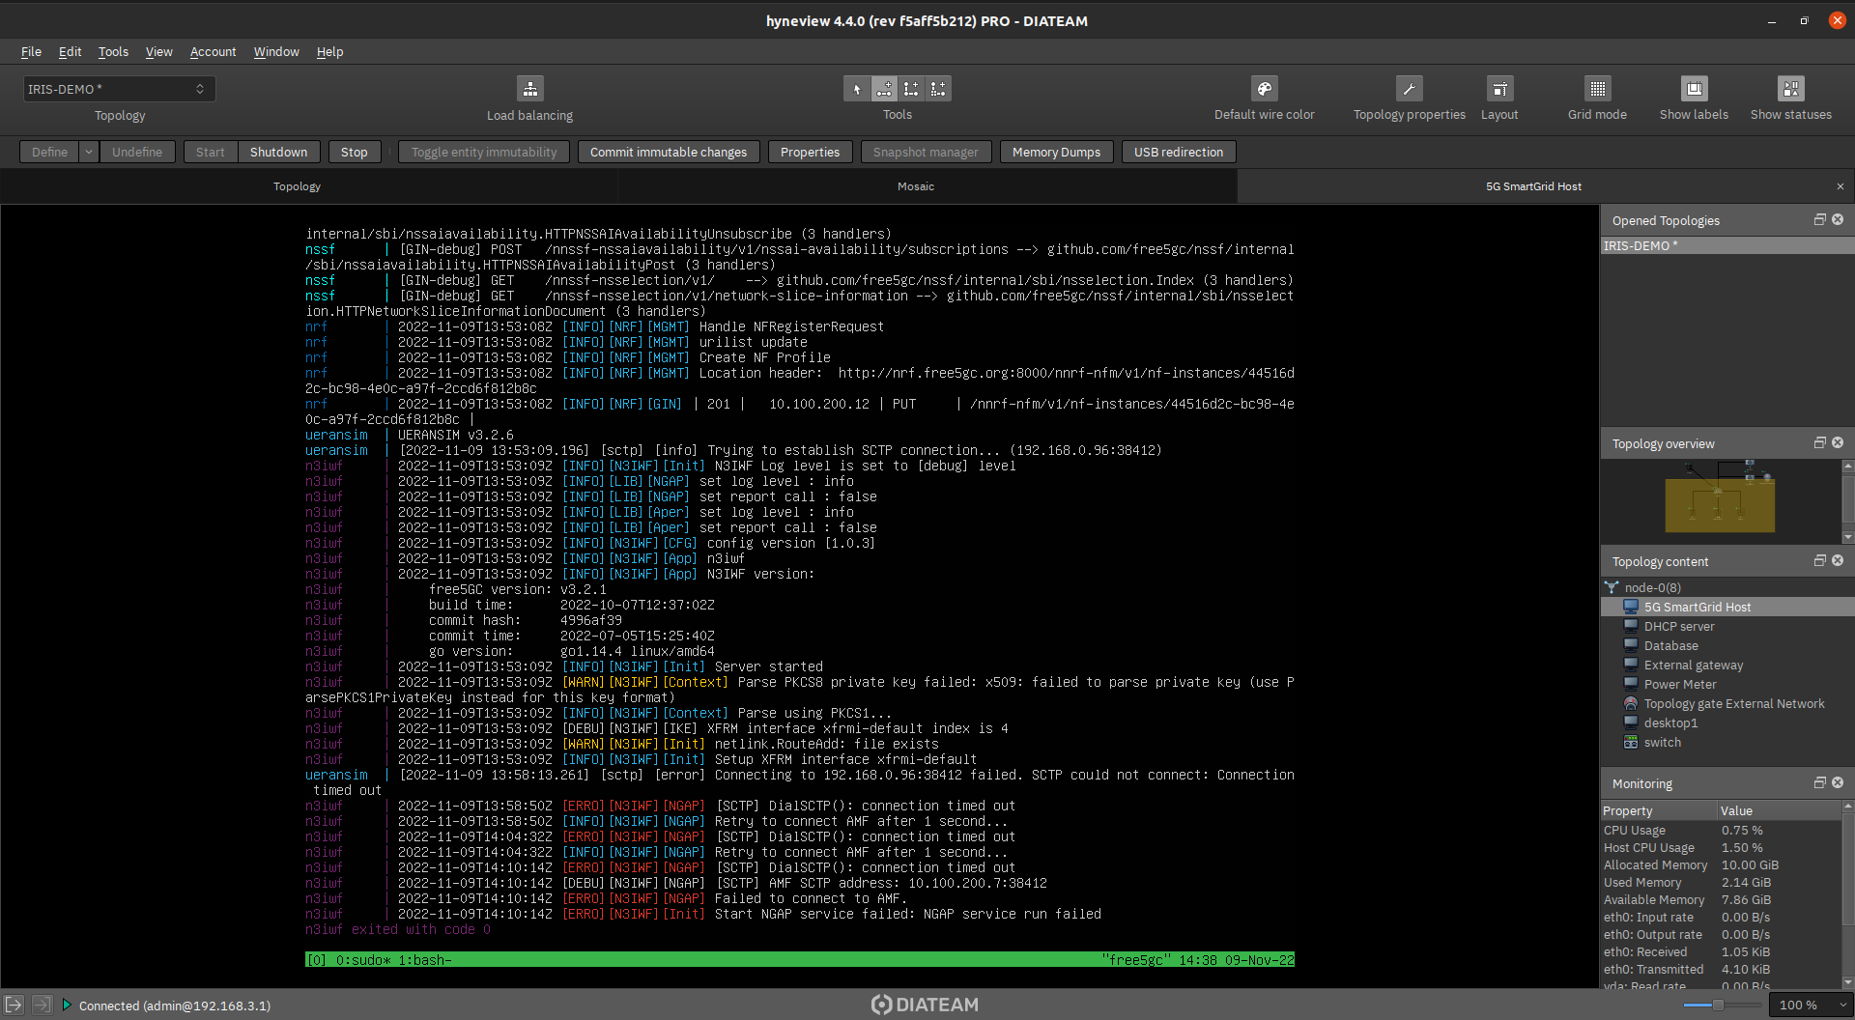
Server console access

Slide 41
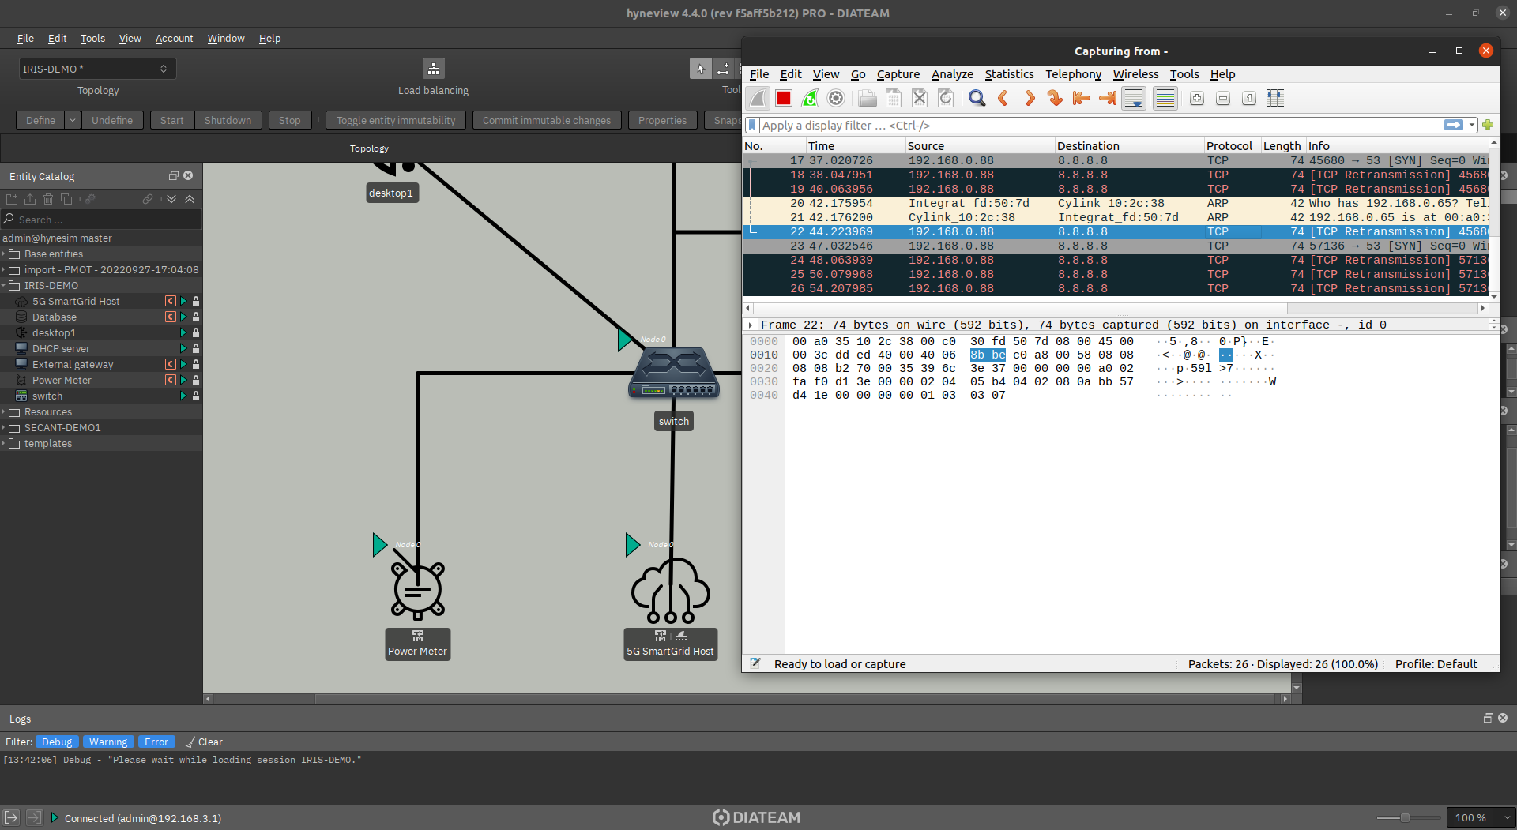
Memory & network dumps
live
network traffic

Slide 42
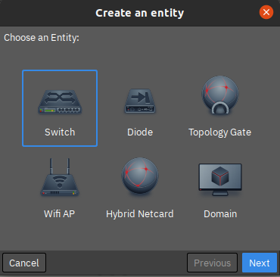
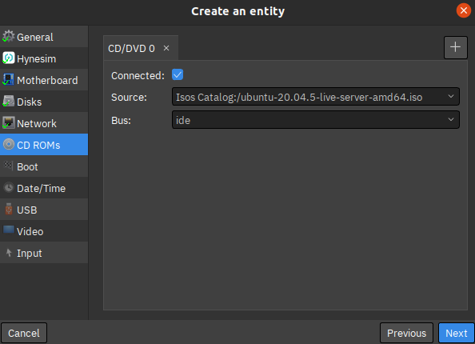
New entity creation
Domain (=VM) configuration
Available resource types

Slide 43
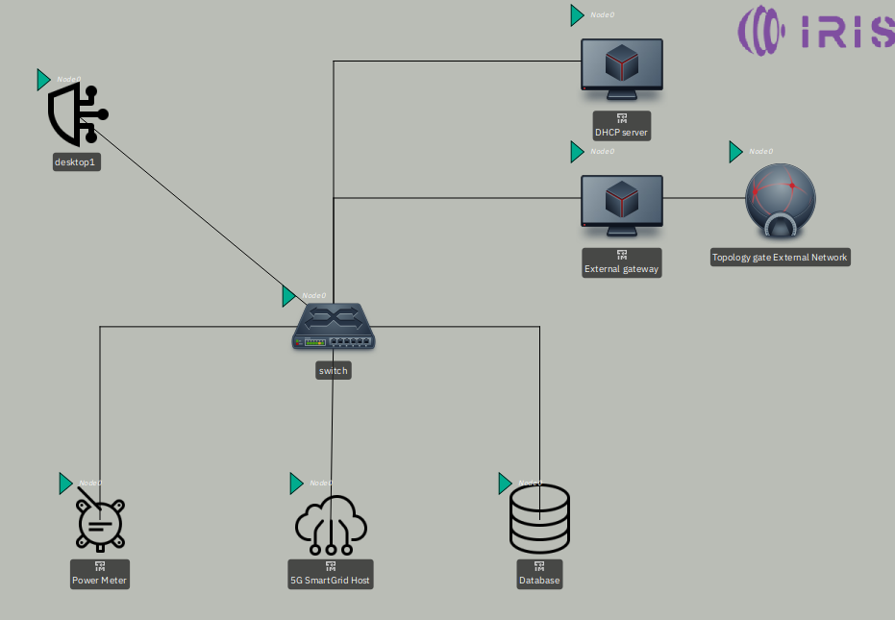
Sample scenario
Attacker
IOT 5G equipment
Scenario infrastructure
Hosted
5G core & SmartGrid

Slide 44
VCR deployment
VCR - delivers an immersive virtual environment for collaborative CERTs/CSIRTs training exercises based on real-world environment platforms
So far, VCR is supplied with two virtual machines (VMs) from the Helsinki infrastructure:
irisReceiver – Helsinki infra Receiving end
irisSend – Helsinki infra Sending end

Slide 45
Any Questions?
IRIS team

Slide 46
Social Acceptance Survey
Direct Link or QR code to Google form
https://forms.gle/TTYLdkjnnUA6jRdb7
Notes:
If there is no time we will send it by email

Slide 47
Questions?
IRIS team

